Slide 1
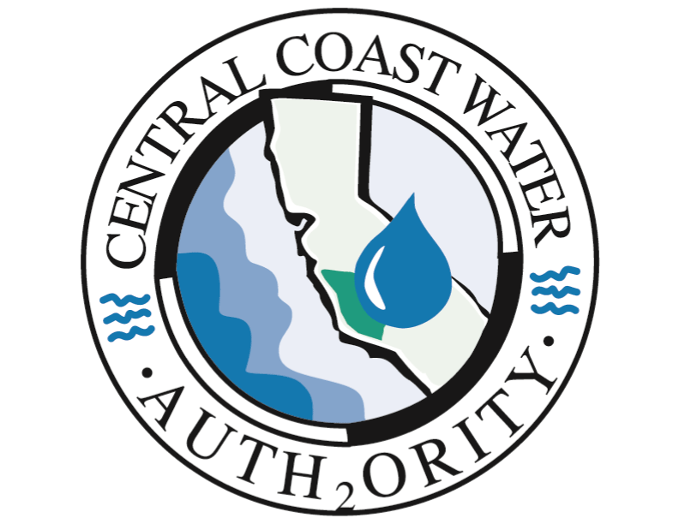
Update on CCWA Protest Items with DWR CCWA Board Meeting February 22, 2024

Slide 2
DWR Statement of Charges Protests
The State Water Project (SWP) Contract allows SWP Contractors (CCWA) to “protest” or challenge DWR’s calculation of charges in the Statement of Charges (SOC).
Errors in calculations
Policy issues
SWP Contractors submit a formal protest item to DWR which is then considered by DWR
Correction of the error
Agreement or disagreement on policy issues

Slide 3
DWR Statement of Charges Protests
CCWA has protested many SOC issues over the years.
Errors found in the SOC by CCWA staff
Errors found in the SOC by CCWA’s SOC auditors, Ernst & Young
Policy issues regarding the calculation of the SOC
Routine calculation errors are normally corrected by the next calendar year SOC
Other protested items have taken many years to resolve and are still outstanding

Slide 4
DWR Coastal Branch Extension Debt Service Protest Items
CCWA filed two protests related to the Coastal Branch Extension debt services charged by DWR to CCWA.
April 20, 2009: Allocation of DWR Revenues Bond Debt Service Payments to the Coastal Branch Extension, Reaches 37 and 38
June 12, 2009: Debt Service payments charged by DWR to CCWA for Reaches 37 and 38 do not take into account the revised debt service when bonds are refinanced.

Slide 5
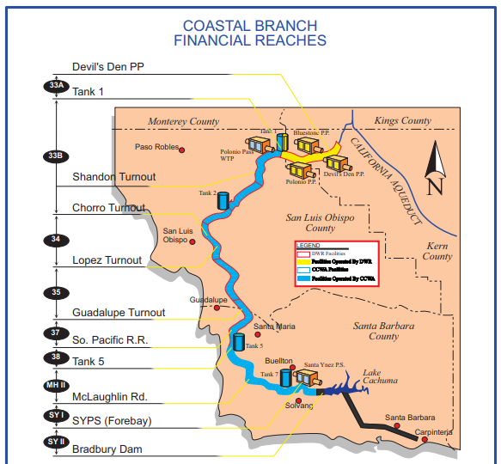
Coastal Branch Extension Reaches 37 and 38

Slide 6
DWR Coastal Branch Extension Debt Service Protest Items
April 20, 2009: Allocation of DWR Revenues Bond Debt Service Payments to the Coastal Branch Extension, Reaches 37 and 38
Total Construction Costs for the Coastal Branch Extension were about $33 million
DWR allocation revenues bonds totaling about $46 million.
DWR agreed with the finding is in the process of correcting the error
Estimated correction is about $6 million
Expecting completion by the end of calendar year 2024

Slide 7
DWR Coastal Branch Extension Debt Service Protest Items
June 12, 2009: Debt Service payments charged by DWR to CCWA for Reaches 37 and 38 do not take into account the revised debt service when bonds are refinanced.
DWR issues bonds for Coastal Branch Extension, Reaches 37 and 38 and charges the debt service directly to CCWA
DWR has refinanced the Coastal Branch revenue bonds many times since original issuance in 1997.
DWR did not revise the debt service invoices to CCWA after the bonds were refinanced in the prior year.
CCWA has paid more in debt service than the actual payments due

Slide 8
DWR Coastal Branch Extension Debt Service Protest Items
Latest estimate provided by Ernst & Young:
$1.2 million
$1.9 million with interest (+/-) (estimate only)
At the February 2024 Audit Finance Meeting, DWR agreed to the corrections including payment of interest
Exact interest component unknown at this time
Will NOT be paid at the DWR Project Interest Rate

Slide 9
Questions and Discussion

