Slide 1
Santa Ynez II Long-Term Project Overview
Central Coast water authority
Operating committee
January 11, 2024

Slide 2
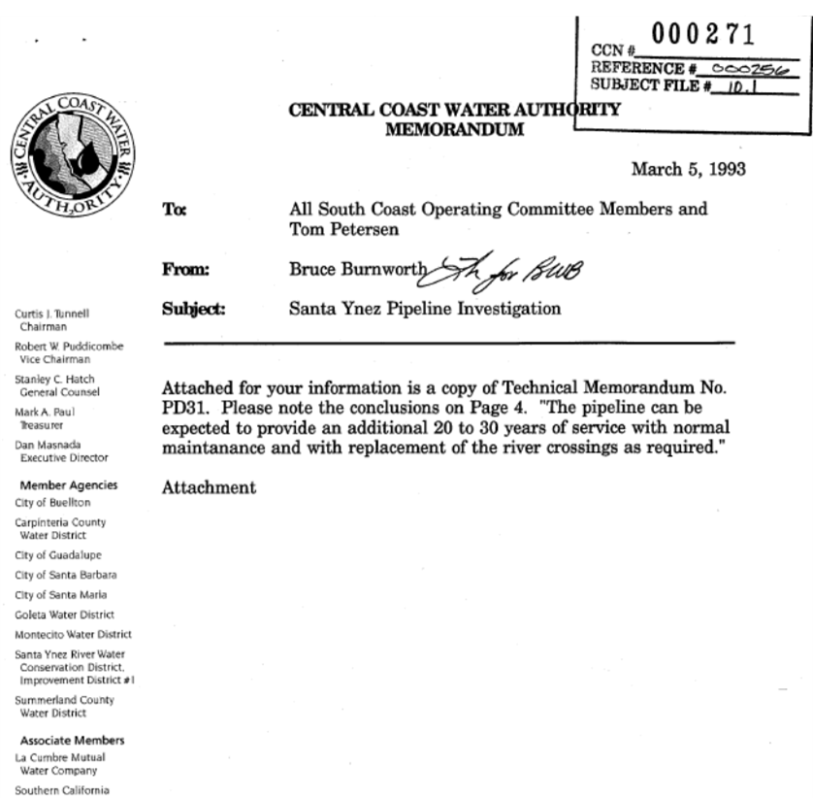
1993
+ 30
2023

Slide 3
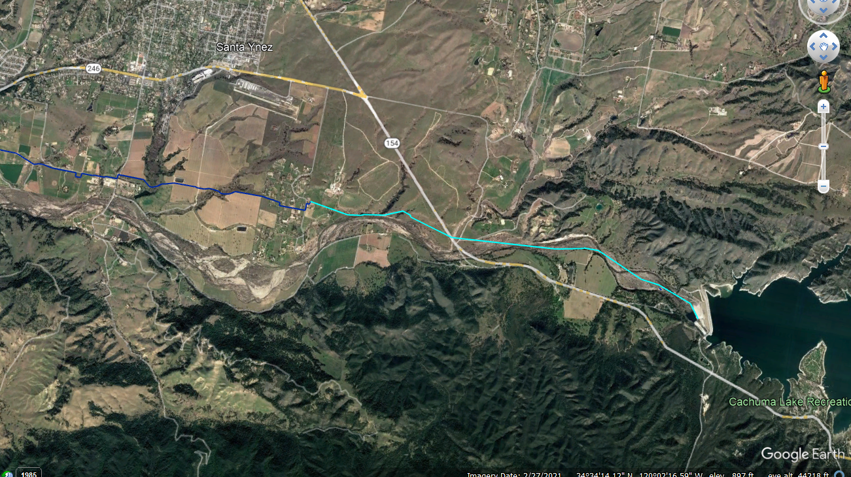
Reach SYII
Monitoring the Pipe Condition:
Hydrostatic Testing at Winter Shutdown
Cathodic Testing Station Monitoring
Inspection of Right-of-Way
Monitoring the Pipe Condition:
No Leaks
Some Indication of the onset of corrosion
Top of pipe exposed during last spill event

Slide 4
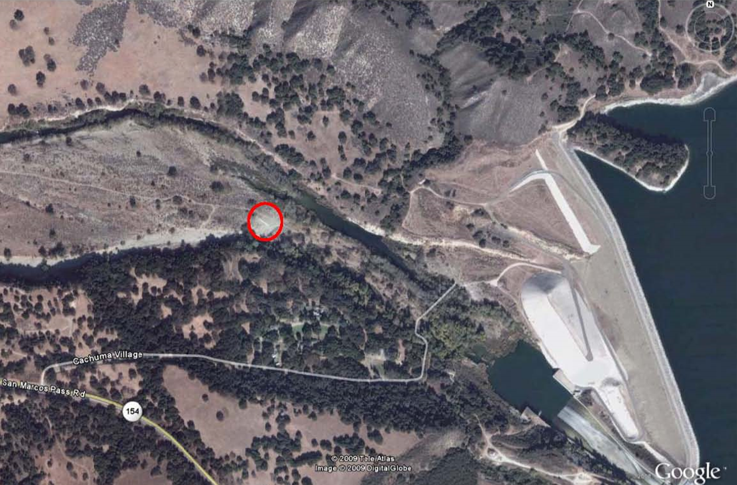
On-going Risk to the Pipeline
Majority in Riverbed Flood Plain

Slide 5
Bradbury Spill Frequency

Slide 8
Project Cost
TOTAL OF TWO PROPOSALS: $121,760.69

Slide 9
Conclusion
CCWA is seeking guidance on how to proceed from those Participants that will fund the project.
The time frame to plan, complete required environmental reviews, to finance, design, permit and construct the new SYII Reach will take years.
The study will develop the information needed to understand the full scope of effort and timing for the project.
We need to determine what metrics to use that will trigger the Reach SYII Reconstruction Project.

