Slide 1
Update on state water contractor activities
Jennifer Pierre
May 25, 2023

Slide 2
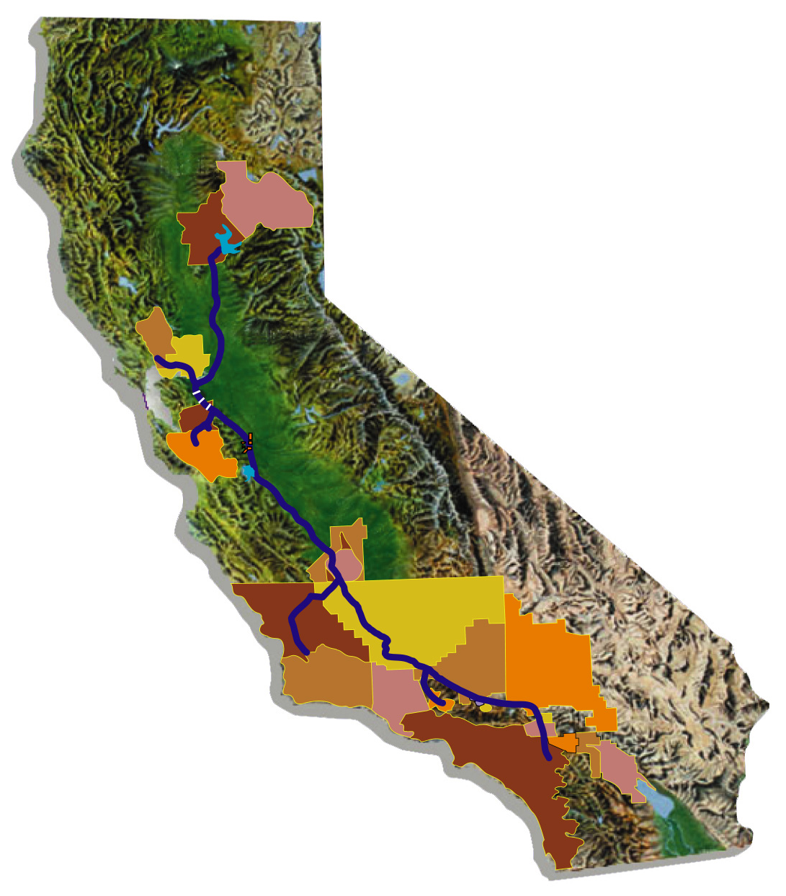
The “State Water Contractors”
Distinct From Individual SWP Contractors
Non-Profit Mutual Benefit Corporation
Membership Open to all Contractors
27 of 29 Contractors Represented
Board of Directors (CCWA represents Central Coast class of contractors)
Notes:
The State Water Contractors is distinct from the SWP contractors. The State Water Contractors is actually a non-profit corporation. Membership is open to all SWP contractors. 27 of the 29 contractors have chosen to be members. With such a large number of contractors, it is not possible for each contractor to be directly represented. Contractors have been divided into eight groups. A director represents each of these groups, with the exception of one which has two directors.

Slide 3
State Water Contractors Approach
Limited Staff (9), plus consultants
“Translate” to/from DWR
Emphasis on Leveraging Staff Efforts through working with DWR
Eyes, ears, mouth of the SWP contractors
Work with Staff and DWR Executives

Slide 4
6 proposed objectives for 2023/24
Business Practices
Energy
Infrastructure
Outreach
Science
Water Supply

Slide 5
Business practices
Contract Extension Implementation
Chief Financial Manager Roles and Coordination
Address Outstanding Items
Cost-debt reconciliation
Project interest rate
Surcharge resolution
Process of Affordability

Slide 6
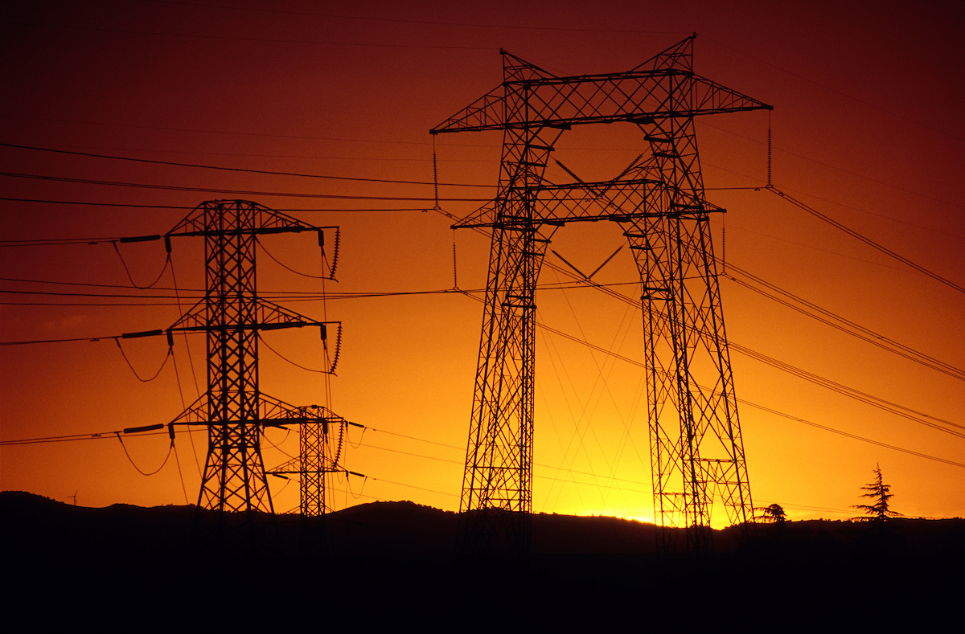
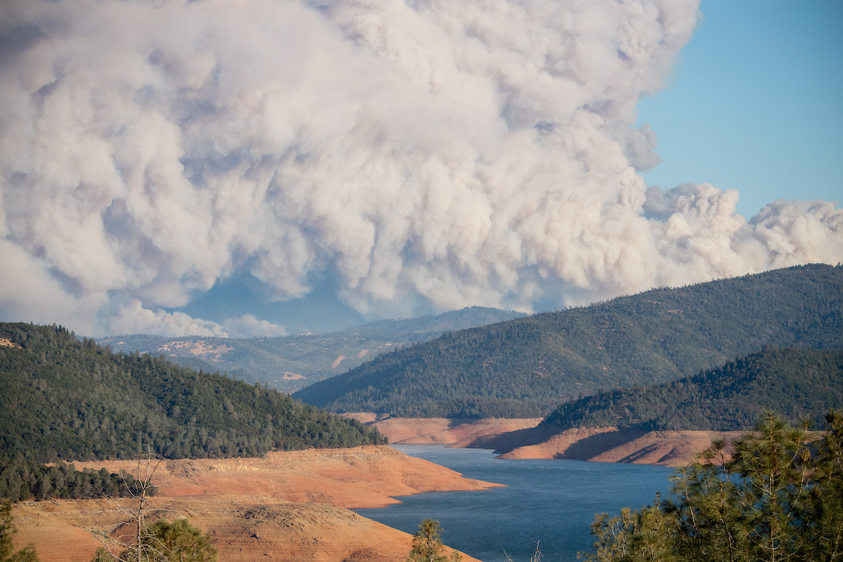
energy
SB1020 Implementation
SB49 report
Energy Roadmap
FERC Relicensing- Oroville and SoCal facilities
Tracking Rate Cases

Slide 7
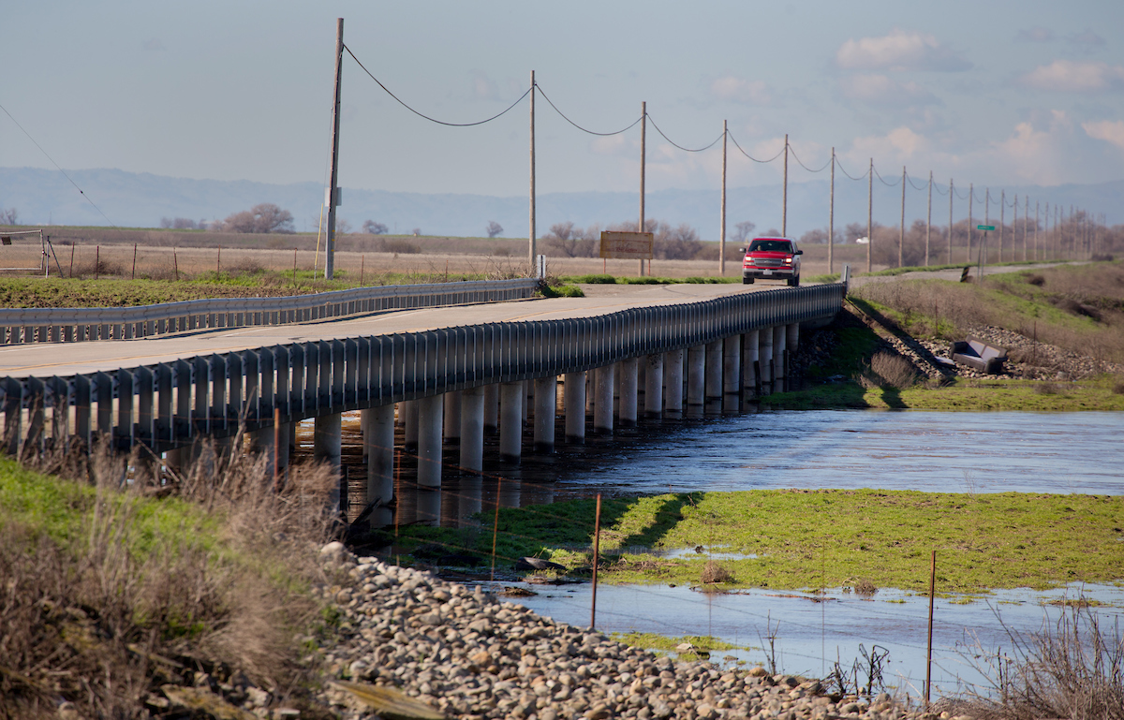
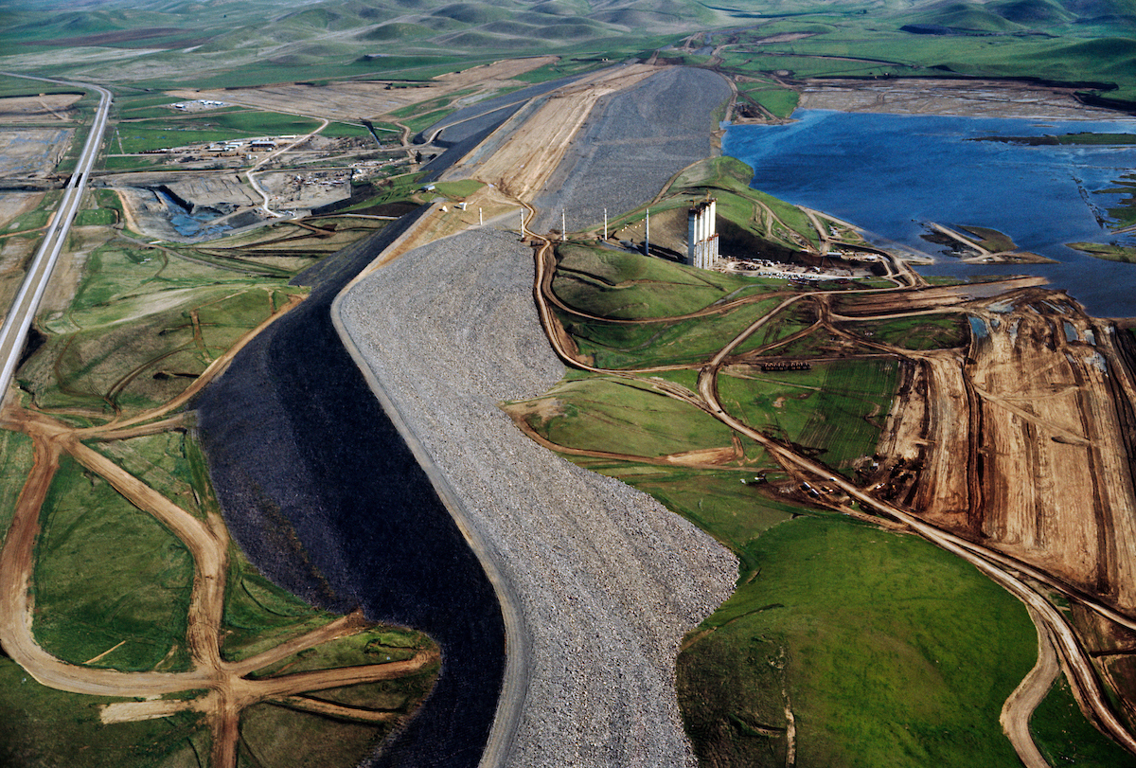
infrastructure
Asset Management
Aqueduct Subsidence
SWP Dam Safety
Sisk Dam
Oroville Comprehensive Needs Assessment
SWP Storage Investigations

Slide 8
outreach
SWP education and awareness
Highlighting research programs and results
Responding to legislative and regulatory threats
Advocacy in the Capitol

Slide 9
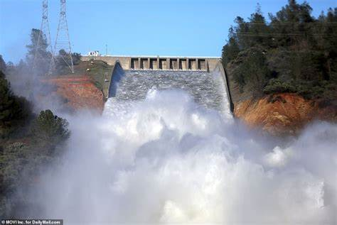
Legislative/budget focus
Budget
Oroville Pumped Storage
Policy Bills
Water Rights Reform
Delta Conveyance
Groundwater Recharge
Climate bond?

Slide 10
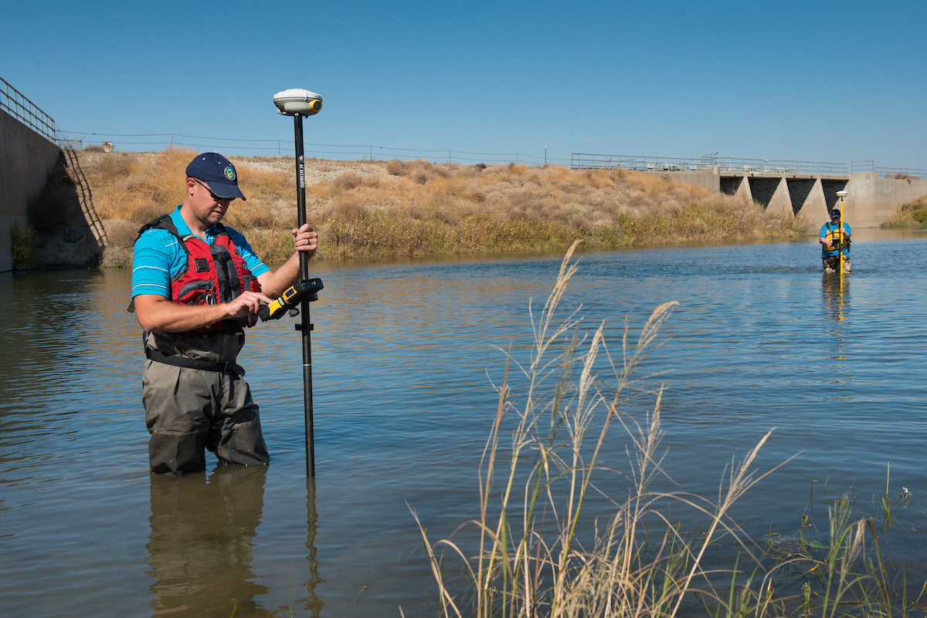
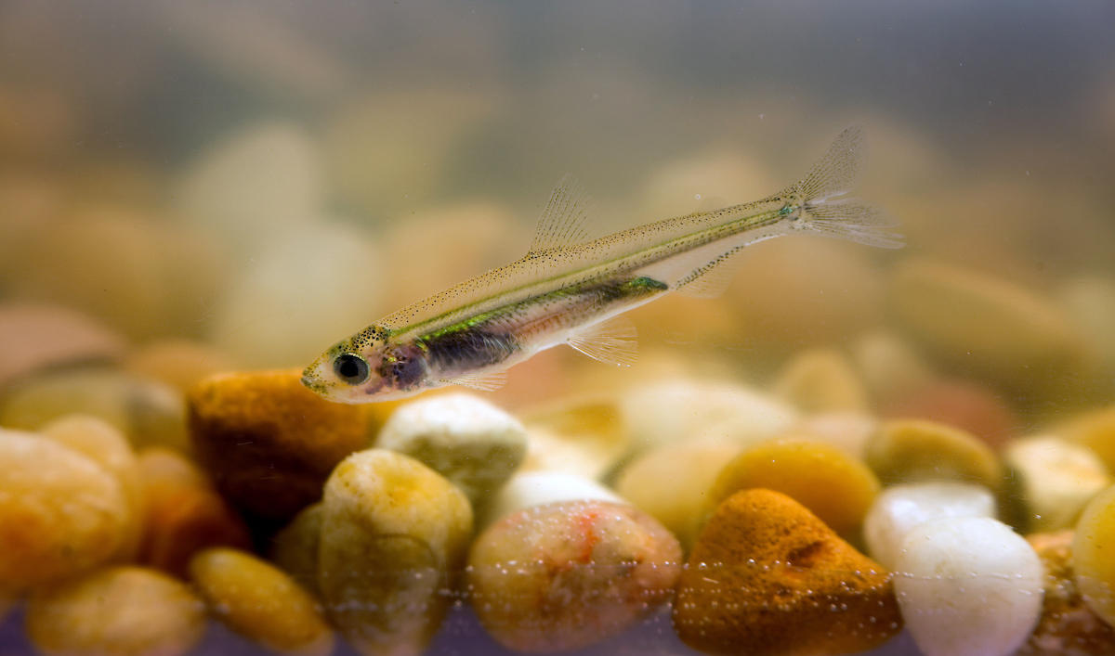
science
Administering approx. 35 contracts
Science Program Solicitation
Coordinating PWA efforts
CSAMP and CAMT participation
Research results symposiums
Salmon recovery
Responsive science investments to inform 2023 management

Slide 11
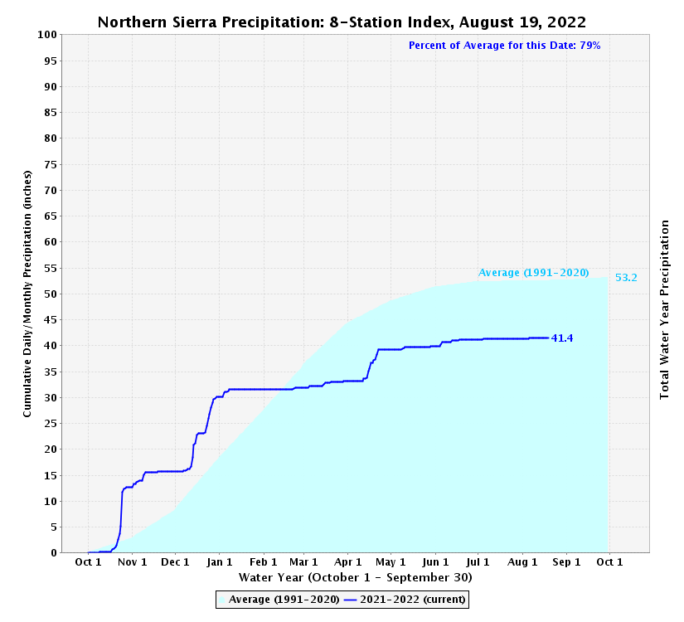
LAST YEAR (2021-22)
THIS YEAR (2022-23)
Prominent stair step patterns - need to take water when available for storage when it’s not.

Slide 12
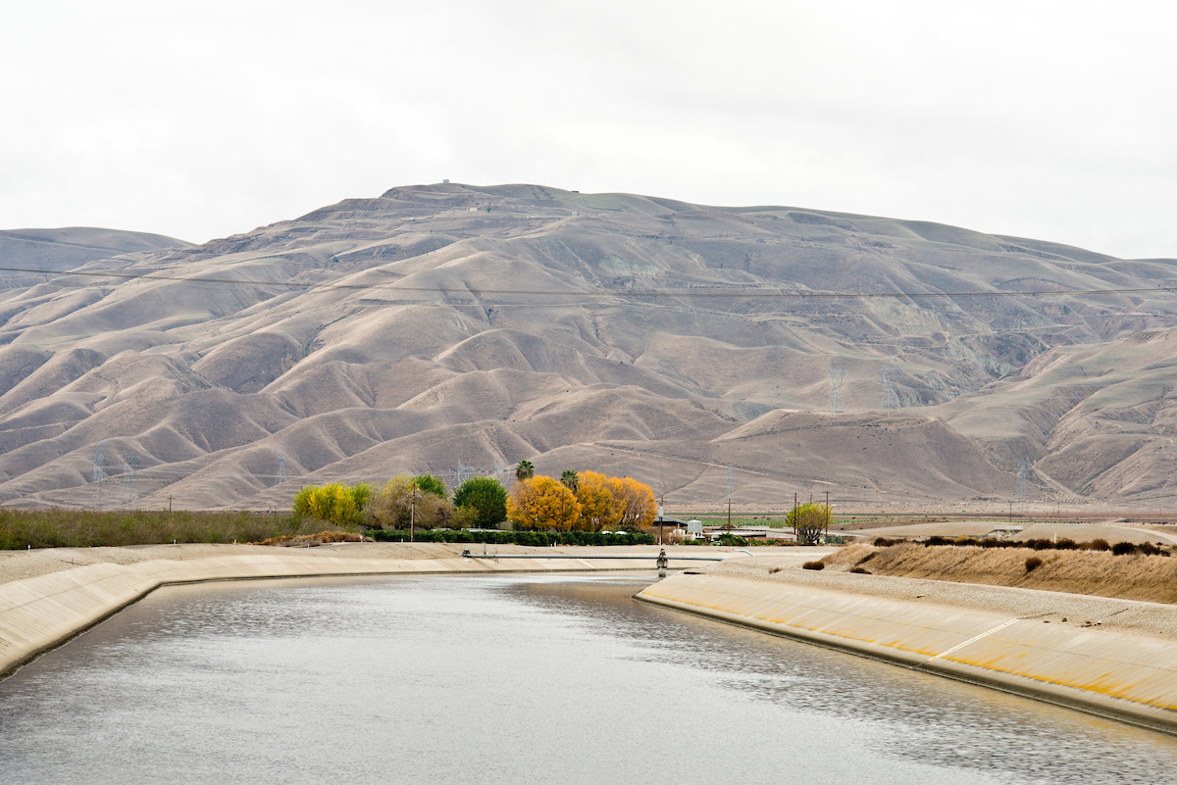
Water supply
Federal ESA Biological Opinion Litigation and Reconsultation
State ESA incidental take permit
Voluntary Agreement Framework
Could resolve litigation issues
Delta Conveyance
Tracking/reporting
Increased emphasis on San Joaquin River conditions

Slide 13
2022 highlights
Implemented the dry year transfer program
Signed VA MOU/term sheet
Began the WSRB workshops and strategy development
Completed Energy Roadmap
Provided support and coordination related to the CFM role
Interim operations engagement
Addressed NBA weed and screen issues
Completed SBA reliability improvements
Released DCP Draft EIR
Returned to in-person/hybrid meetings
Significant positive amendments to SB1020, reducing cost impacts by over $2B
Held another science symposium on San Joaquin River i:e ratio
Significant movement on Sisk Dam cost share
Began SWP storage investigations
Moved forward on contract extension, including successful litigation
Engaged with the SWB on TUCPs and curtailments
Held a legislative briefing on SWP issues

Slide 14
Overall 2023/24 priorities
Improved financial tracking and understanding
Resolution of environmental litigation/proceeding with Voluntary Agreement
Energy Roadmap and SB49 implementation
Continued science and research engagement
Delta Conveyance planning
SWP Storage
Continue public outreach on SWP priorities

Slide 15
Questions?

Slide 16
Video Link
DWR Forecasting & Infrastructure Improve California's Water Management

