Slide 1
SWC Science Program
Central Coast Water Authority
Board of Directors Meeting
February 22, 2024

Slide 2
Today’s Discussion
Why science and why Delta science?
SWC Science Program
SWC science highlights
A look ahead
Questions

Slide 3
Why Science?
Systematic observation and measurement
Observation leads to hypotheses that can be tested
Science involves discussion and debate from the scientific community
Science is cumulative

Slide 4
Why Delta Science?
Species in decline
Delta and Longfin Smelt
Winter Run and Spring Run Chinook Salmon
The State Water Project is regulated to mitigate impacts from water operations
There are many drivers of change and stressors, not just water operations
Evaluate scientific uncertainties

Slide 5
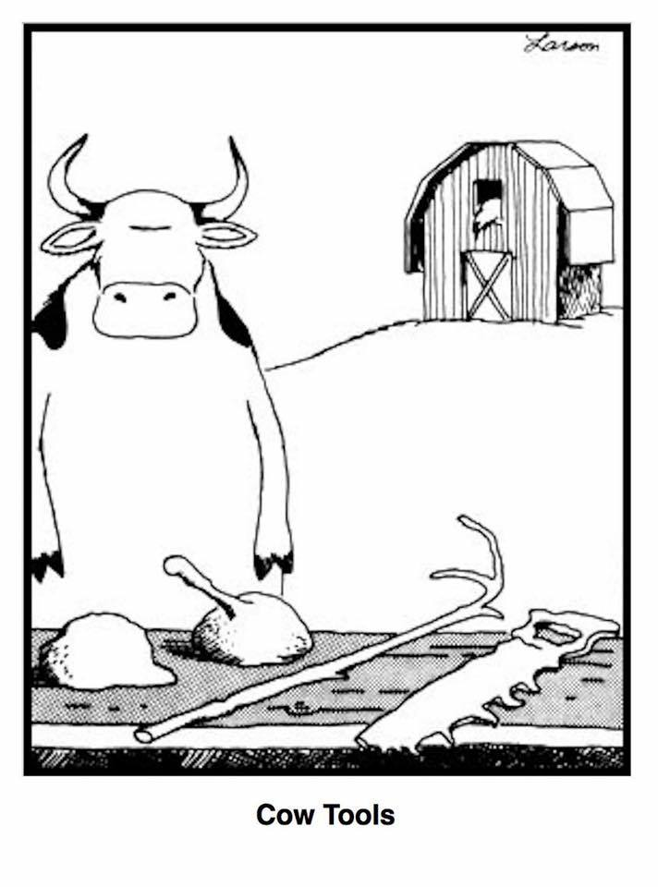
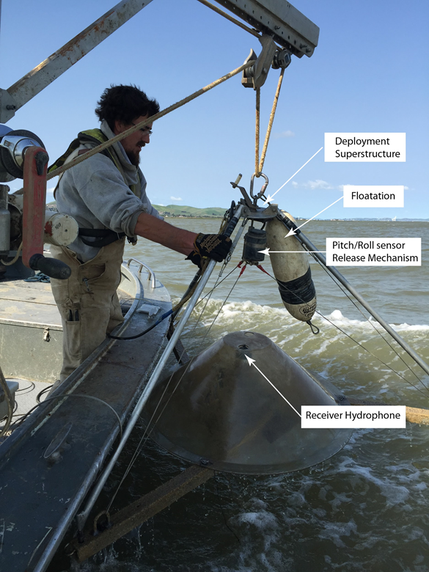
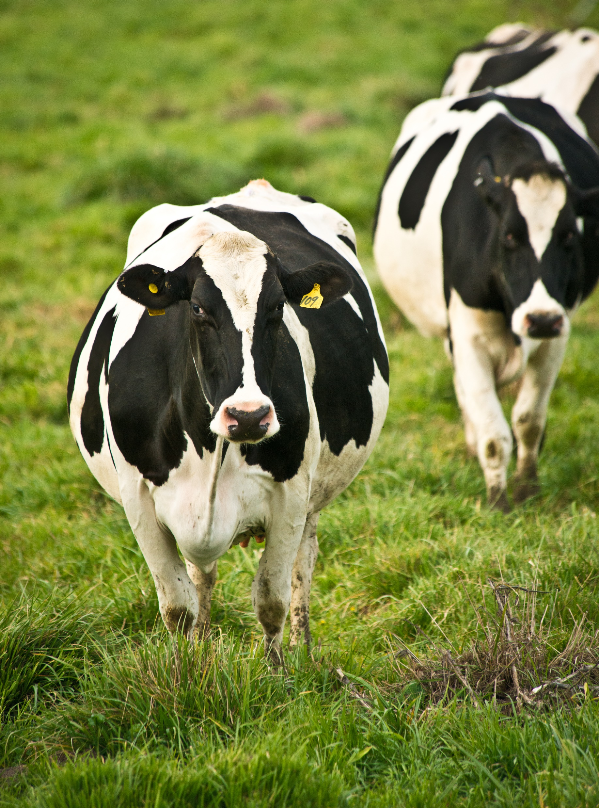
This Photo by Unknown Author is licensed under CC BY-SA

Slide 6
Elements of a Science Program
Research Priorities
Hypothesis-based management questions
Evaluation of stressors
Science Plan
Processes:
Proposal Review
Funding allocation framework
Contracting
Peer Review (Publications)
Publication of Findings (this requires investment)
Synthesis and Communication
Tracking of funding and outcomes (Dashboard)

Slide 7
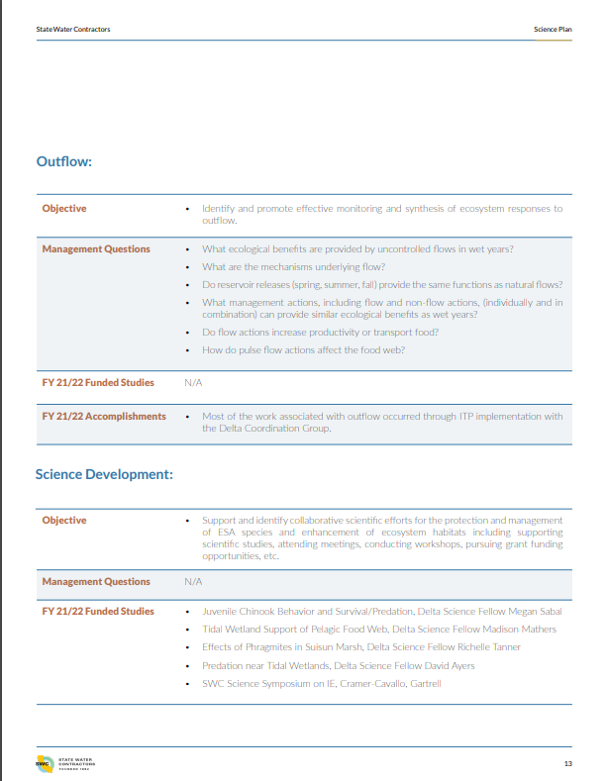
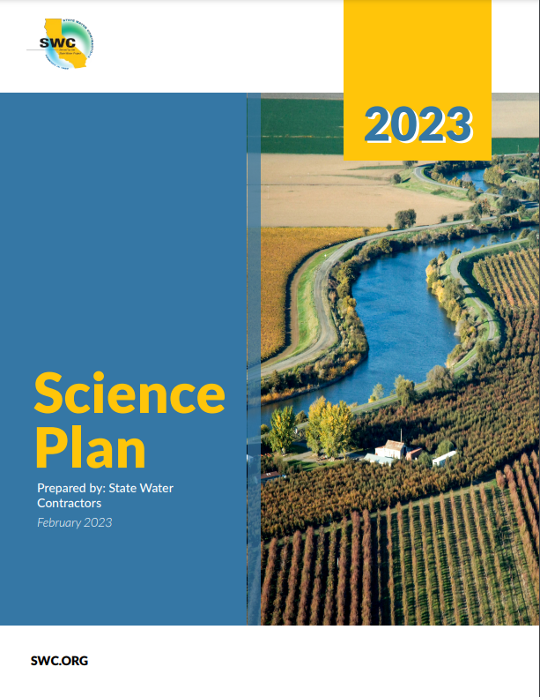
SWC Science Plan
Guides investments
Bases investments on Science Objectives and Management Questions
https://swc.org/wp-content/uploads/2023/02/SWC-2023-Science-Plan.pdf

Slide 8
SWC Science Program Goals
Organize SWC funded projects
Develop vision, mission, and strategic objectives
Identify metrics of success (how will we know if we’re making a difference, and in what ways)
Develop SWC management questions
Identify science gaps
Develop funding strategy
Develop templates for invoices and quarterly reports
Fund $2M in contracts
Provide internal forums for science communication and coordination
Begin development of a communication strategy
Evaluate and refine metrics of success
Synthesize outcomes of SWC funded projects
Identify gaps in knowledge
Refine management questions
Fund $2M in contracts
Implement communication strategy
Provide internal forums for science communication and coordination
Establish SWC as a collaborative partner in science

Slide 9
Still to do…
From the list of goals,
Identify and refine metrics of success
Identify science gaps
But also,
Define the SWC body of science
Conduct a program review
Synthesize outcomes

Slide 10
SWC Science Objectives
Regulatory Compliance
Collaborative Adaptive Management Team
Municipal Water Quality Investigations Team
Entrainment Effects
Non-operational Stressor Reduction
Management Tools
Habitat and Ecology
Outflow
Science Development

Slide 11
Example
Mission: SWC collaboratively funds and facilitates objective, relevant, rigorous science that advances the understanding of factors affecting water supply reliability and habitat restoration for improved decision-making and management in the Delta.
Entrainment Effects: Define and fund key scientific investments in factors that lead to entrainment and entrainment effects that will improve management of ESA fish species; routing probabilities of fish into South Delta and SWP/CVP facilities, and fish detection and identification.
Management Questions:
1. What proportion of the (salmonids/Delta Smelt/Longfin Smelt) population is being entrained? How does this affect the population?
2. How do exports influence routing throughout the southern Delta (e.g., drawn in vs. away from pumps)?
3 .What are the indirect effects of predation (e.g., prescreen loss)?
4. How does entrainment of food affect fish?
5. What are the management scenarios that would allow for modifications in pumping during times of low risk?
Delta Smelt entrainment studies

Slide 12
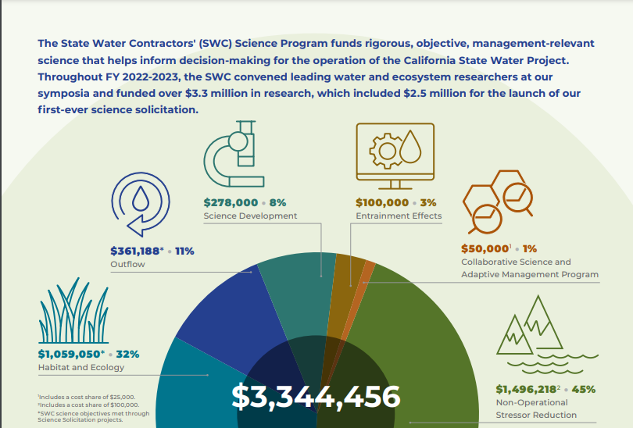
FY 22/23 Funding Breakdown
First SWC Science Solicitation
Reflects evolving priorities
This pattern will change as the SWC Science Program grows
Non-operational stressor reduction
Habitat and ecology
https://swc.org/wp-content/uploads/2024/01/SWC_2023_Annual_Science_Report.pdf

Slide 13
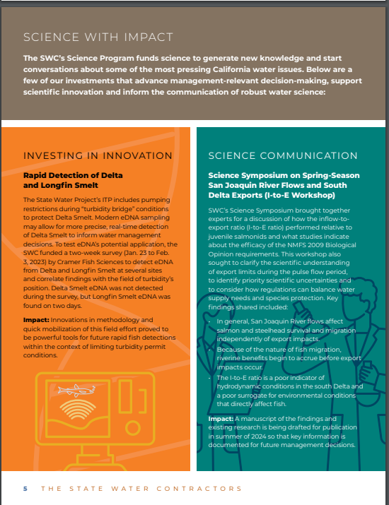
FY 22/23 Science Highlights
Environmental DNA (eDNA)
Science Symposia
https://swc.org/wp-content/uploads/2024/01/SWC_2023_Annual_Science_Report.pdf

Slide 14
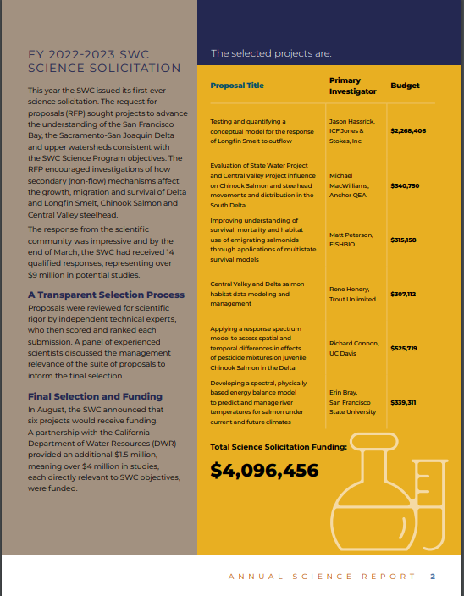
FY 22/23 Science Highlights
I’m new!
2022/2023 Science Solicitation
https://swc.org/wp-content/uploads/2024/01/SWC_2023_Annual_Science_Report.pdf

Slide 15
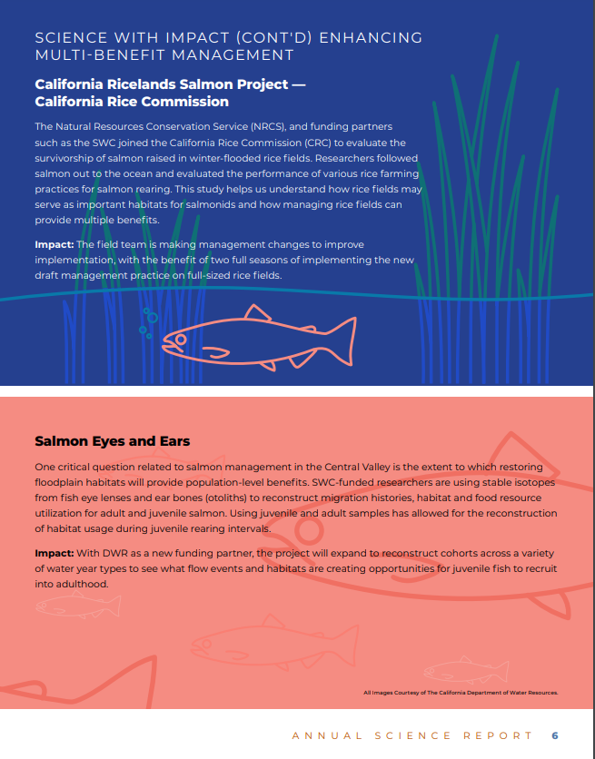
Some Key Findings
Entrainment Effects
Habitat and Ecology
Non-operational Stressor Reduction
Management Tools

Slide 16
A Look Forward
Science related to the permits will continue to be a focus
Policy-level Advisors
Evaluate studies and synthesize findings
Identify gaps and uncertainties
Continue communication and collaboration
Programmatic Adaptive Management

Slide 17
Questions?
Notes:
Seeking suggestions

