Slide 1
Water Supply Situation Report
CCWA Board of Directors Meeting
January 23, 2025

Slide 2

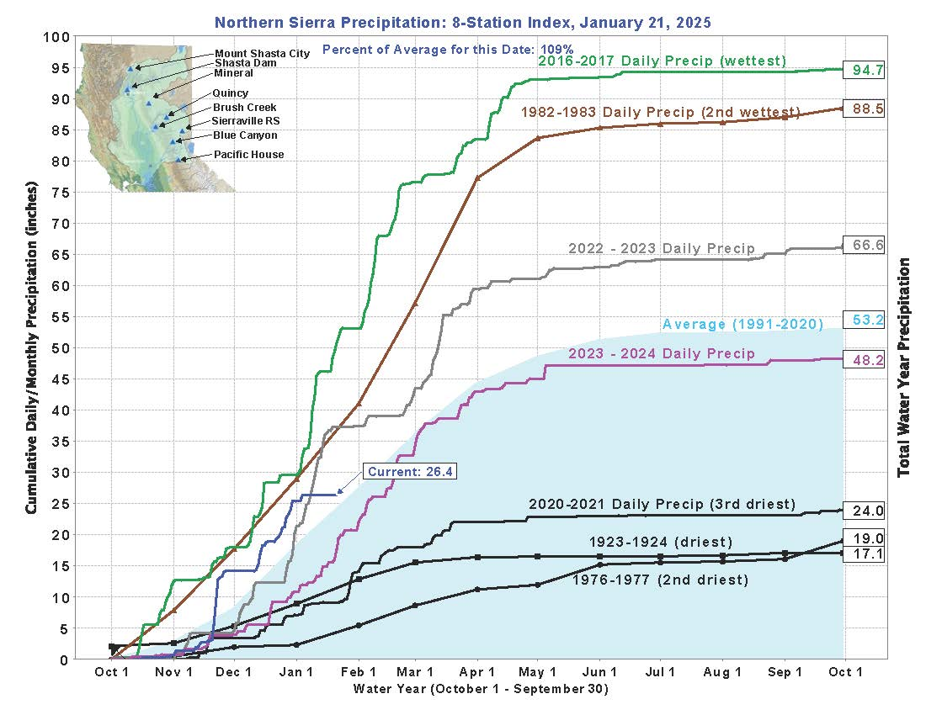

Slide 3
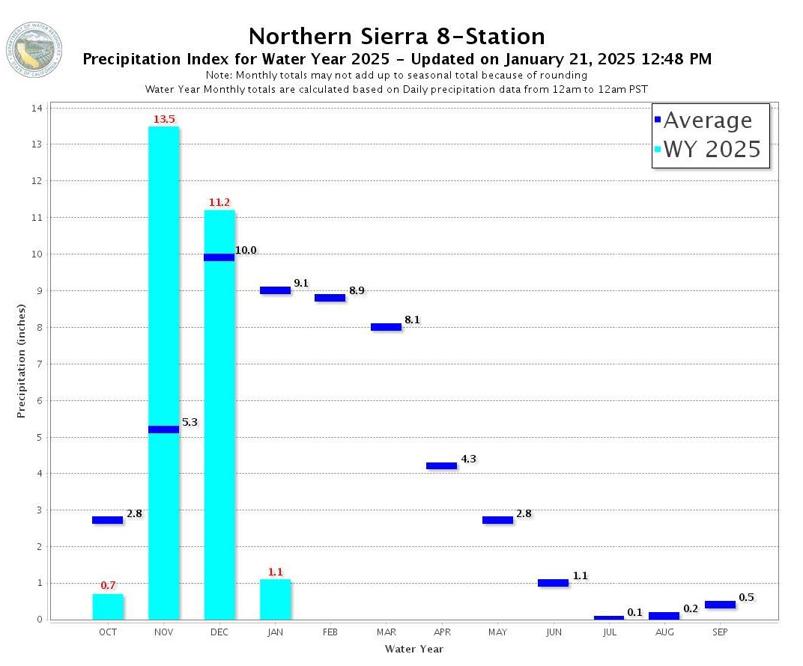

Slide 4
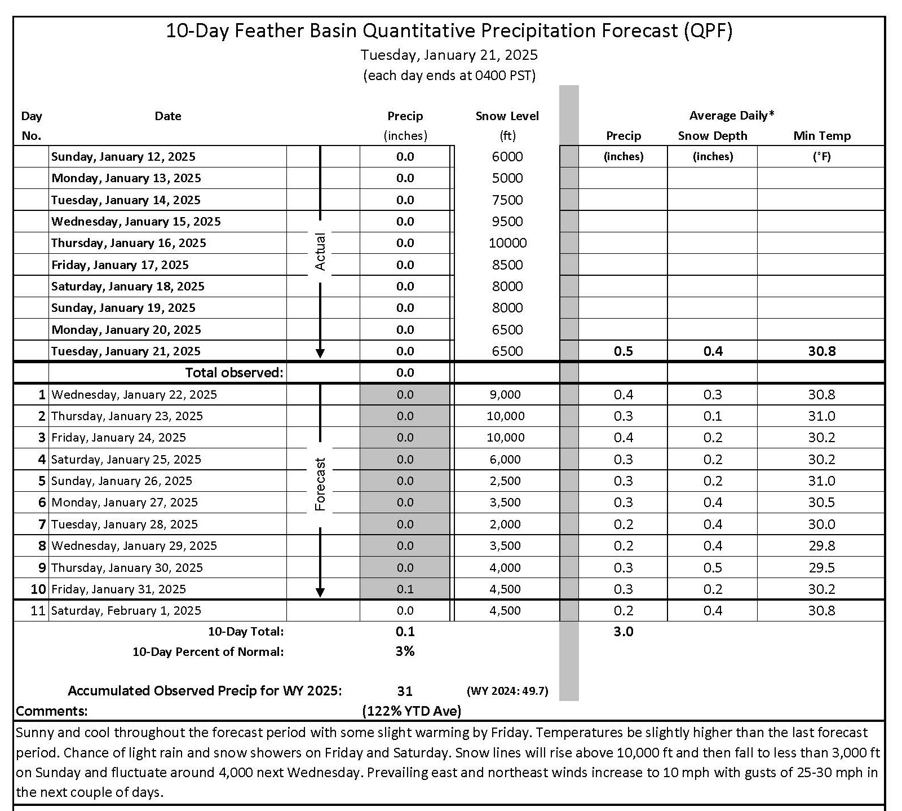

Slide 5
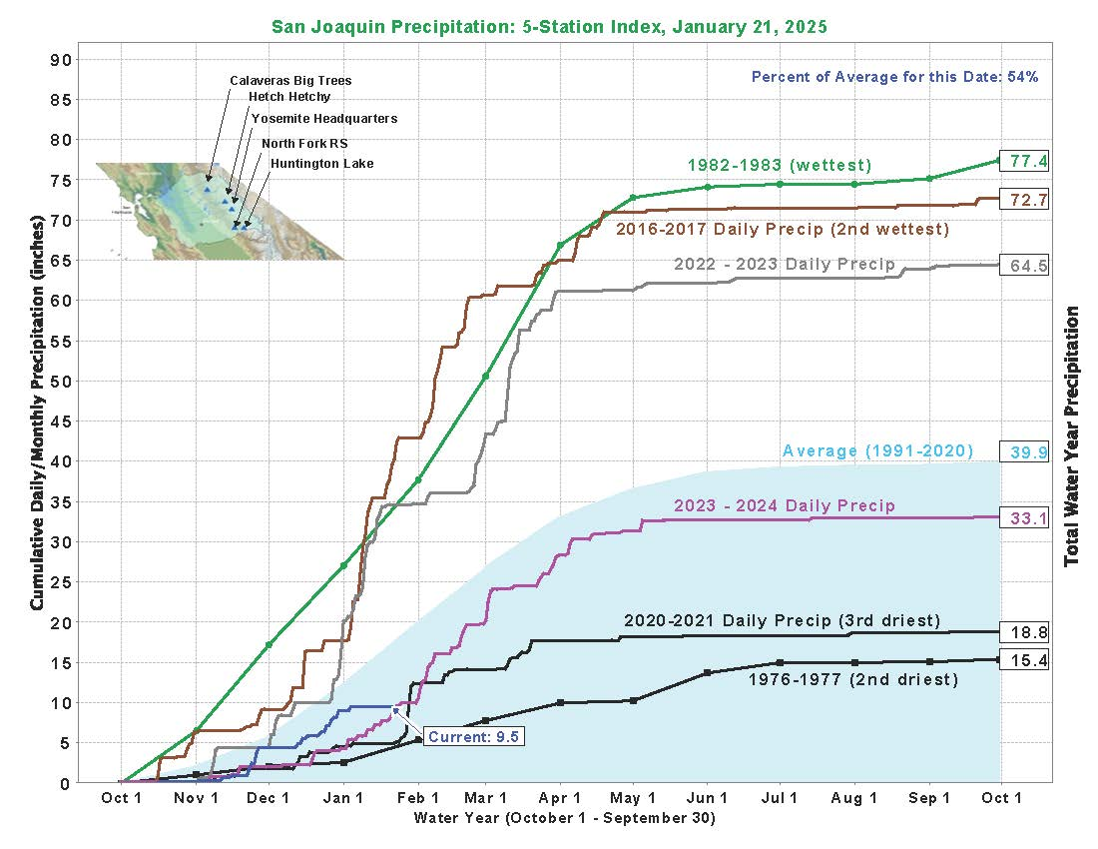

Slide 6
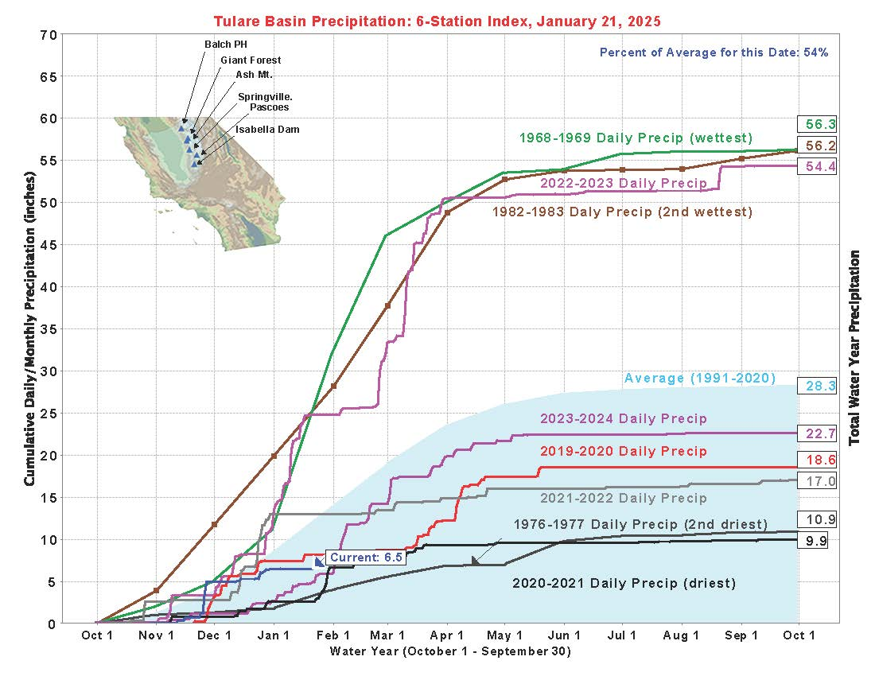

Slide 7
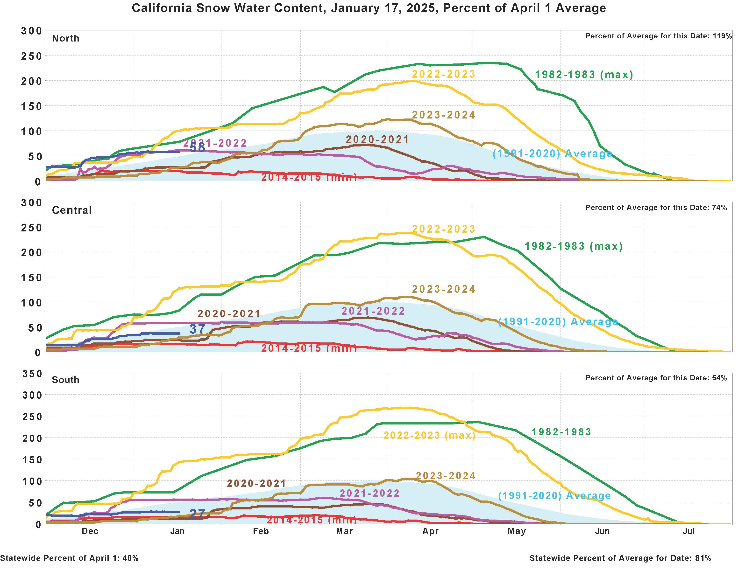

Slide 8
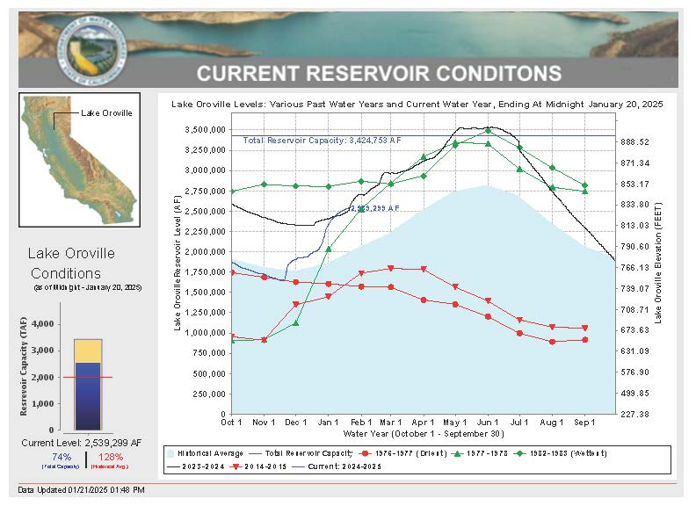

Slide 9
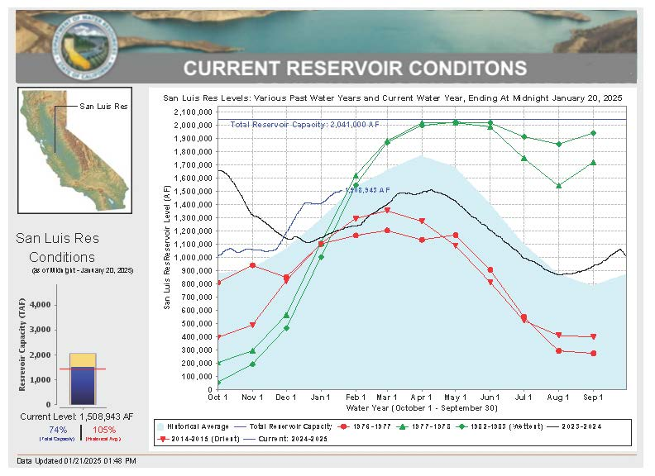

Slide 10
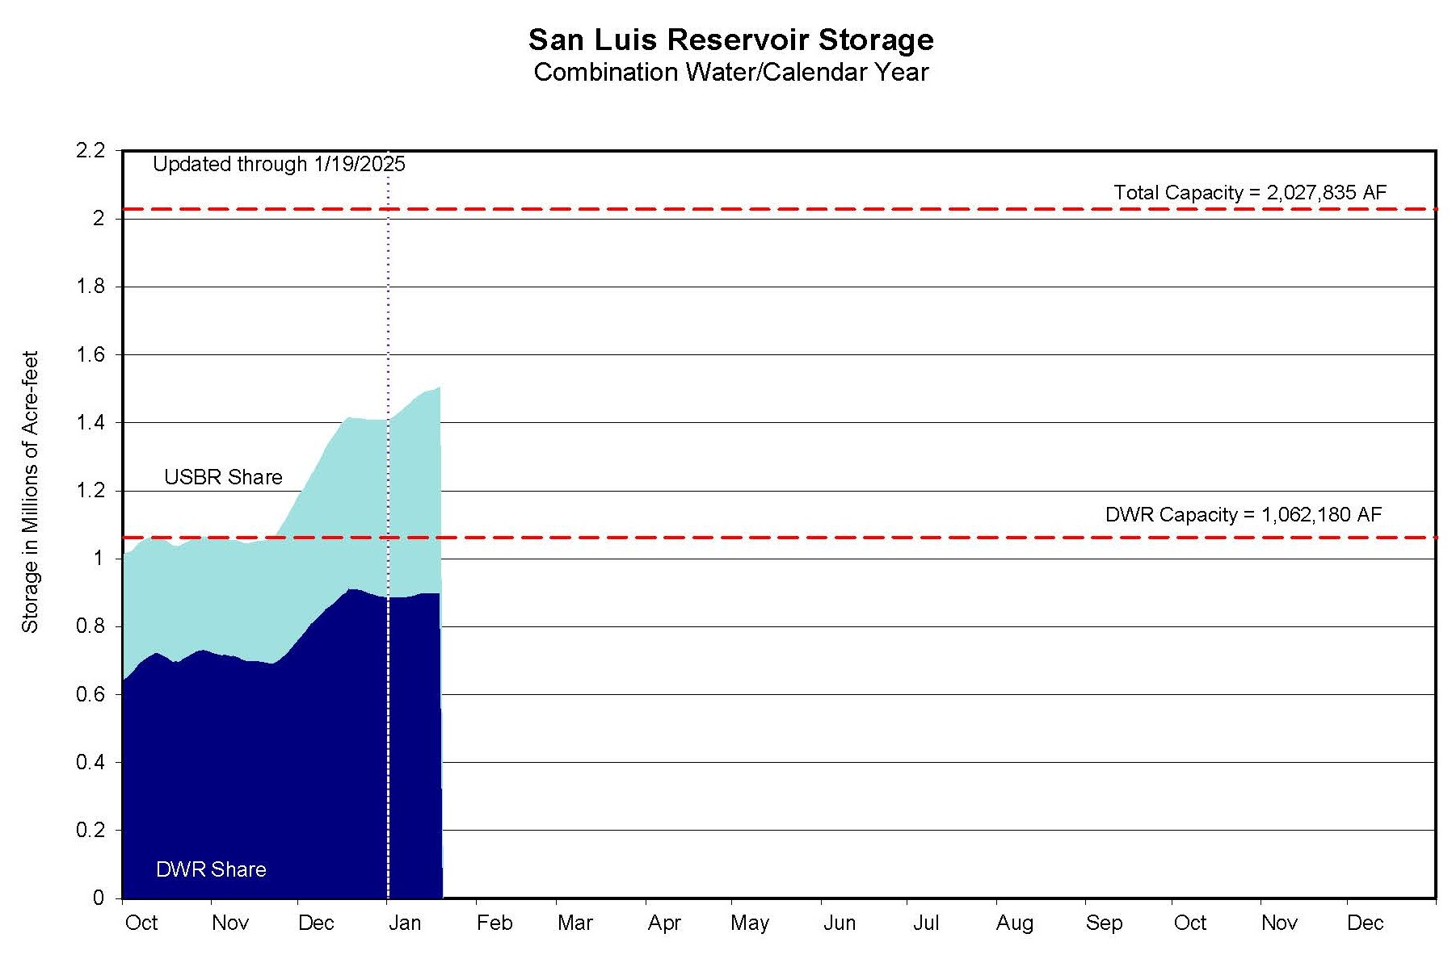

Slide 11
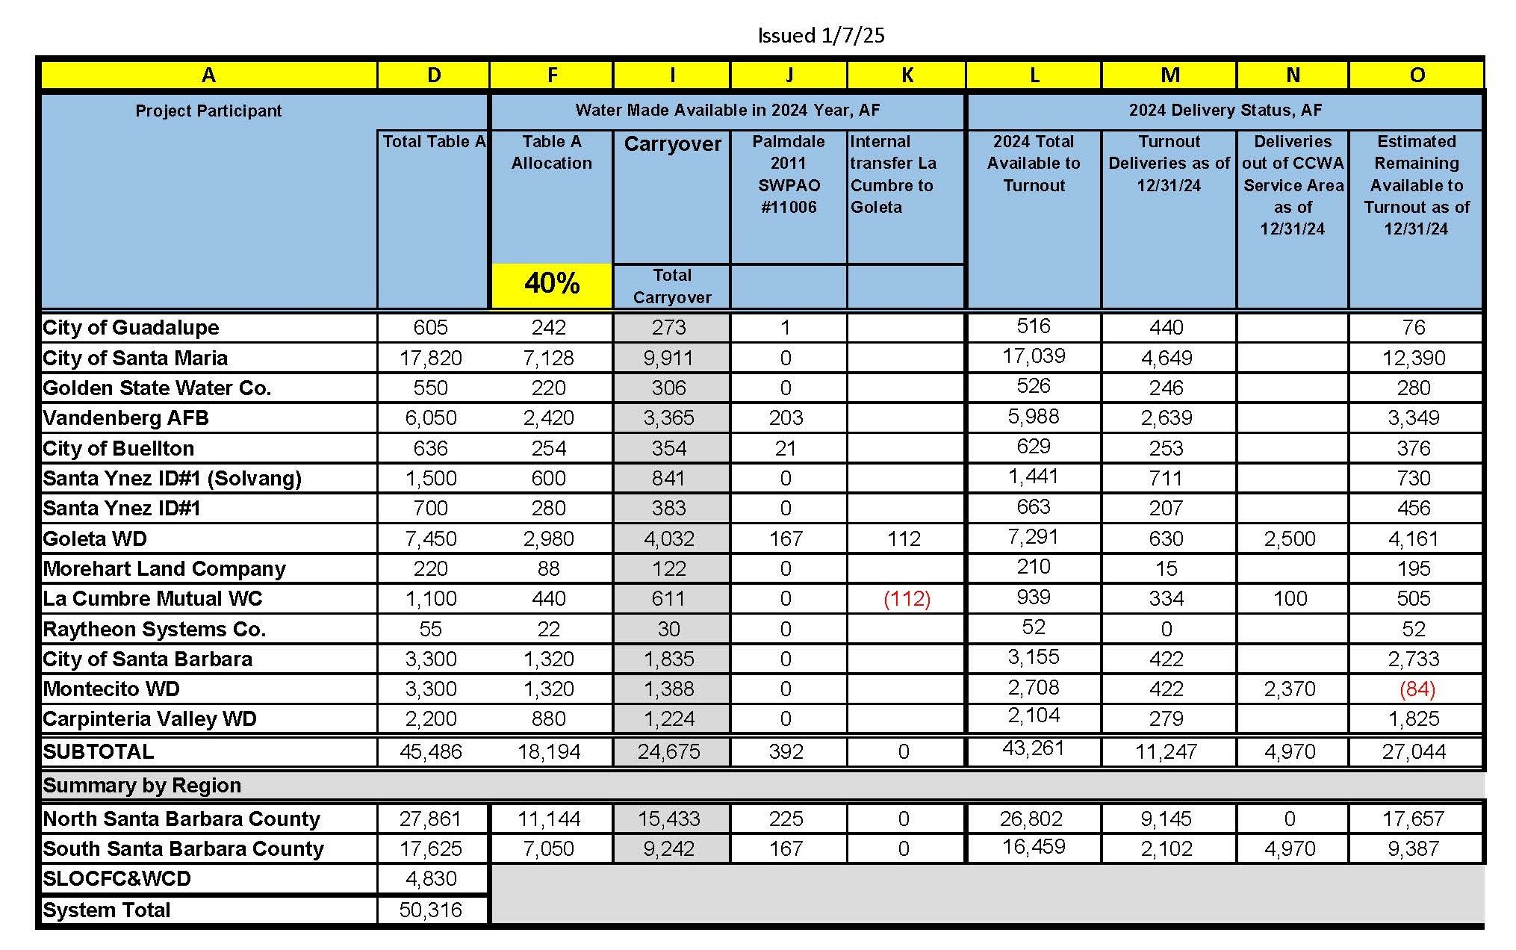
2024 Water Delivery Status Report

Slide 12
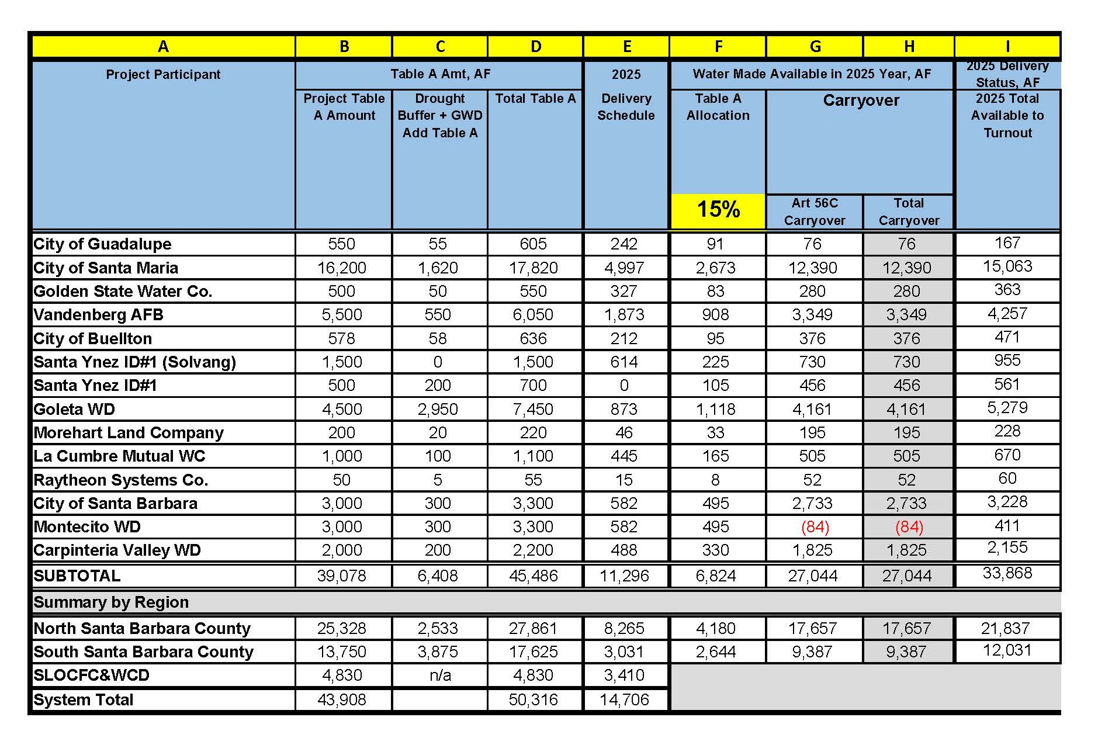
2025 Water Delivery Status Report

Slide 13
Overview of Water Transfers
Montecito Water District (MWD) and Homer LLC (Homer)
  Water Management Program Agreement between MWD and Homer executed
  Assistance Agreement between CCWA and MWD executed
  MWD completed CEQA analysis
  CCWA working on transfer agreement with DWR
La Cumbre Mutual Water Company (LCMWC) and Homer
  Assistance Agreement between CCWA and LCMWC executed
  LCMWC in process of completing CEQA analysis

Slide 14
Questions?

