Slide 1

SWP Operations Overview
Central Coast Water AUTHORITY
Oct 24, 2024

Slide 2
Outline
CA hydrology
SWP system
Regulations
SWP Allocations
SWP Outlook

Slide 3
Hydrology

Slide 4
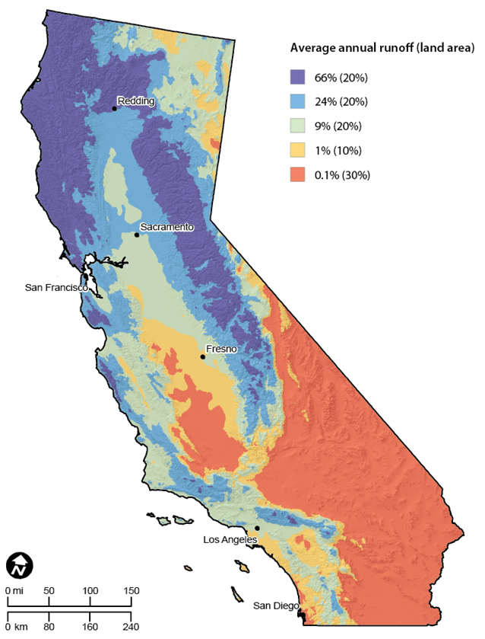
Majority of Runoff in the Northern California

Slide 5
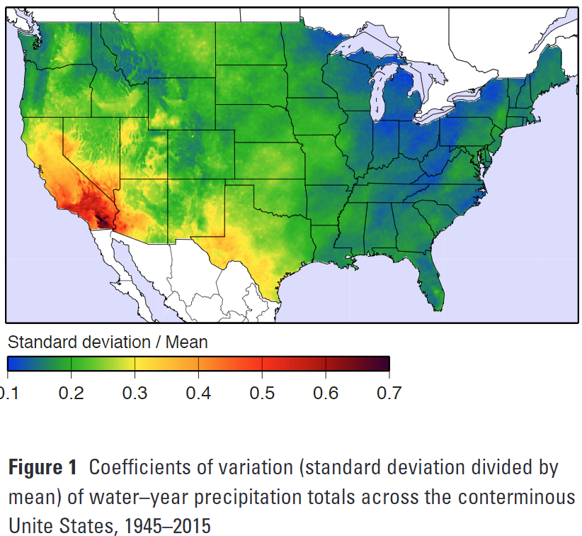
California Has High Precipitation Variability When Compared with Rest of Continental U.S.
https://escholarship.org/uc/item/2r71j15r

Slide 6
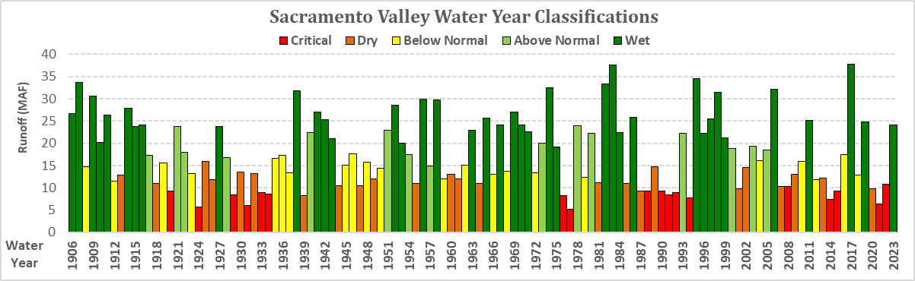
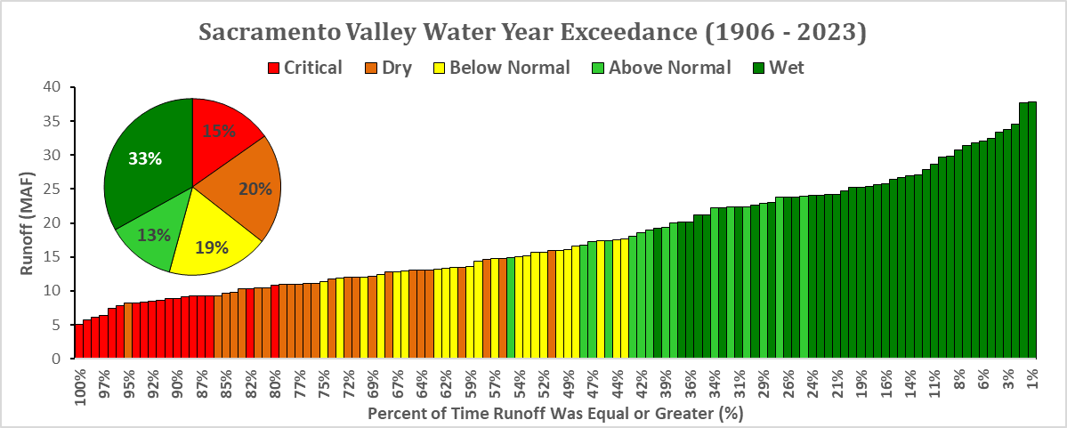
Uncertain and Variable Interannual HydrologY
Notes:
For Northern Sierra 8-Station:
https://cdec.water.ca.gov/prev_barcharts8SI.html

Slide 7
SWP Source Watersheds

Slide 8
Typical Source of SWP Exports in November to May

Slide 9
Typical Source of SWP Exports in June to October

Slide 10
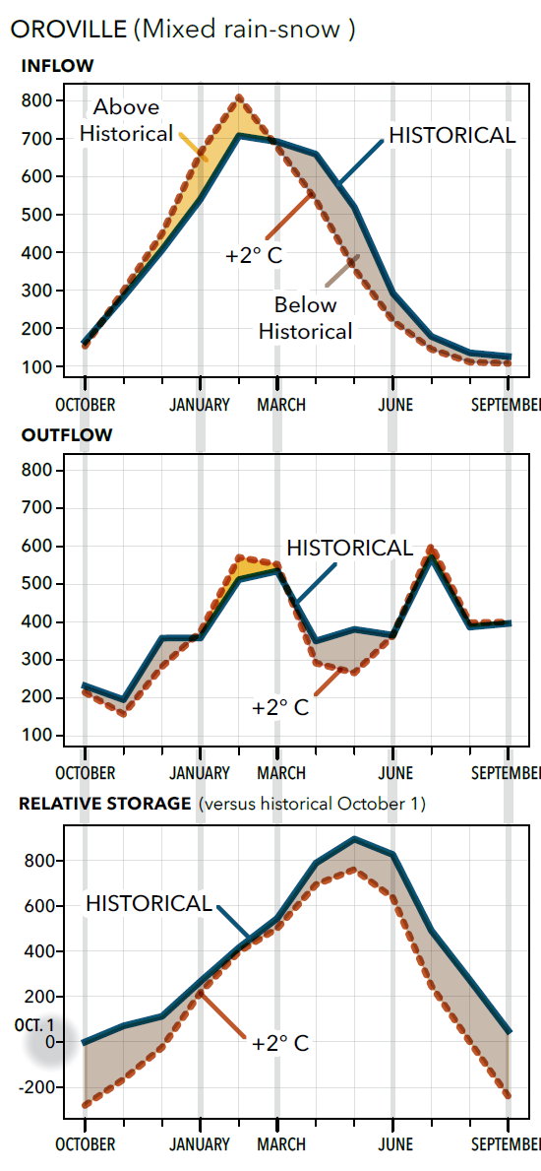
Historic and Future Runoff Patterns
Climate Change Creates Challenges to Future Reservoir Operations

Slide 11
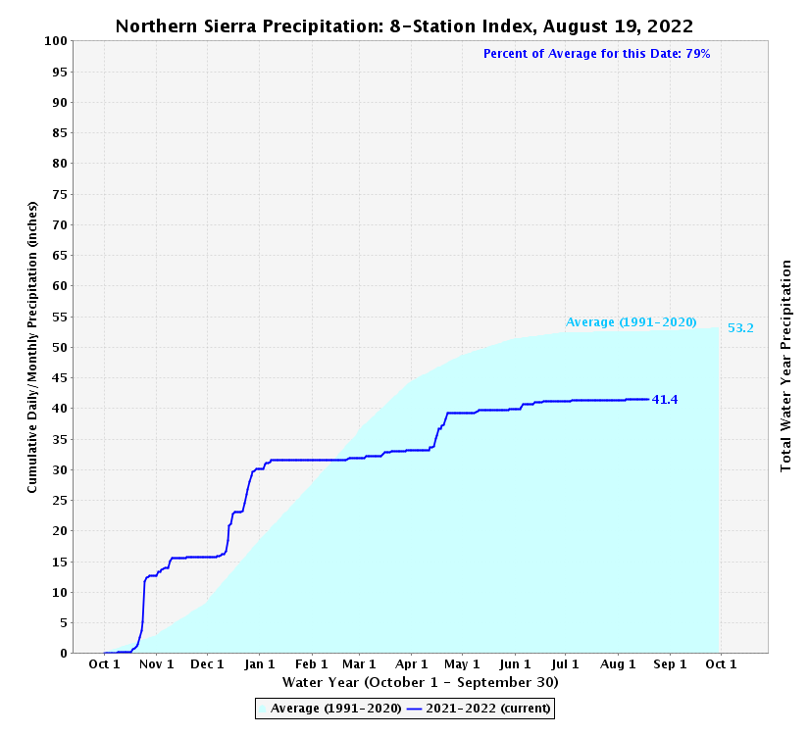
Stairstep pattern in
WY 2022
exemplifies new extremes and variability associated with climate change
Dry
Dry
Wet
Dry
Wet
Wet

Slide 12
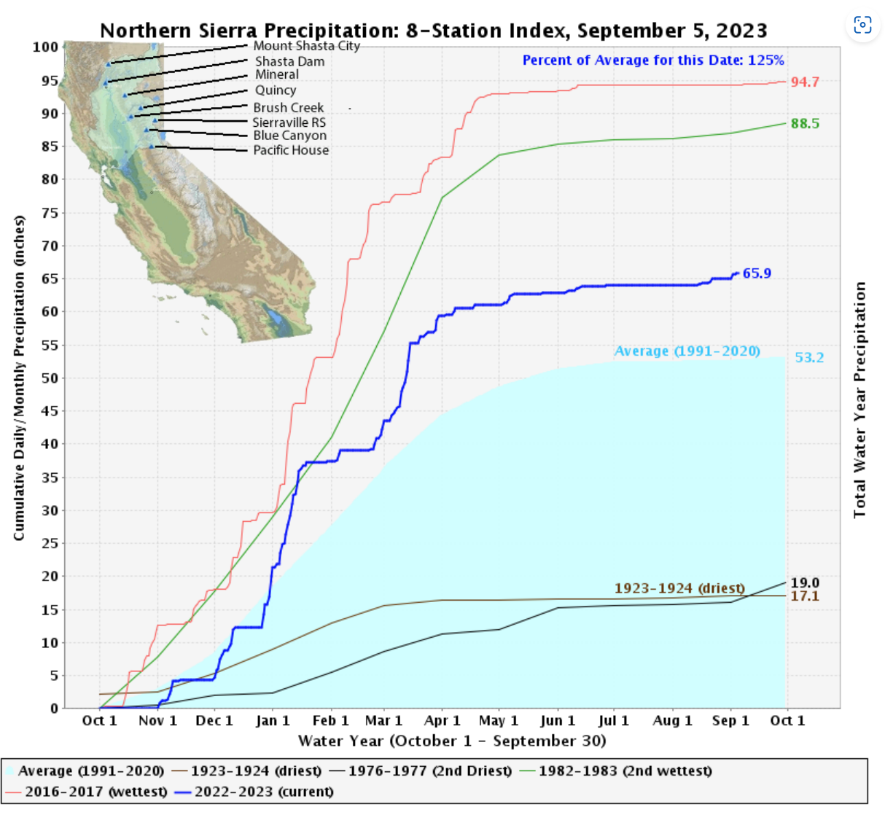
Stairstep pattern continued in
WY 2023, even though completely different hydrology
Dry
Dry
Wet
Dry
Wet
Wet

Slide 13
SWP Facilities

Slide 14
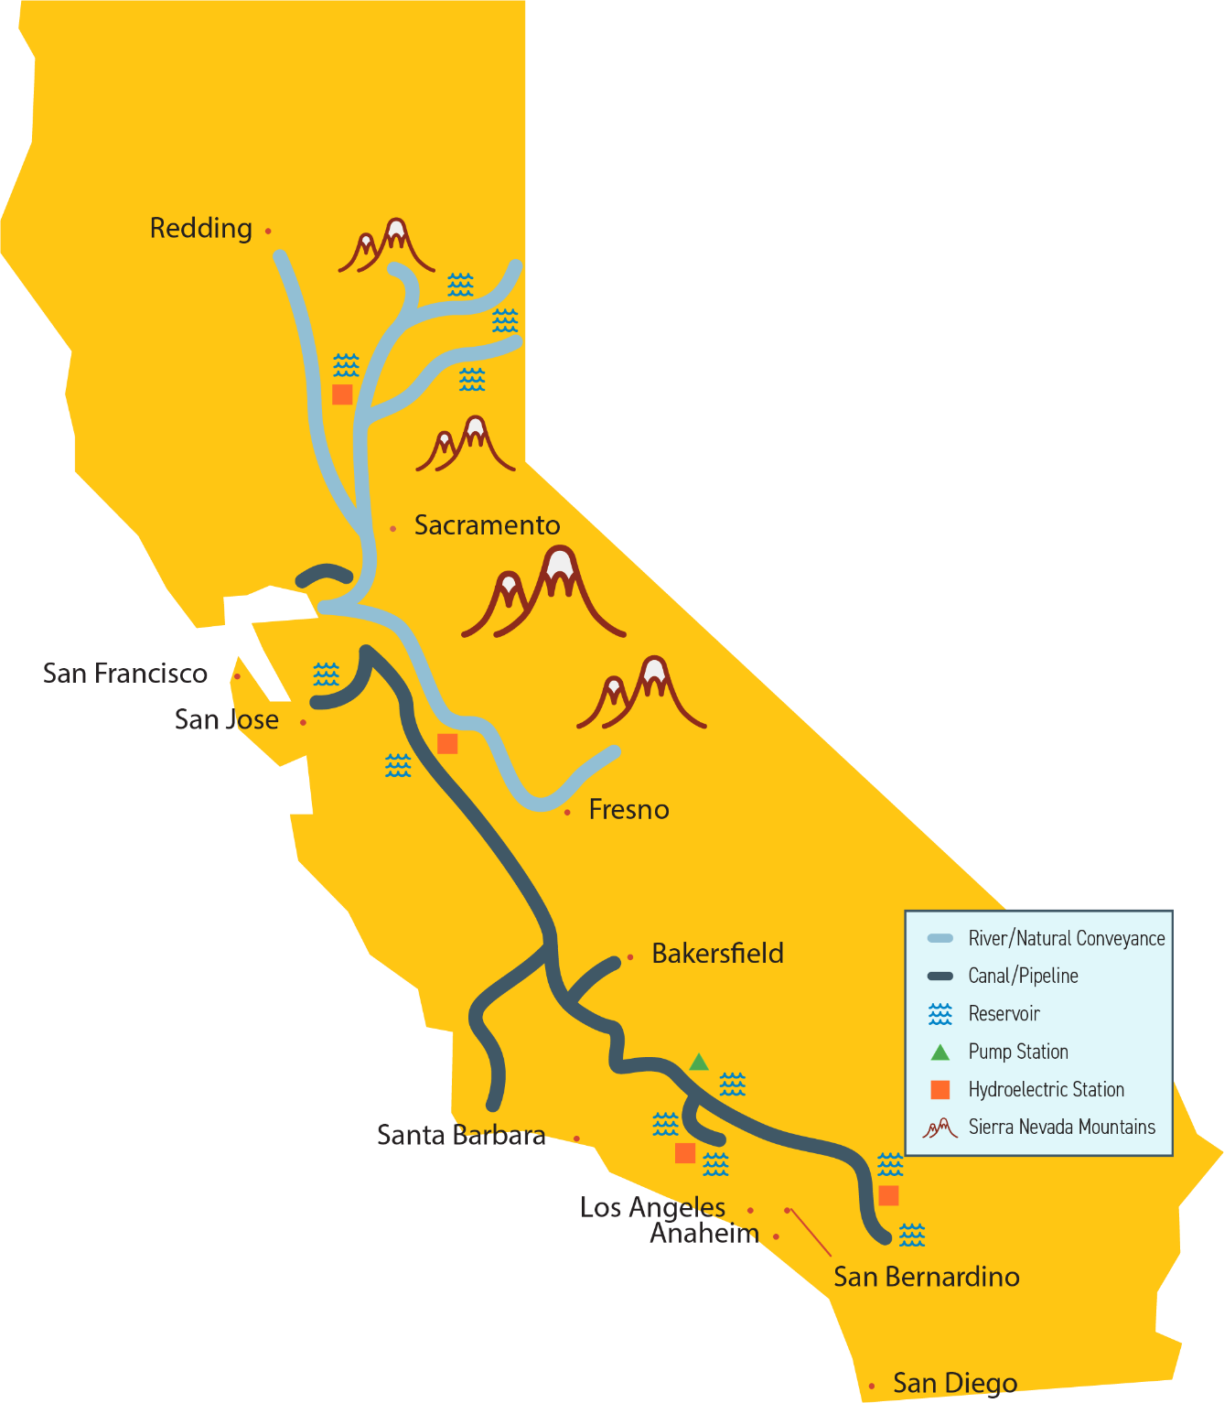
State Water Project
34 storage facilities, reservoirs and lakes
20 pumping plants
4 pumping-generating plants
5 hydroelectric power plants
701 miles of open canals and pipelines
Construction began in the 1960s

Slide 15
Key SWP Facilities Built to Capture Water Under Historic Runoff Patterns

Slide 16
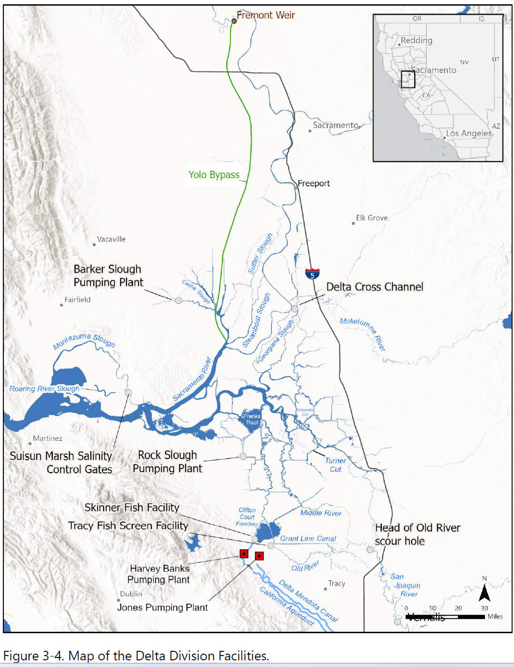

Slide 17
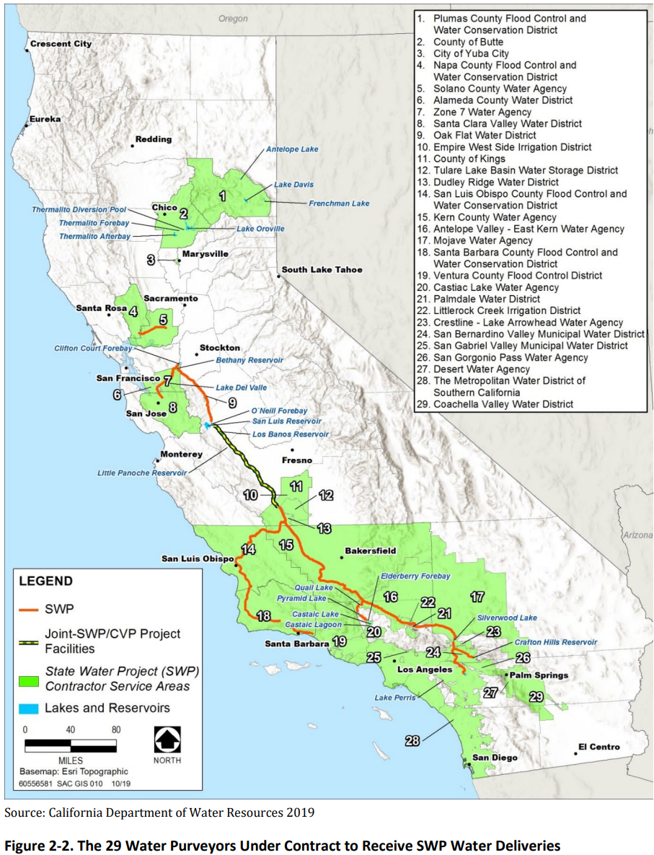
SWP Service Areas

Slide 18
SWP Regulations

Slide 19
Regulatory Limits for SWP and CVP
SWP Water Right Permits
Bay Delta Water Quality Control Plan (D-1641)
ESA Biological Opinions (BiOps)
CESA Permit
SWP Diversions to Storage and for Exports
CVP Water Right Permits
Bay Delta Water Quality Control Plan (D-1641)
ESA Biological Opinions (BiOps)
CVP Diversions to Storage and for Exports

Slide 20
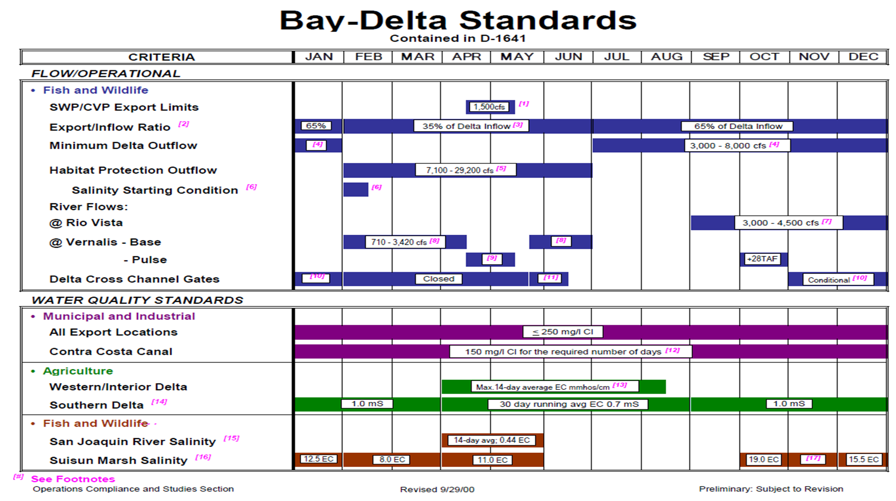
State Water Board’s Bay-Delta Water Quality Control Plan (WQCP)

Slide 21
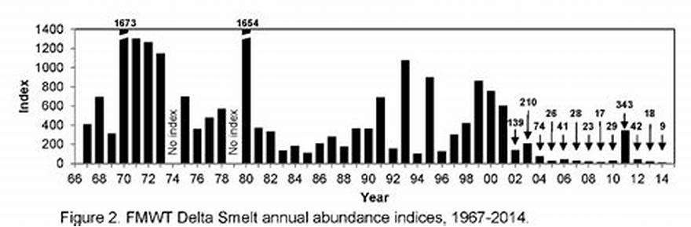
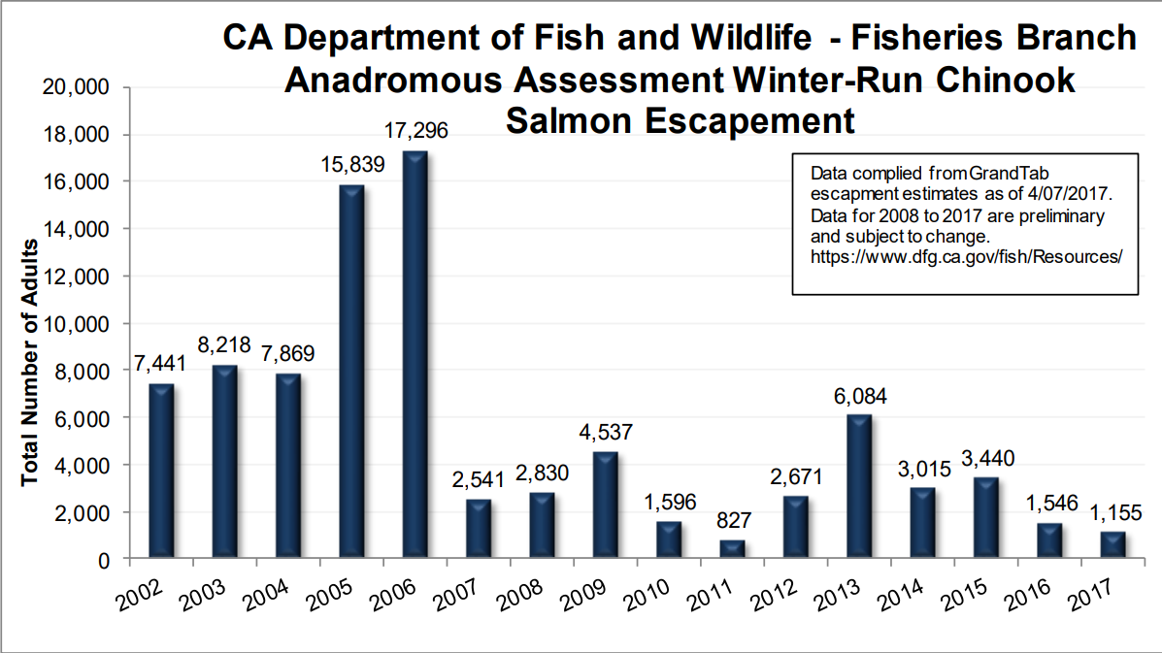
Status of Fish Species Resulted in Additional Regulatory Restrictions

Slide 22
CVP and SWP Permits Updated Periodically
1995
2004
2008-09
2019-20
2022
2023-24
2024-25
WQCP (D1641)
BiOps
BiOps and CESA permits
BiOps and CESA ITP
Interim Operations Plan (IOP)
Interim Operations Plan (IOP)
New BiOps & ITP
New WQCP (VAs)
Protects beneficial uses in the Delta (flows, salinity, export limits)
Protect ESA listed species: Winter-run, Spring-run, Steelhead, Green Sturgeon, Delta Smelt and Longfin smelt*
Protect CESA listed species: Winter-run, Spring-run, Delta Smelt, Longfin smelt and White Sturgeon*
(Flows and Export limits)

Slide 23
Bay – Delta Regulations
N
State Water Board Bay-Delta Standards (Decision-1641)
  Delta Flow and Outflow requirements
  Salinity requirements
  Export limits
ESA Biological Opinions
  Old and Middle River Flow Requirements
  Export limits
  Delta outflow requirements
CESA Incidental Take Permit
  Export limits
  Delta outflow requirements
Port Chicago
Delta Cross Channel Gates
Chipps Island
Threemile Slough
Collinsville
Emmaton
Rio Vista
Jersey Point
64
75
81
Outflow
Pacific Ocean
85
95
X2 locations
Rock Slough
West False River Drought Barrier

Slide 24
Old and Middle River Flow (OMR) Requirements
OMR Requirements:
  Limit net reverse flows in Old and Middle Rivers
  Limit how much flow comes from the north and central Delta to south Delta
Therefore, south Delta exports depend on the San Joaquin River flow
For the same OMR Requirement, higher south Delta exports with higher San Joaquin River flow and vice-versa

Slide 25
SWP Allocations

Slide 26

SWP Annual Allocation Process
OCT
NOV
DEC
JAN
FEB
MAR
APR
MAY
JUN
JUL
AUG
SEP
(30/50/60/100% Delivery Schedules Due)
SWP Studies
(Initial Allocation Announced)
(Typical Final Allocation Announced)
(Begin SWP Water Year)
- Schedule Updates and Monthly Status Reports
Prior Year Finalizations
(Prior-Year Finalizations Due)

Slide 27
SWP Allocation Process
Storage Conditions
Forecasted Hydrology
Actual/Forecasted Demands
State/Federal
Environmental Requirements
Update SWP Water Operations Annual Plan
Allocation: Revise, as needed
Next Month
Real-time Operations

Slide 28
SWP Allocation Process
Storage Conditions
Forecasted Hydrology
Actual/Forecasted Demands
State/Federal
Environmental Requirements
Update SWP Water Operations Annual Plan
Allocation: Revise, as needed
Next Month
Real-time Operations

Slide 29
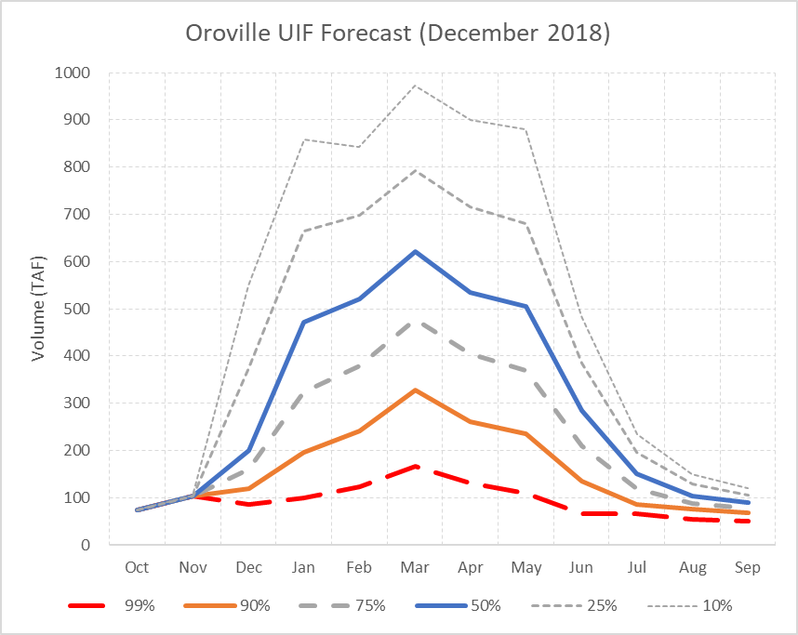
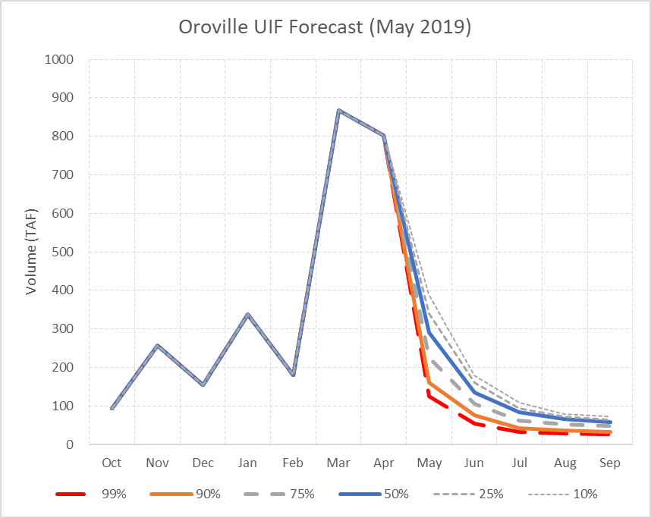
Hydrology Forecast
Forecast Availability
Nov
  Historical Exceedance
Dec – Jan
  DFM forecast (precipitation)
Feb – May
  DFM forecast (incorporates snow)
Notes:
Initially based on historic exceedances
Starting in Dec
Suite of hydro from DFM
First 2 are based on precip
Starting feb incorporate snow

Slide 30
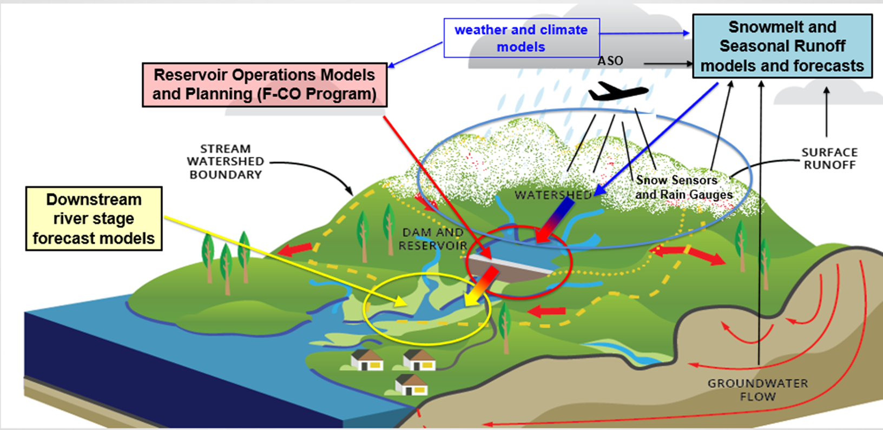

Observations and Forecasts Informing Water Management
AR Recon

Slide 31
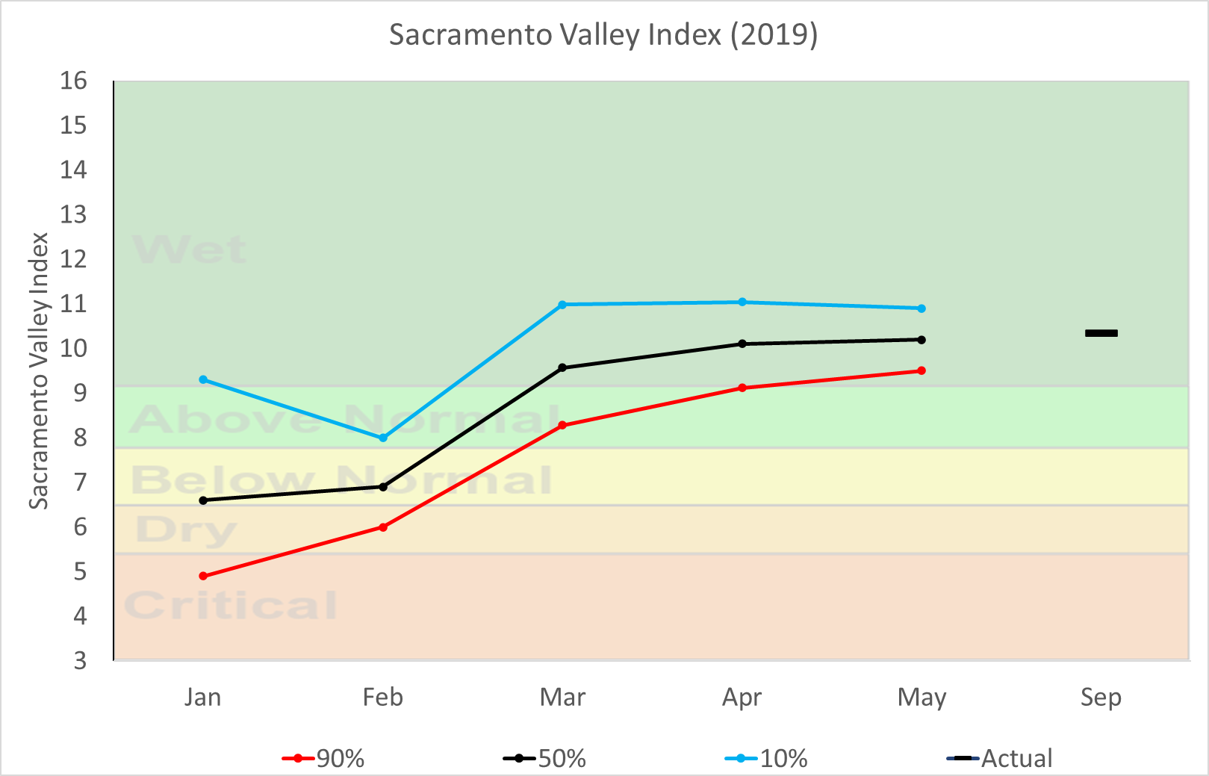
Regulations & Obligations
Minimum Instream flow
Flood control
Delta requirements
  State Water Board Bay-Delta Standards (Decision-1641)
  ESA Biological Opinions
  CESA Incidental Take Permit
Other In-Basin Use
Coordinated Operations Agreement
Notes:
Initially based on historic exceedances
Starting in Dec
Suite of hydro from DFM
First 2 are based on precip
Starting feb incorporate snow

Slide 32
Storage Operational Goals
Carryover Targets
  Oroville
    1.6 MAF end of September
  San Luis
    State Water Contractors Carryover
    San Luis Low Point
Terminal reservoir seasonal operations

Slide 33
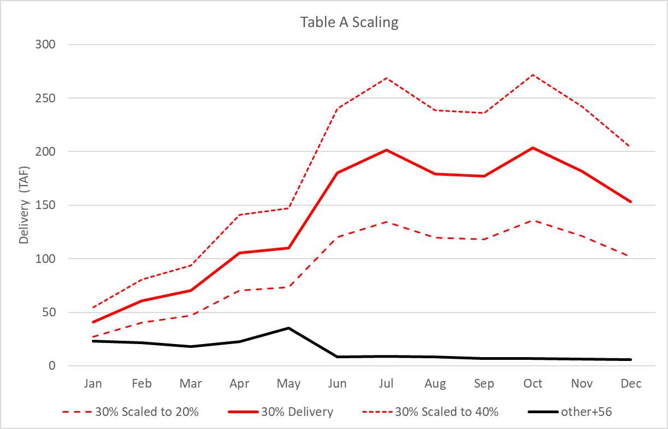
Deliveries Forecasts
Range of delivery requests
  0%, 10%, 30%, 50%, 60%, 100%
Table A scaled to maximize delivery of available supply
Other Deliveries (not scaled)
  Article 56
  Backup

Slide 35
Complex Water Management: WY 2022 Example
AR5
2019 BiOp Lawsuit & IOP
TUCP
TUCP Withdrawn
TUCP
Dry Season/
Monsoon
Warm
And
Dry
TUCO
Record Dryness
TS Kay
Heat
Dome
WIND
Oct
Nov
Dec
Jan
Feb
Mar
Apr
May
Jun
Jul
Aug
Sep
Time
Allocation Revisions
Obtain Initial Demands
Initial
Allocation
Final
Allocation
0% + HH&S
20%
5% + HH&S
Notes:
Here is a graphic illustrating the seasonal perspective of water management below the timeline and the way water year 2022 played out above the timeline. Fall rains started on time with the record-setting atmospheric river in late October. However, November was warm and dry that began to dry out the landscape again before December kicked in with abundant precipitation and snowfall. The seasonal snowpack got off to a great start, but the new calendar year brought a new record setting stretch of warm and dry limiting further growth and further easing of drought conditions. By April 1 the snowpack was very limited but spring rains helped the snowmelt make it to the streams and rivers. The summer brought more heat and some new extremes with the Southwest Monsoon including flooding in Death Valley National Park in August. In September a record-setting heat wave took place and was disrupted by a decaying Pacific hurricane which was still a tropical storm when it impacted southern CA. Shortly after that a decayed typhoon impacted northern California as a cutoff low that spun offshore. While the timing of events helped, the pace and scale were off leading to the continuation of the drought. In fact, 2020-2022 is now the driest three-year stretch for statewide water-year precipitation breaking the previous record set in 2013-2015.

Slide 36
SWP Outlook

Slide 37
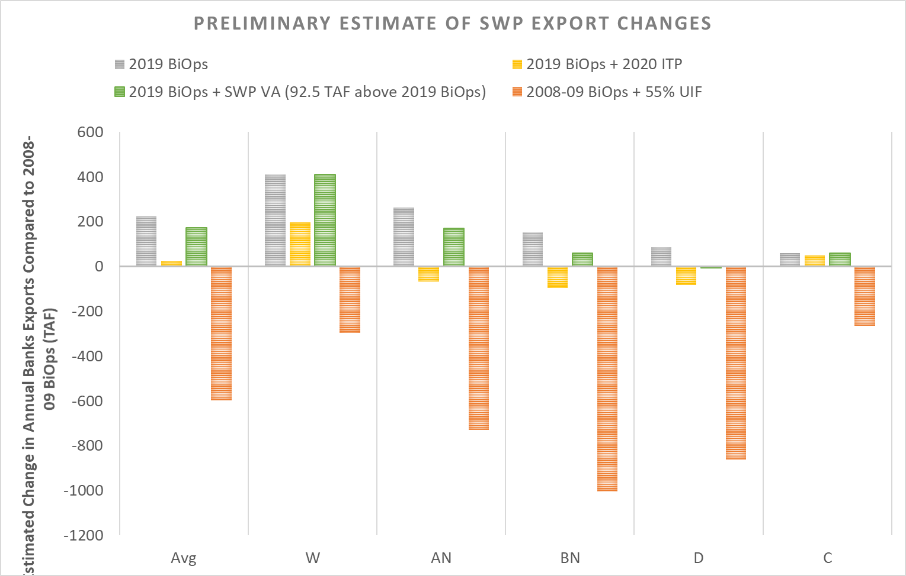
VA flows will address ESA and CESA spring outflow requirements
Relationship of VA to BiOps, ITP and WQCP
Estimated changes in Banks PP exports compared to 2008-09 BiOps
VA modeling reflects initial water user VA proposal
Compared to 2008-09 BiOps:
If ITP outflow elements are replaced by VA, 2019 BiOps improvements largely continue
55% UIF likely results in significant reductions in SWP exports
Source: 2019 BiOps from DWR’s LTO EIR PP model. 2020 ITP results estimated using DWR’s LTO EIR Alt2B model. VA results estimated using DWR’s LTO EIR PP model. 55% UIF results based on Nov 2019 SWRCB models. Note that models do not include potential real time export restrictions.

Slide 38
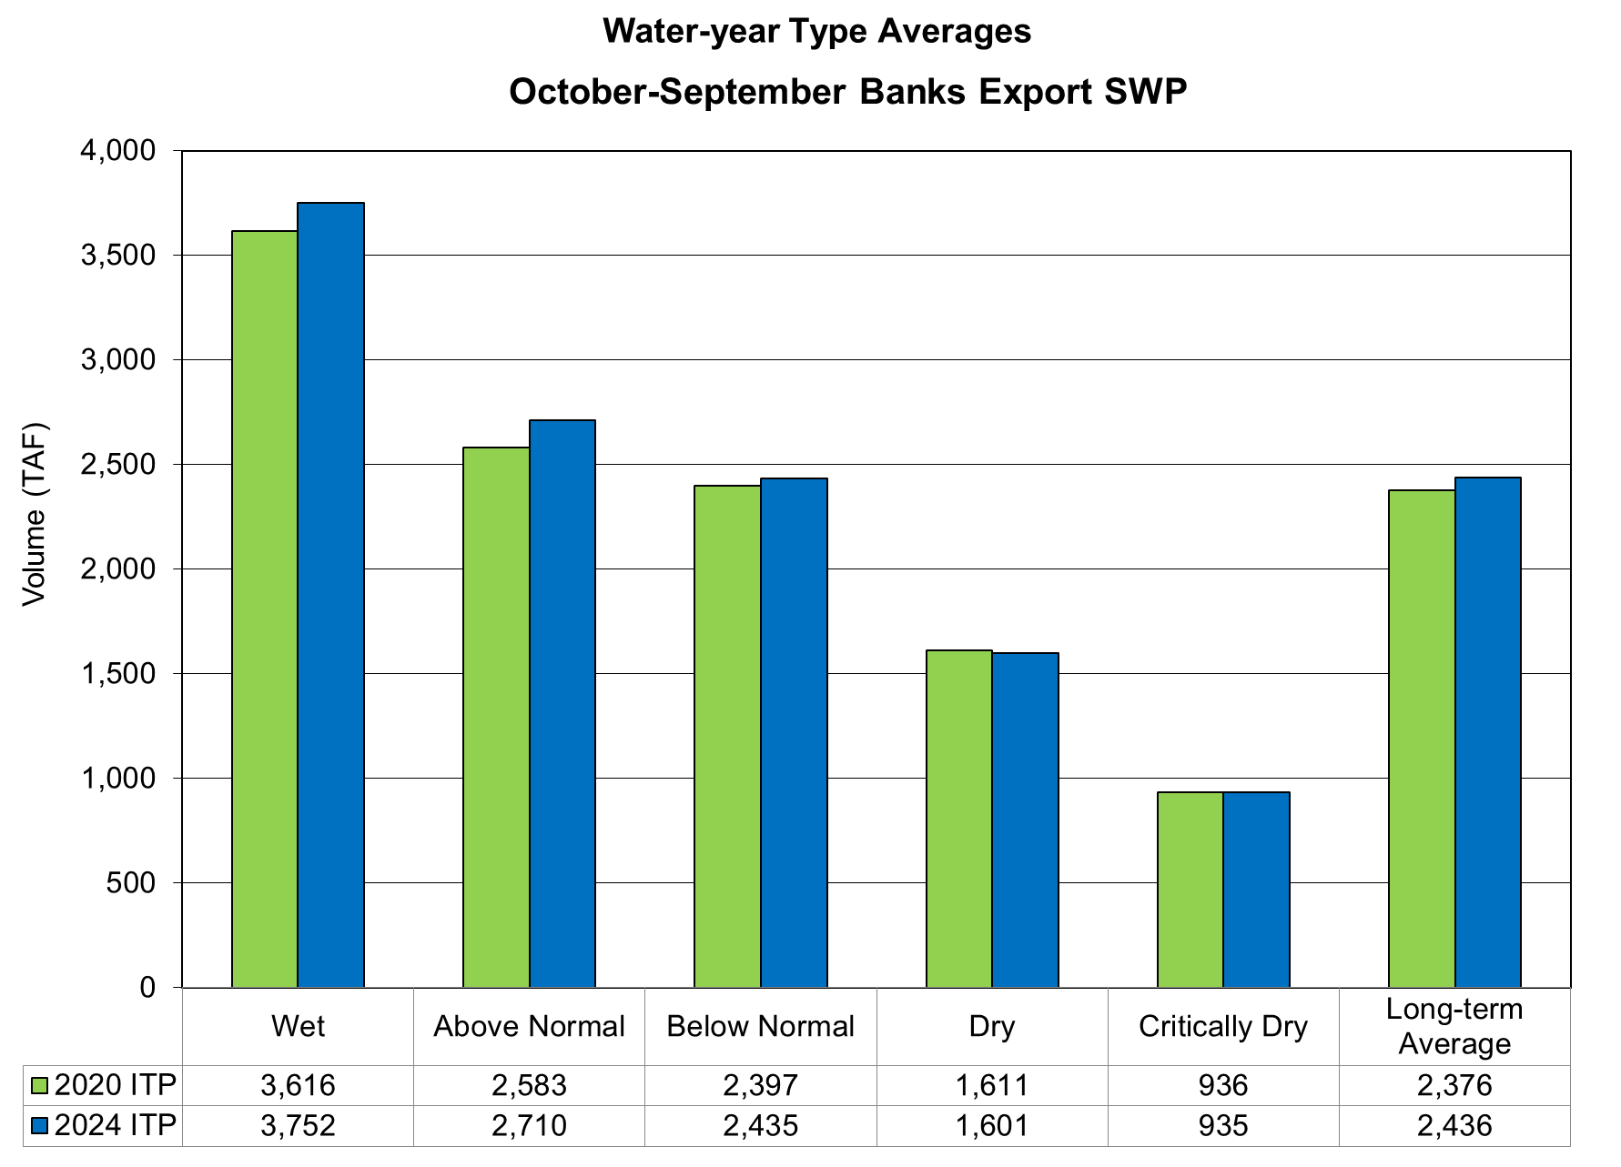
Resultant Water Supply Comparison

Slide 39
Decreasing Trend in SWP Allocations

Slide 40
What is the Delta Conveyance
Project (DCP)?
DWR issued FEIR/NOD in 12/2023 and selected Bethany Reservoir Alignment
Two new diversion intakes in the north Delta with state-of-the-art fish screens
Total diversion capacity of 6,000 cfs (3,000 cfs each)
45 miles of 36-feet single tunnel, from new intakes to California Aqueduct at Bethany Reservoir
New pumping plant connecting the tunnel to Bethany Reservoir

Slide 41
Questions?

Slide 42
SWP Water Supply Allocation Inputs
Oroville
Storage
Forecasted Dry Hydrology
- Inflow to Reservoirs
- Runoff to Bay-Delta
Releases
Central Valley Project (CVP) Operations
Bay-Delta Regulatory Objectives
Delta Outflow
Water Quality
Delta
BiOps/ITP
Export
South of Delta Storage
San Luis Reservoir
SWP Actual and Forecasted Contractor Demands
Deliveries
Notes:
Pull in data from a variety of sources
Suite of Hydro from DFM (Seans group)
Estimates inflows/runoff
Informs potential regulatory requirements
CVP operation from Reclamation
Storage
Demands from SWC and processed by mahmouds group
Strategy
Simulate the project operations
Winter/spring
Minimize releases – build storage
Maximize export of un-stored water
Summer
Manage Oroville storage to requirements
Export Available storage
Scale TA deliveries to maximize delivery
Resulting TA is what is used to determine allocation percentage

Slide 43
