Slide 1
Central Coast Water Authority
Operating Committee Meeting
July 2024

Slide 2
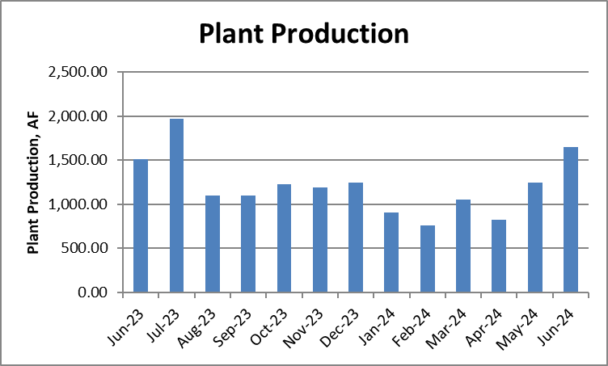
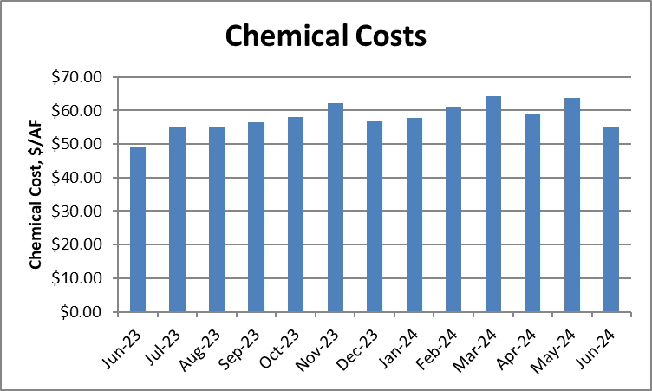
PLANT PRODUCTION, CHEMICAL COSTS
AND LAKE CACHUMA PUMPING
 | Plant Production (AF) | Chemical Costs ($/AF) | SYPF Pumping (AF)
April 2024 | 823.83 | $59.07 | 4.65
May 2024 | 1,248.22 | $63.82 | 8.64
June 2024 | 1,647.99 | $55.28 | 0.00

Slide 3
2024-25 CHEMICAL CONTRACT
EXTENSION PRICING
2023 chemical contracts included option for up to two 1-year extensions.
Updated pricing results in an estimated total expenditure of $693,300 for these chemicals.

Slide 4
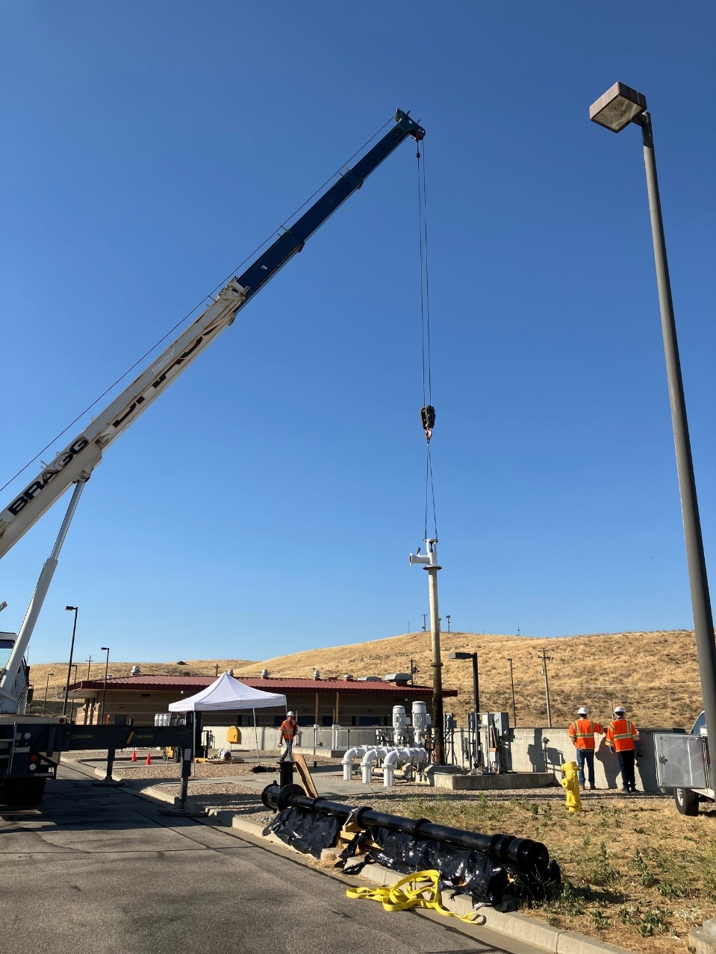
Filter-To-Waste Pump Installed
Three Filter-To-Waste (FTW) Pumps were purchased in 2023-24 to replace existing FTW Pumps.
First new FTW Pump installed on July 10, 2024.

Slide 5
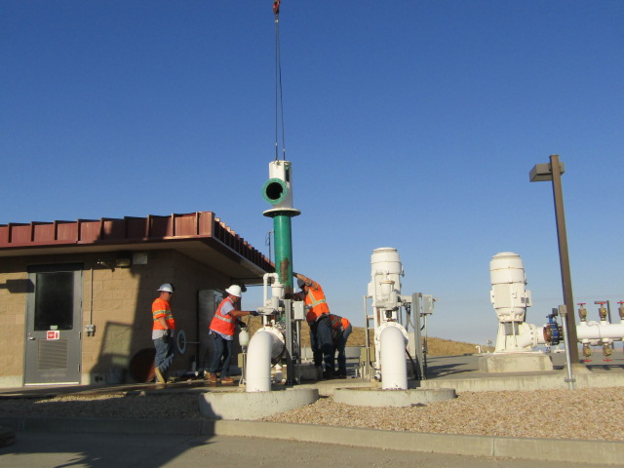
Backwash Pump Repaired and Installed
Backwash Pump No. 1 was taken out of service on March 22, 2024.
Repairs were completed and pump was installed on July 10, 2024.
Replacement backwash pumps ordered in 2024-25 (~30 week lead time).

Slide 6
SYPP Surge Tank Pedestal
Replacement Project
Two lowest bidders appear to be nonresponsive and non-responsible.
Consider issuing Notice of Award at July Board of Directors meeting.
2023-24 budget amount of $367,500.
The 2023-24 operating expense credit will be used as the funding source for the difference between the budget and construction amounts.

Slide 7
General Items
DWR Coastal Plant Winter Shutdown
  Tentative dates 10/28/24 – 11/17/2024
Projects/Design Work
  Tank 7 Chloramination Station Planning and Design
  PPWTP Filter Media Replacement (3 filters)
Environmental Compliance
  Management of Change Process For Chlorine Scrubber
  Red Legged Frog Response Procedures
Staff Updates
  WTP Operator/Trainee Recruitment
  WTP Supervisor Appointed
  Deputy Director Hired

Slide 8
General Items
David Beard – Contact Information
  Desk phone: (805) 688-2292 ext. 228
  Mobile phone: (805) 680-2116
  drb@ccwa.com

