Slide 1
Water Supply Situation Report
CCWA Board Meeting
June 27 2024

Slide 3
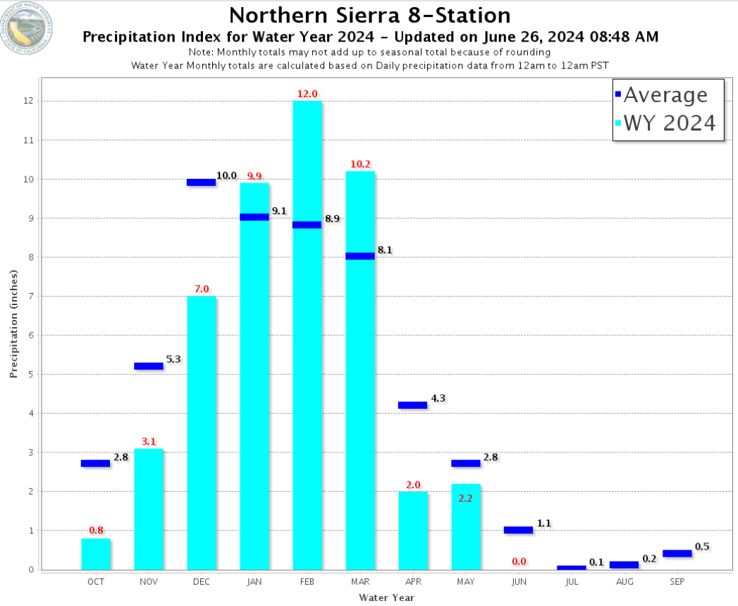

Slide 5
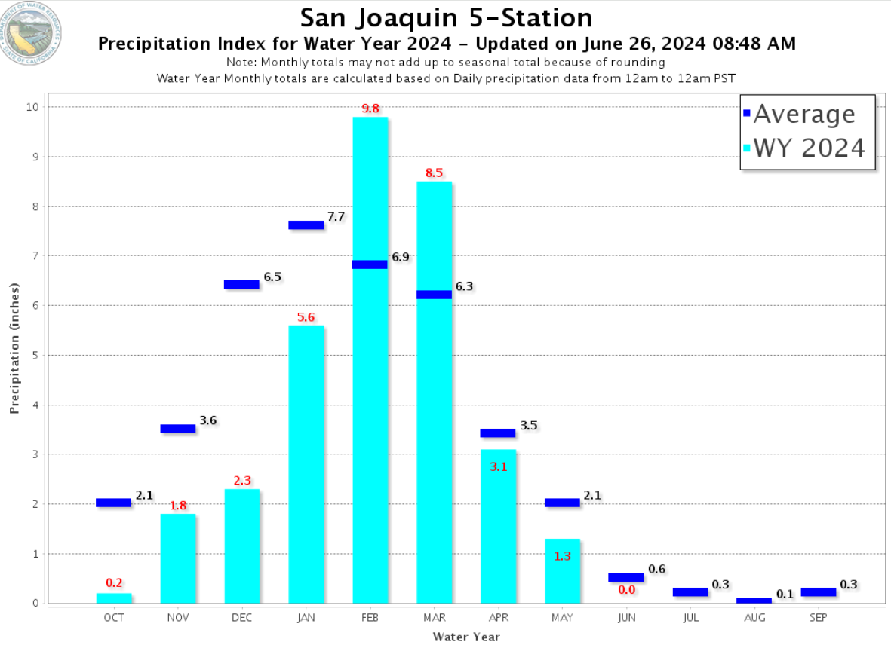

Slide 7
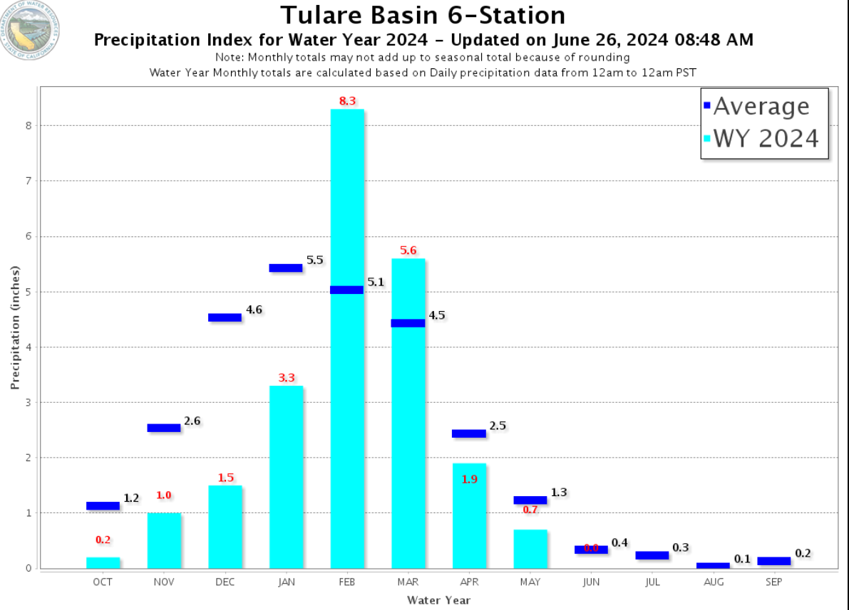

Slide 12
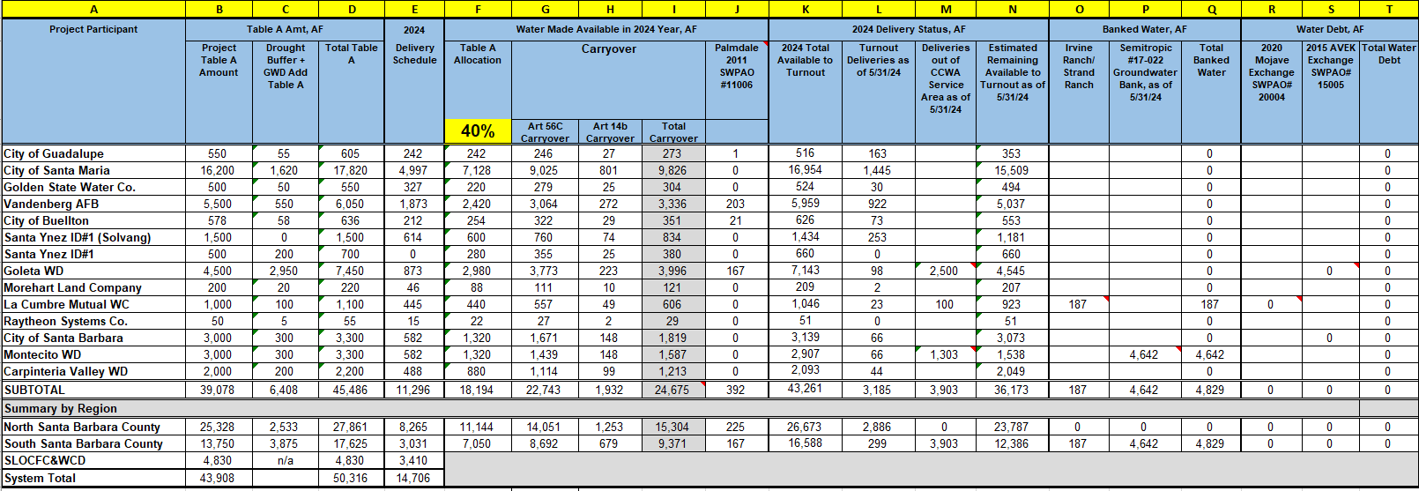

Slide 13
Questions?

