Slide 1

Operations Update
Operating Committee Meeting
March 13, 2025

Slide 2
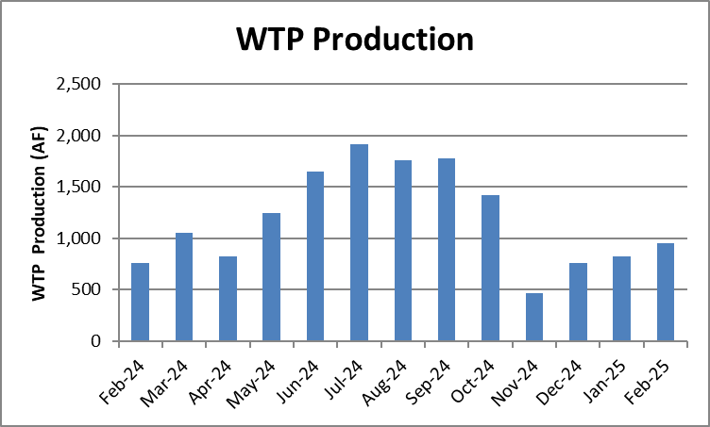
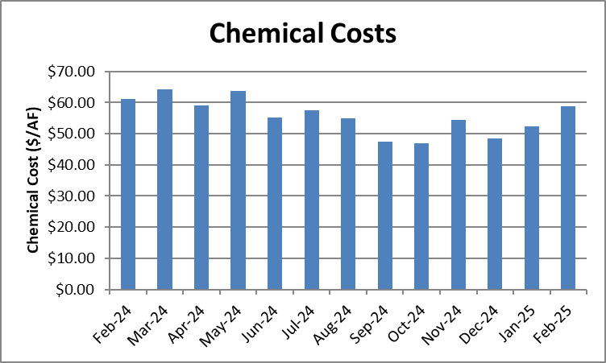
WTP Production, Chemical Costs and SYPP Pumping
 | WTP Production (AF) | Chemical Costs ($/AF) | SYPP Pumping (AF)
January | 828 | $52 | 42
February | 955 | $59 | 27
March | - | - | -

Slide 3
Water Treatment Plant Filter Assessment
A filter condition assessment was completed at the WTP which included:
  Collecting and analyzing samples from the filter media
  Inspection of filter underdrains
  Identification of backwash anomalies such as air or water maldistribution
  Visual evaluation of concrete, backwash troughs, piping, valves and instrumentation

Slide 4
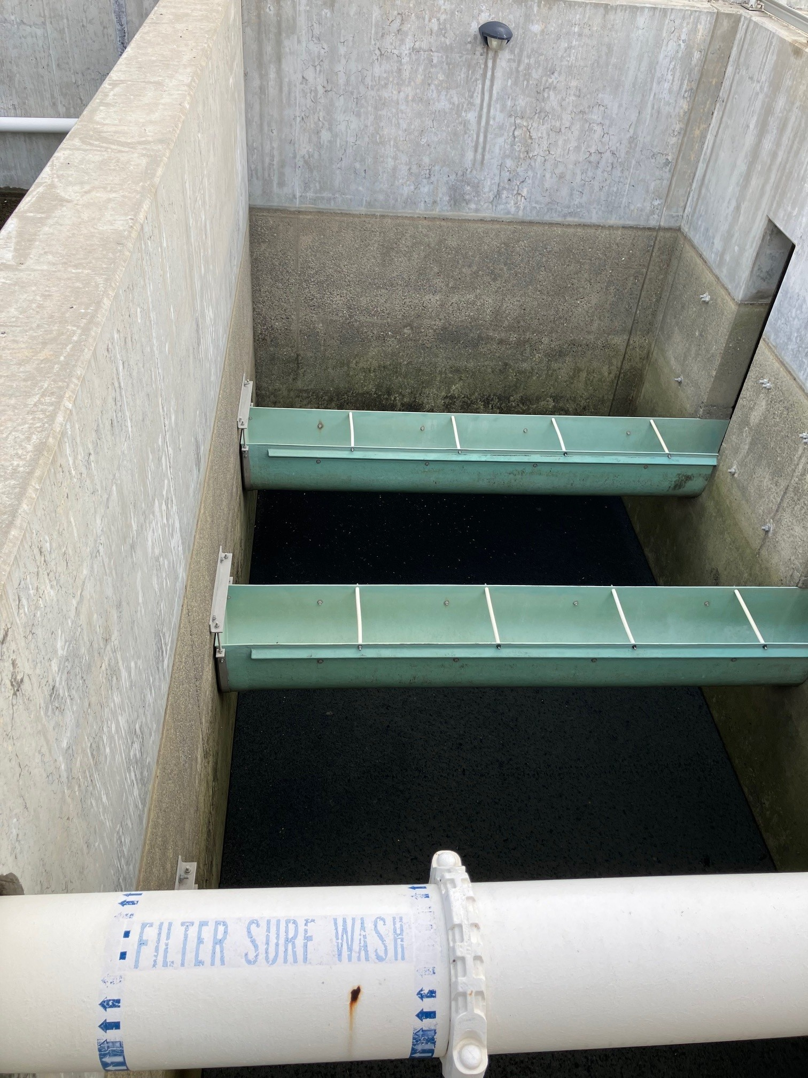
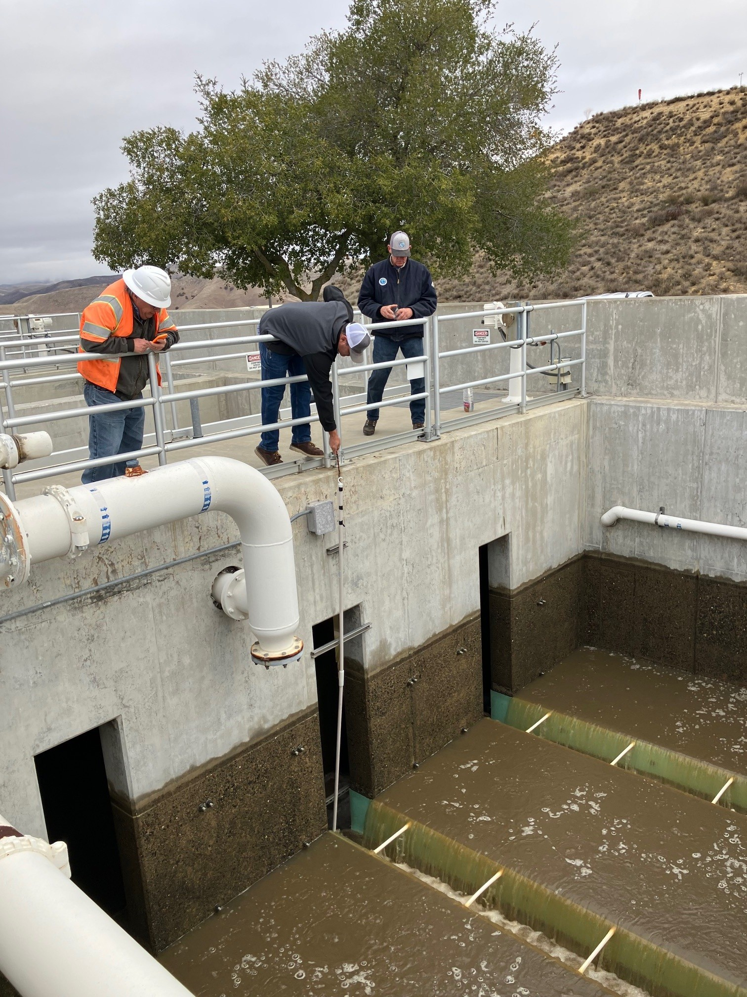
Filter Assessment

Slide 5
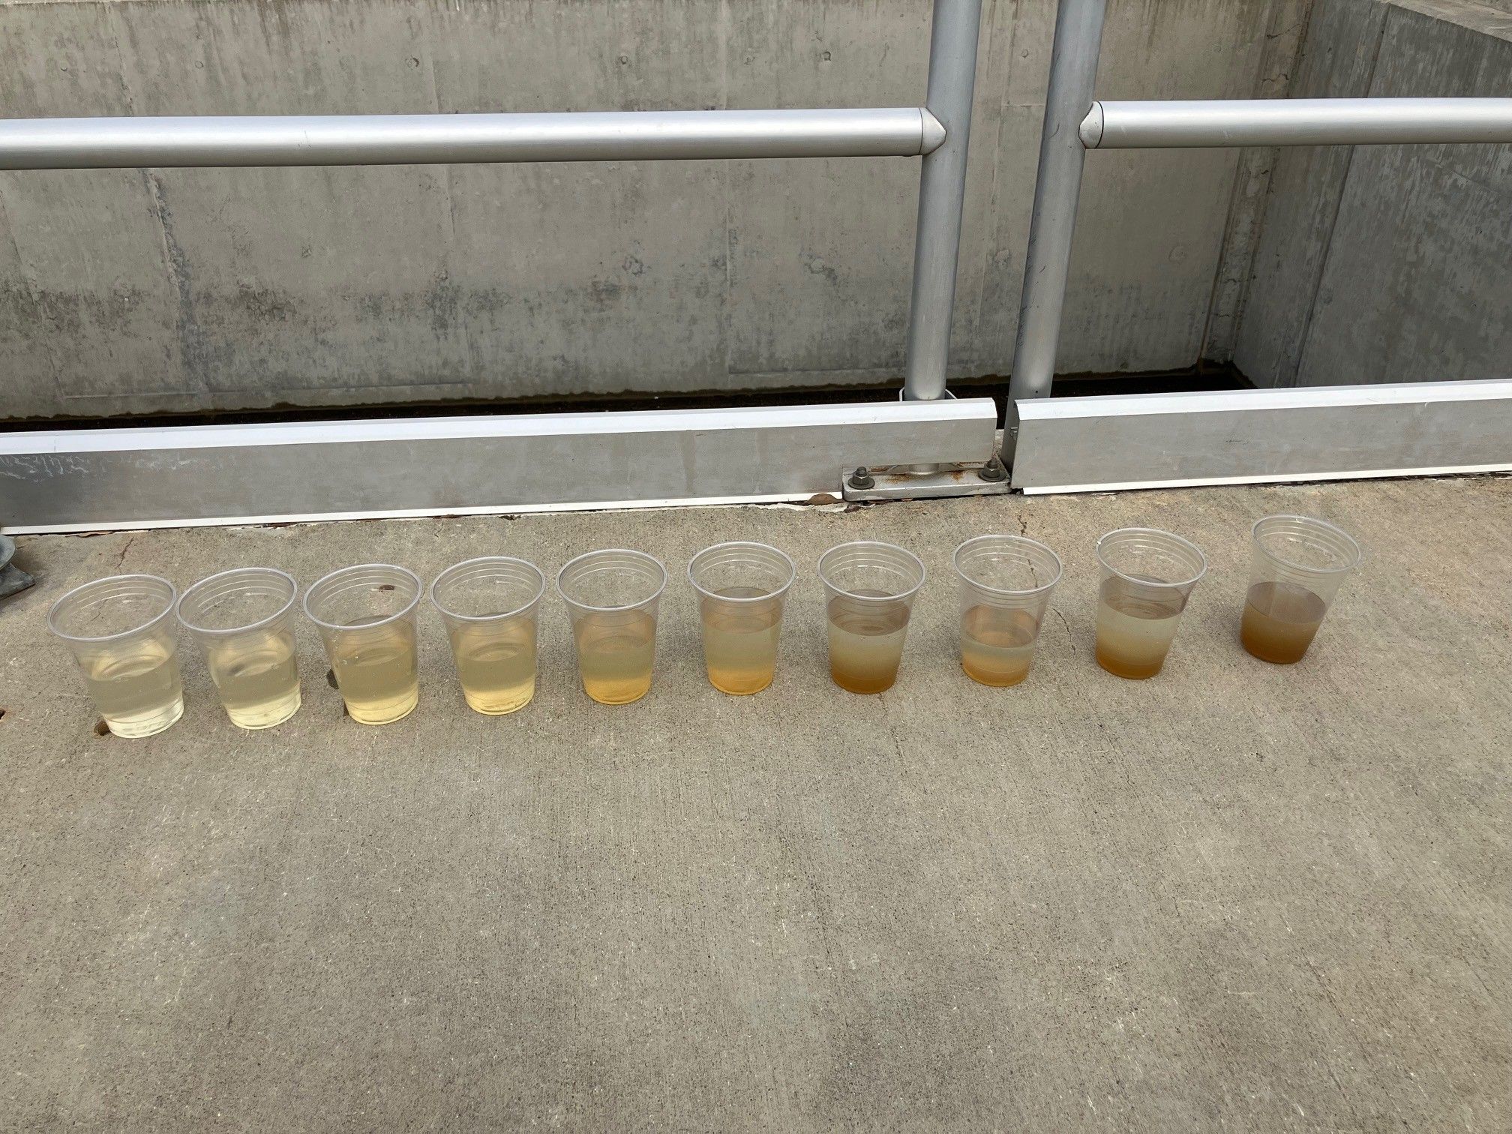
Filter Assessment

Slide 6
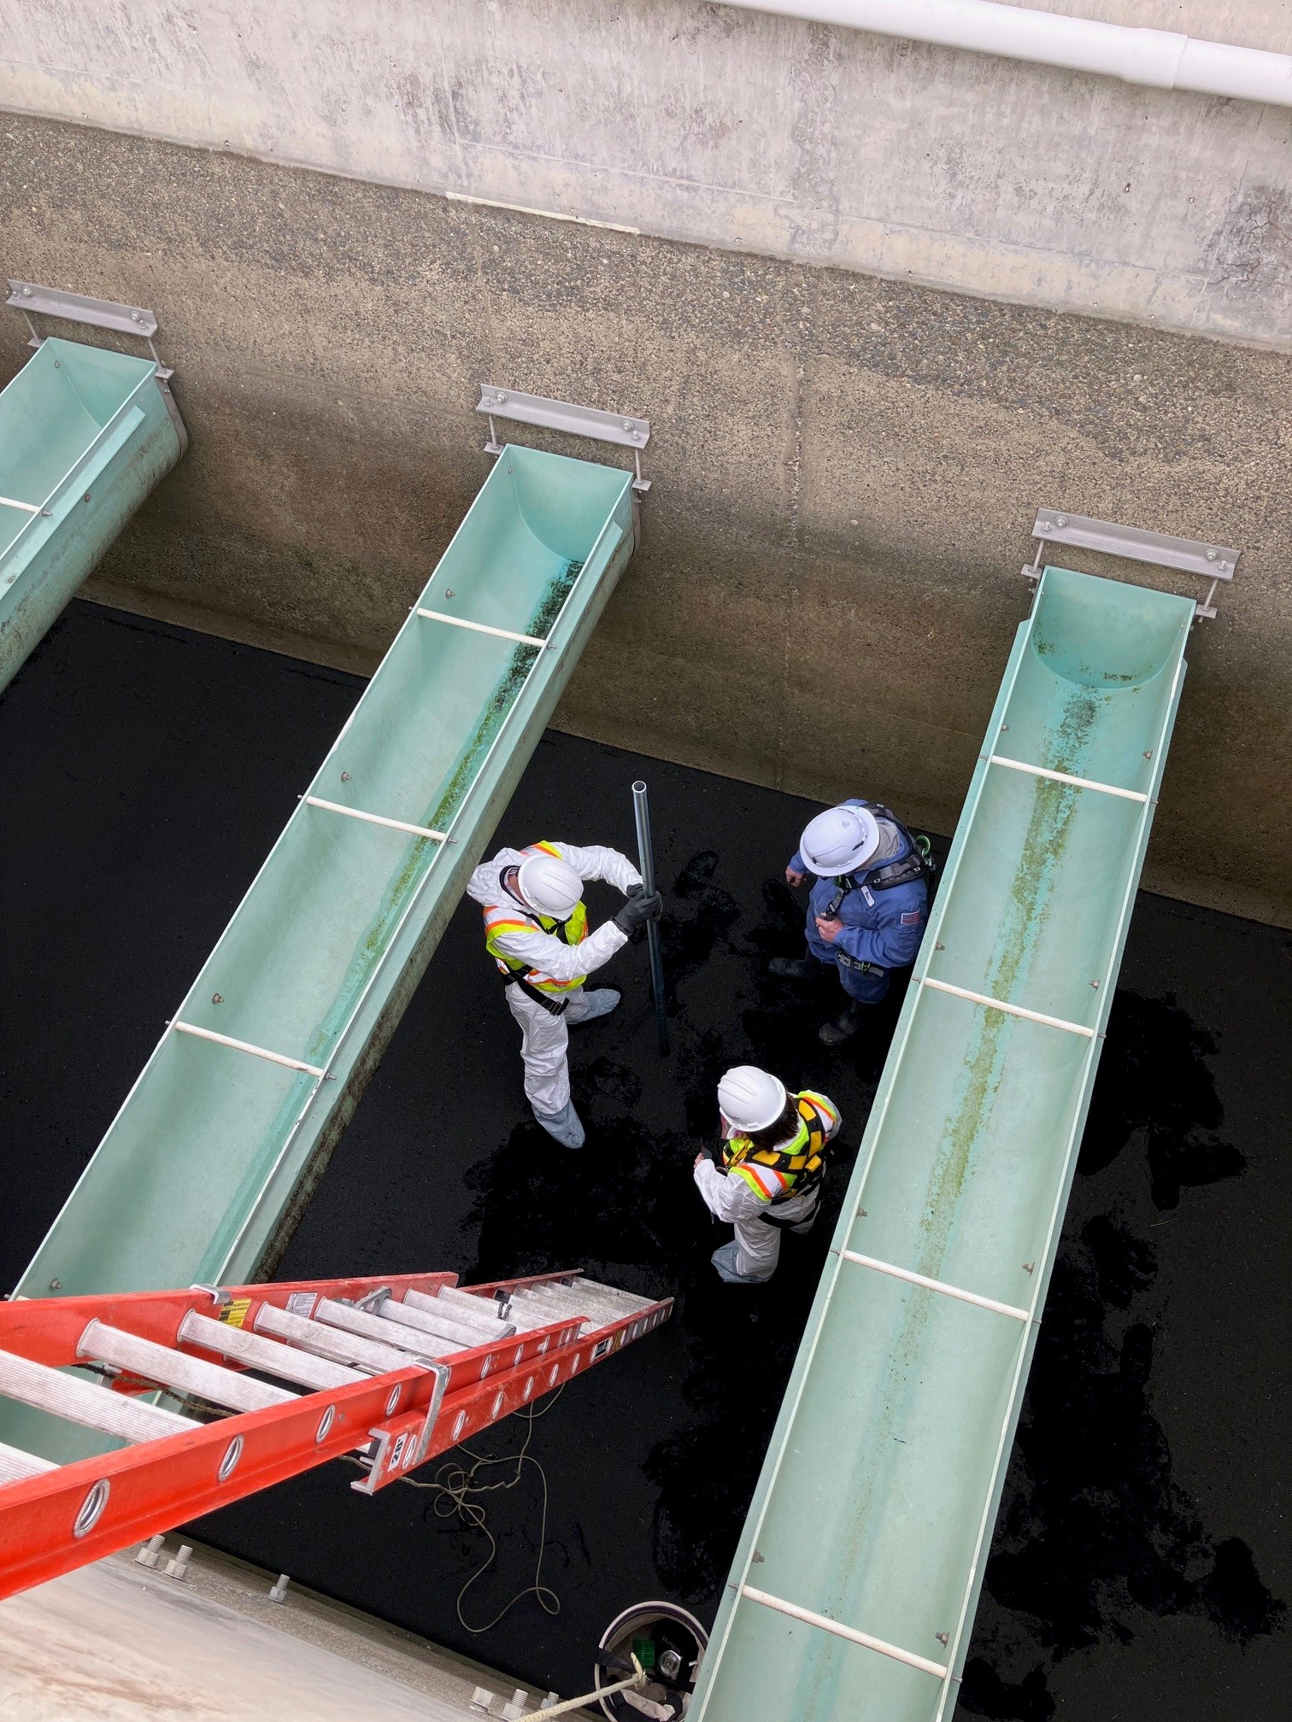
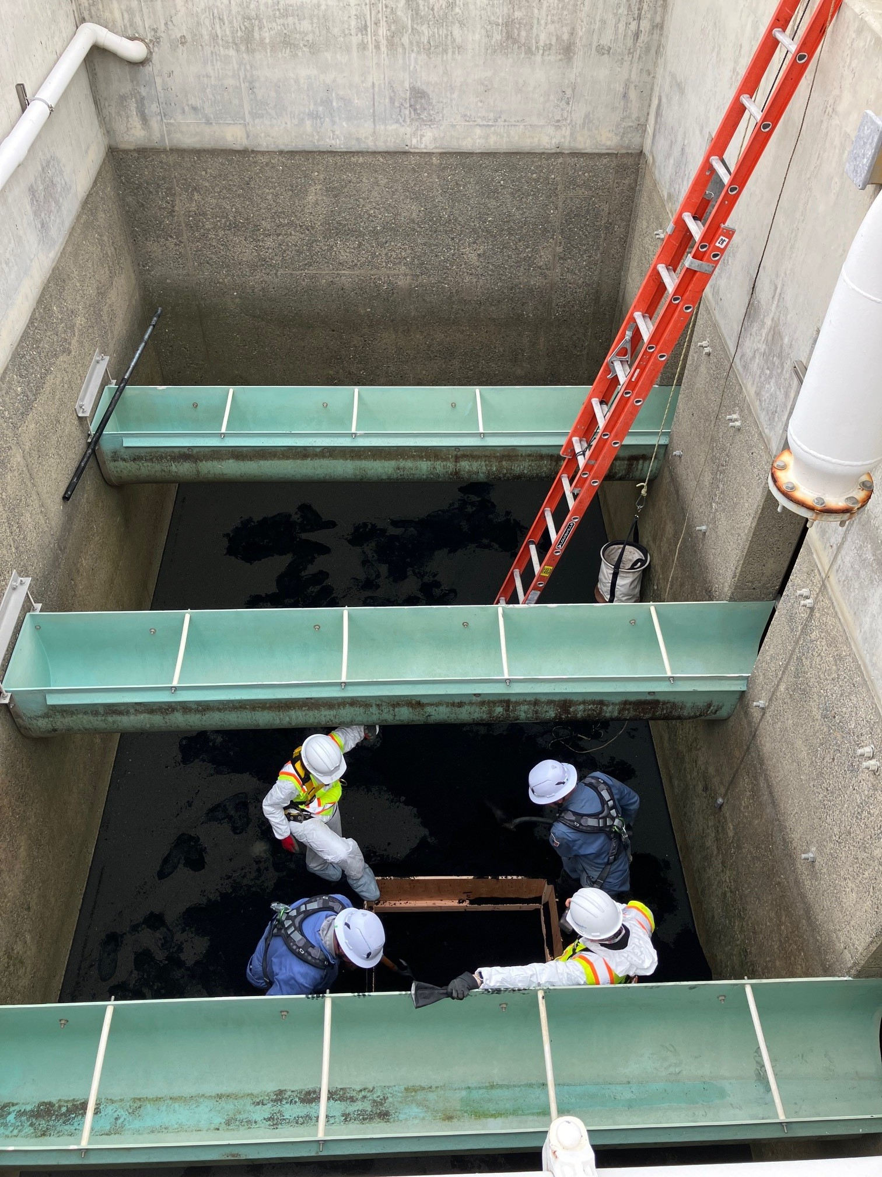
Filter Assessment

Slide 7
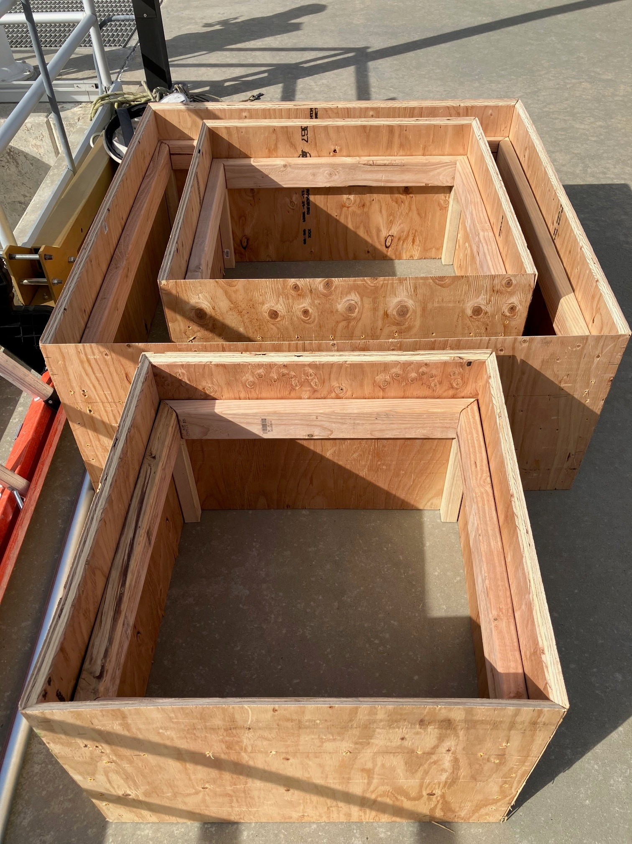
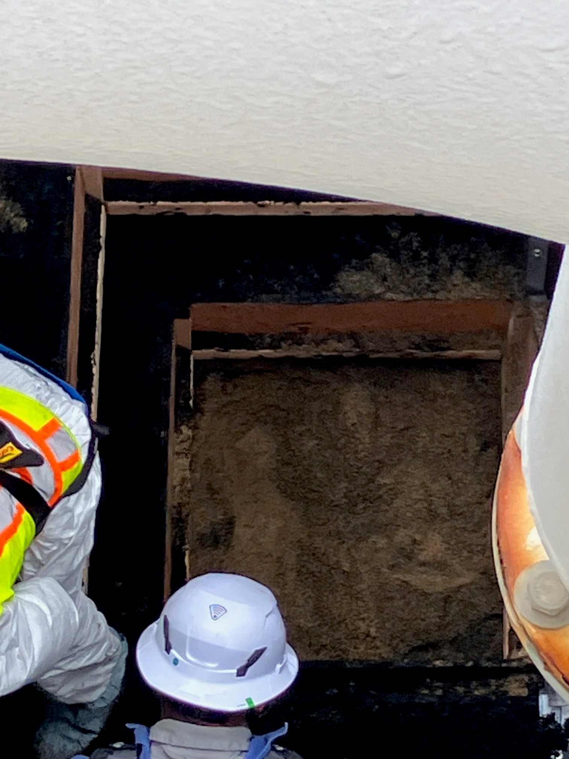
Filter Assessment

Slide 8
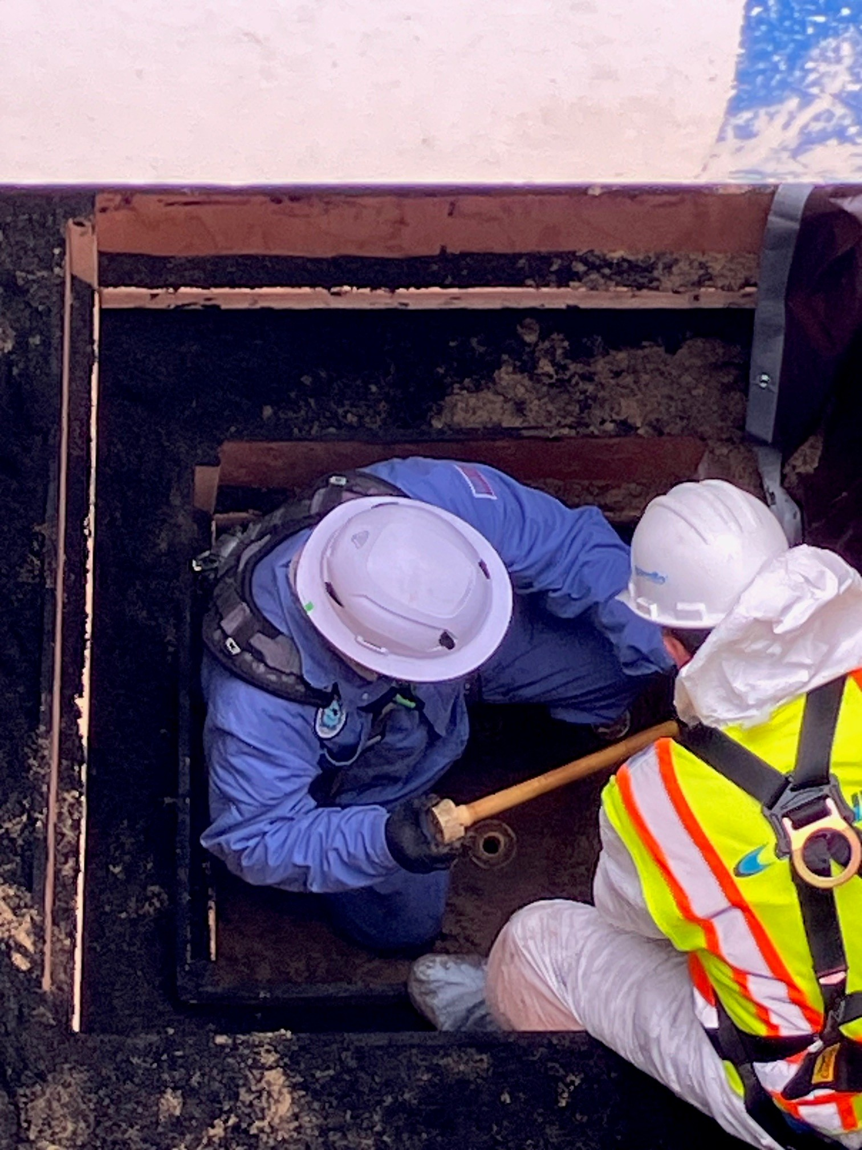
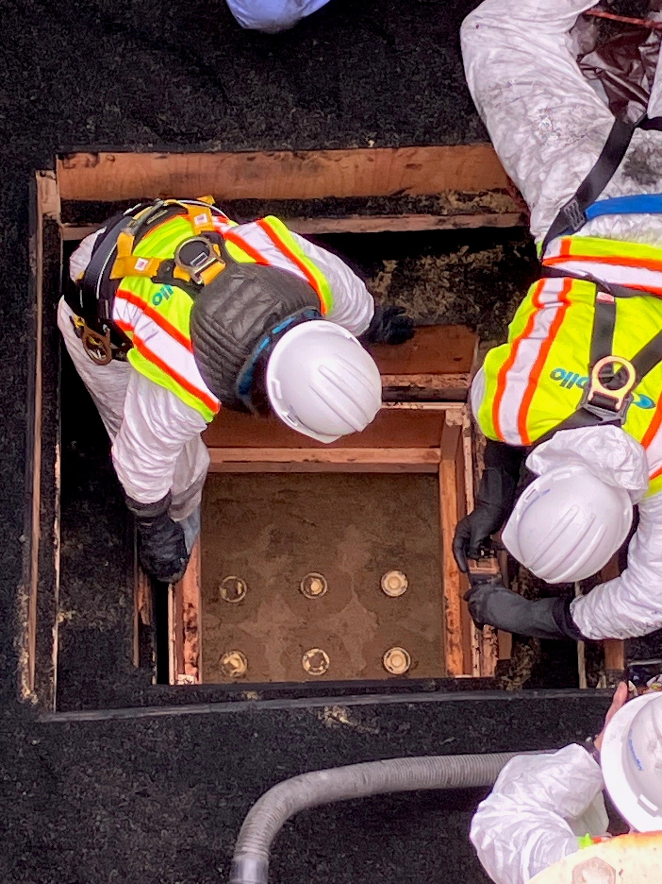
Filter Assessment

Slide 9
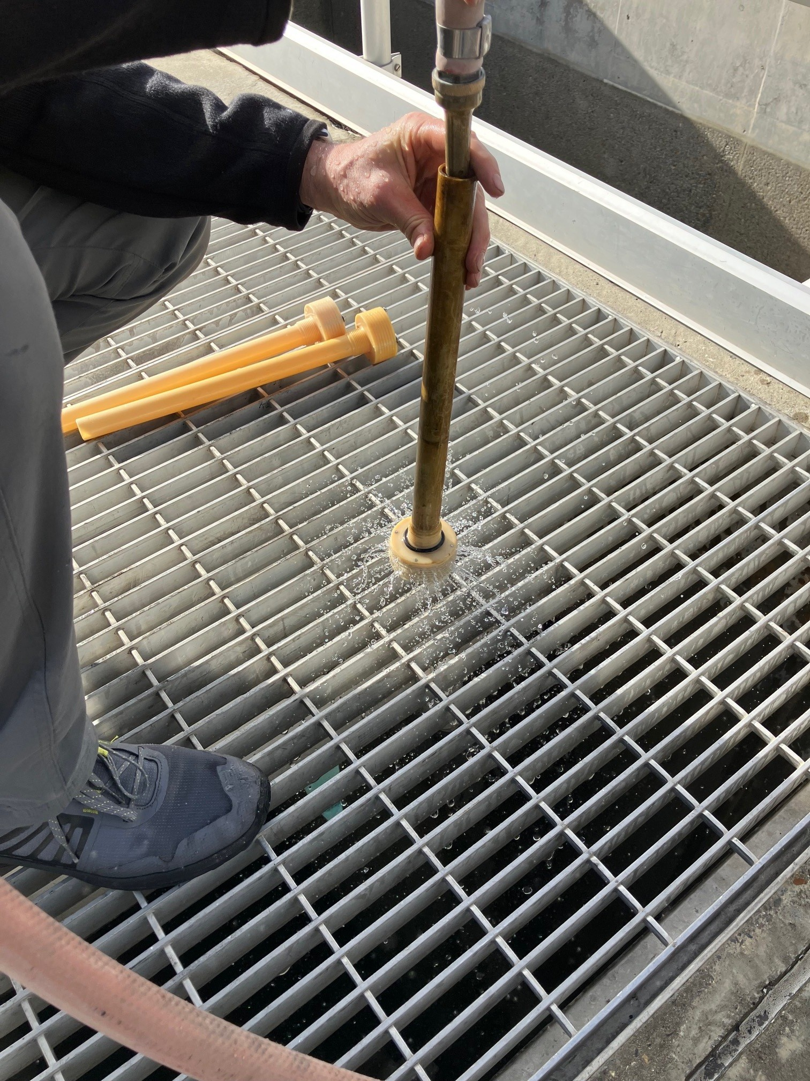
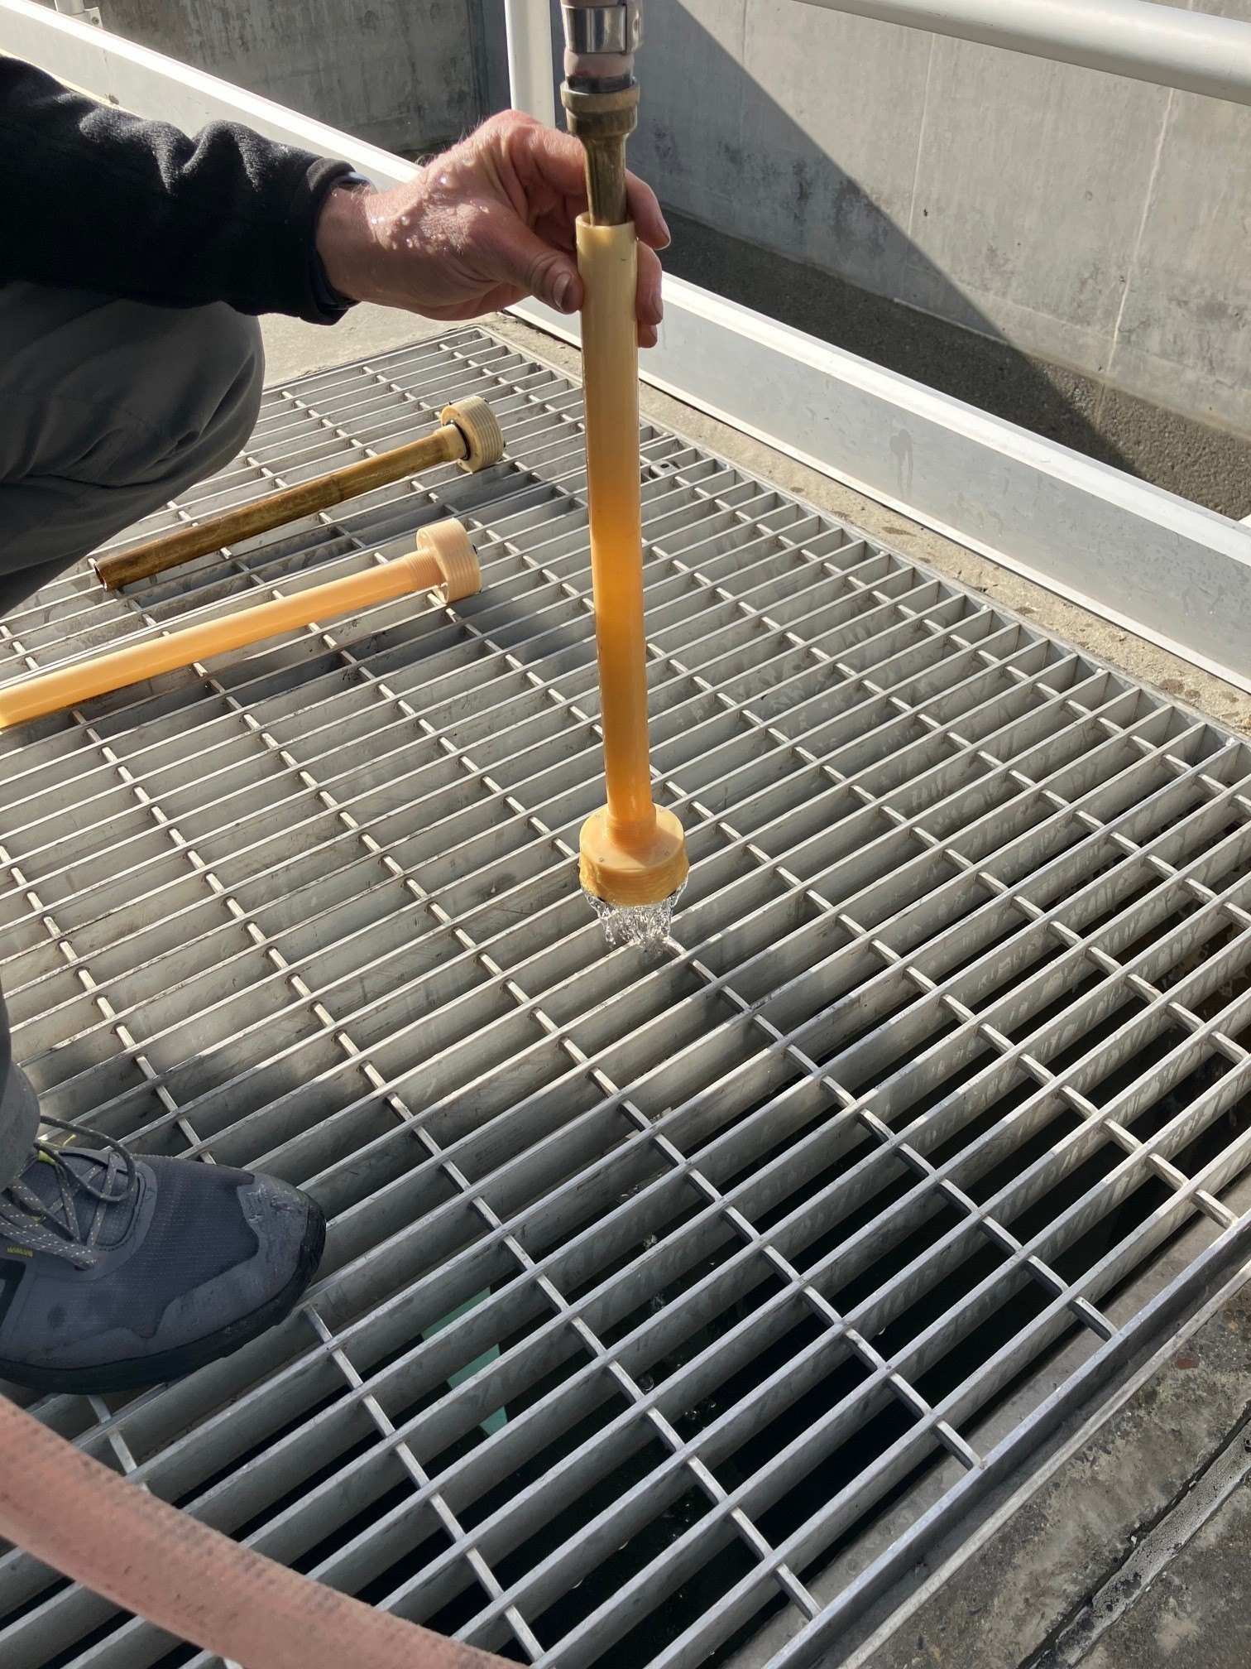
Filter Assessment

Slide 10
Water Treatment Plant Filter Assessment
Next steps include:
  Report development and backwash system head-loss analysis
  Media analysis (size, durability, specific gravity)
  Underdrain nozzle head-loss and coating analysis
  WTP treatment chemistry and desktop water quality profiling
Report will be used to inform the design of the filter multimedia and underdrain nozzle replacement project

Slide 11
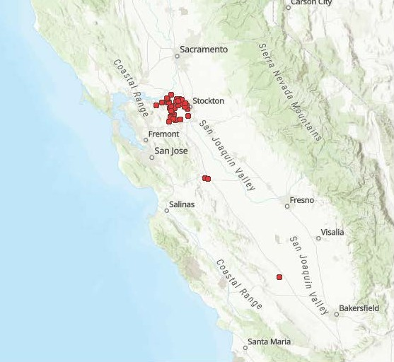
Golden Mussel Detections
March 7, 2025

Slide 12
Golden Mussel Detection in Coastal Branch
In February a colony of golden mussels was discovered in the Coastal Branch at Las Perrillas Pumping Plant
DWR is conducting additional inspections to determine the extent of their spread
CCWA has not observed any golden mussel colonies at the WTP
The WTP is an effective built-in control to remove golden mussel veligers from source water and prevent passage downstream to CCWA and/or CCWA Participant facilities

Slide 13
Golden Mussel Detection in Coastal Branch
DWR is developing plans to mitigate golden mussel colonies in SWP facilities upstream of the Coastal Branch, such as the O’Neil Forebay, Skinner Fish Facility and Dos Amigos Pumping Plant
There are not any immediate operational impacts to the Coastal Branch
Additional maintenance tasks are expected because of the golden mussel colonization

Slide 14
General Items
Projects/Design Work
  Mesa Verde Road survey and design
  Tank 7 access road design
  Electrical vehicle charging station design
  EDV Hydraulic Package Replacement bid opening
  Corroded Riser Replacement Project bid preparation
  Nipomo Dosing Facility power pole and security fence installation
2025 Coastal Branch outage planning
Staffing Updates
  Maintenance/Instrumentation Calibration and Repair Technician Recruitment
  Water Distribution Technician Recruitment

Slide 15


