Slide 1

Water Supply Situation Report
CCWA Board of Directors Meeting
March 27, 2025

Slide 2
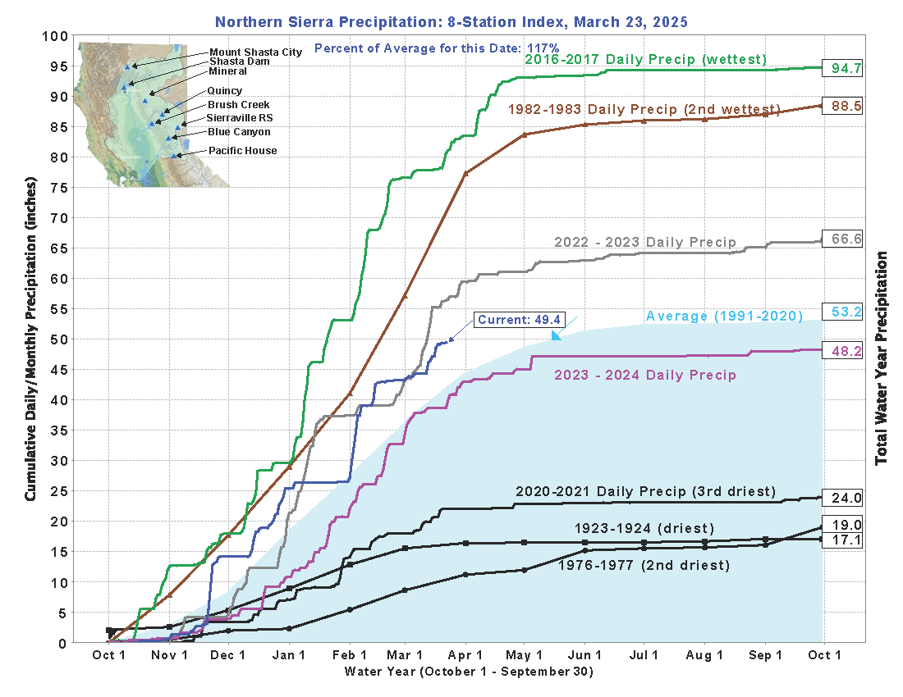

Slide 3
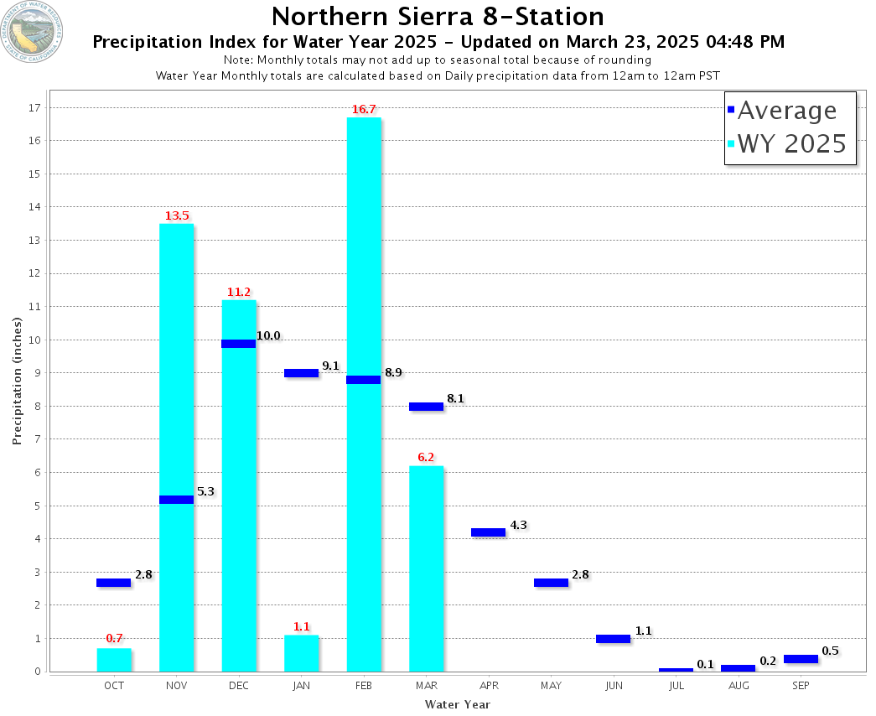

Slide 4
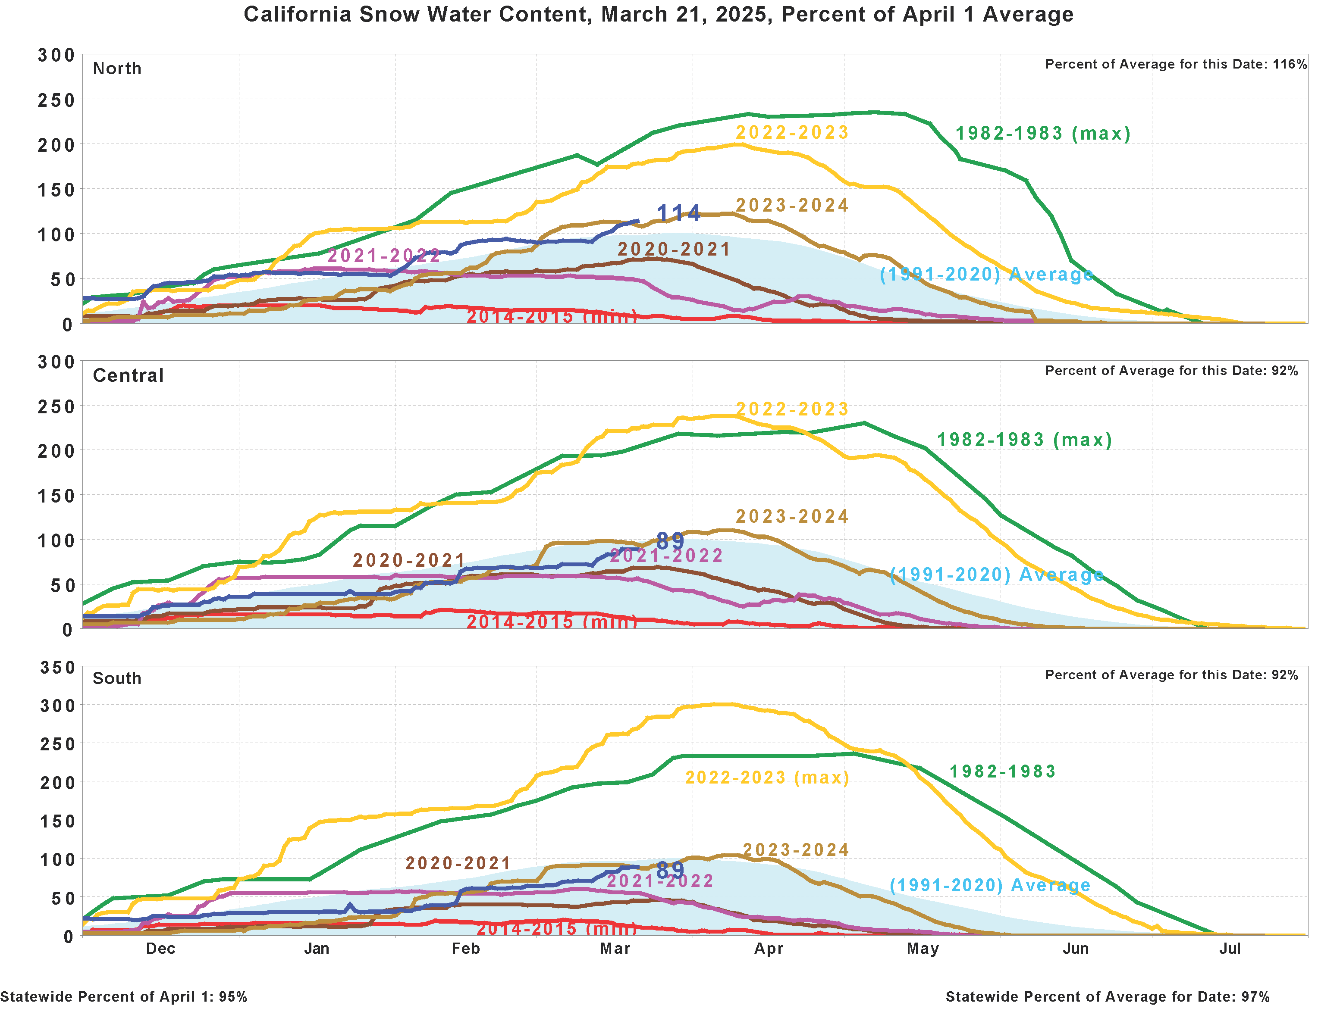

Slide 5
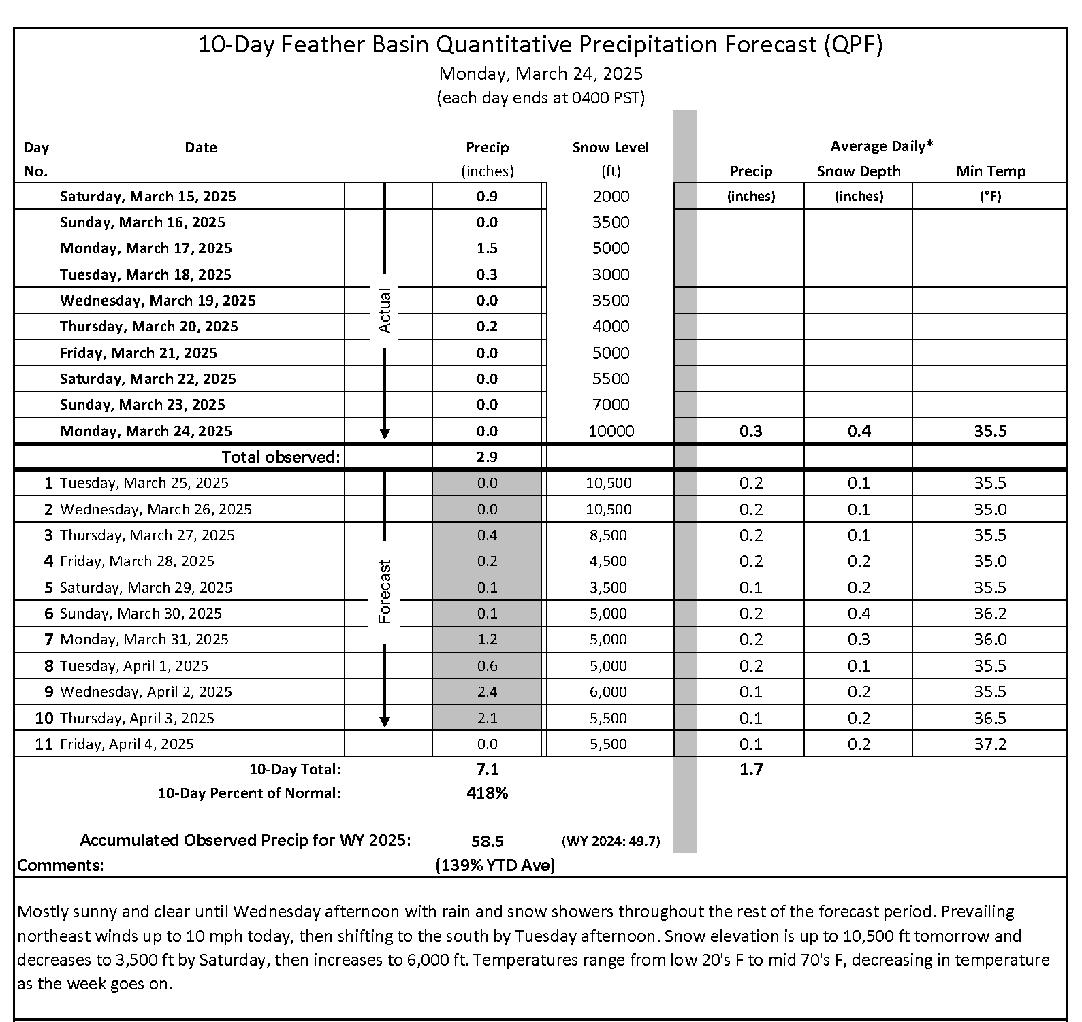

Slide 6
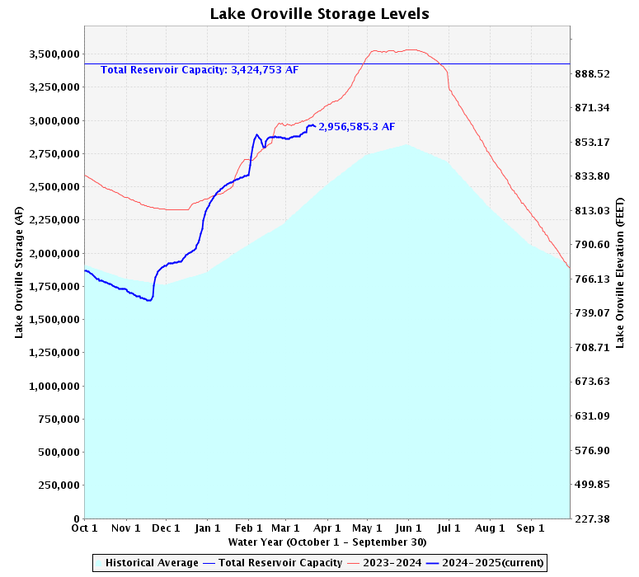

Slide 7
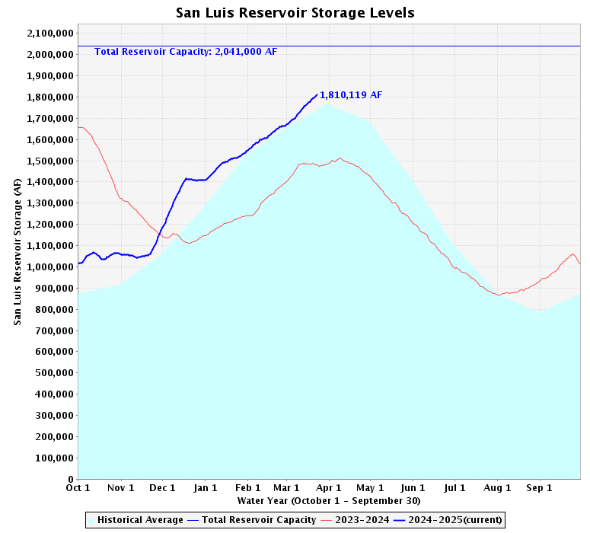

Slide 8
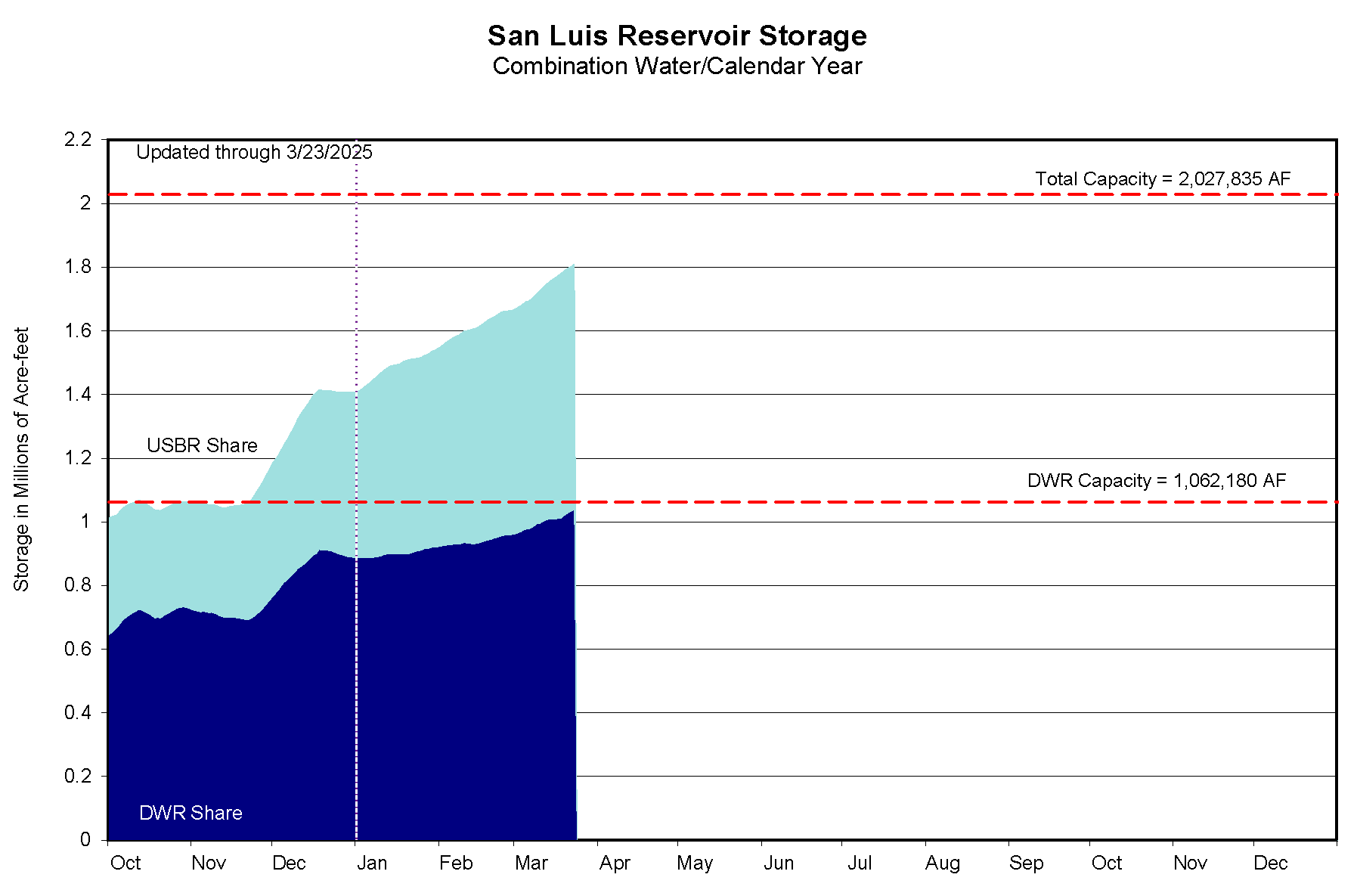

Slide 9
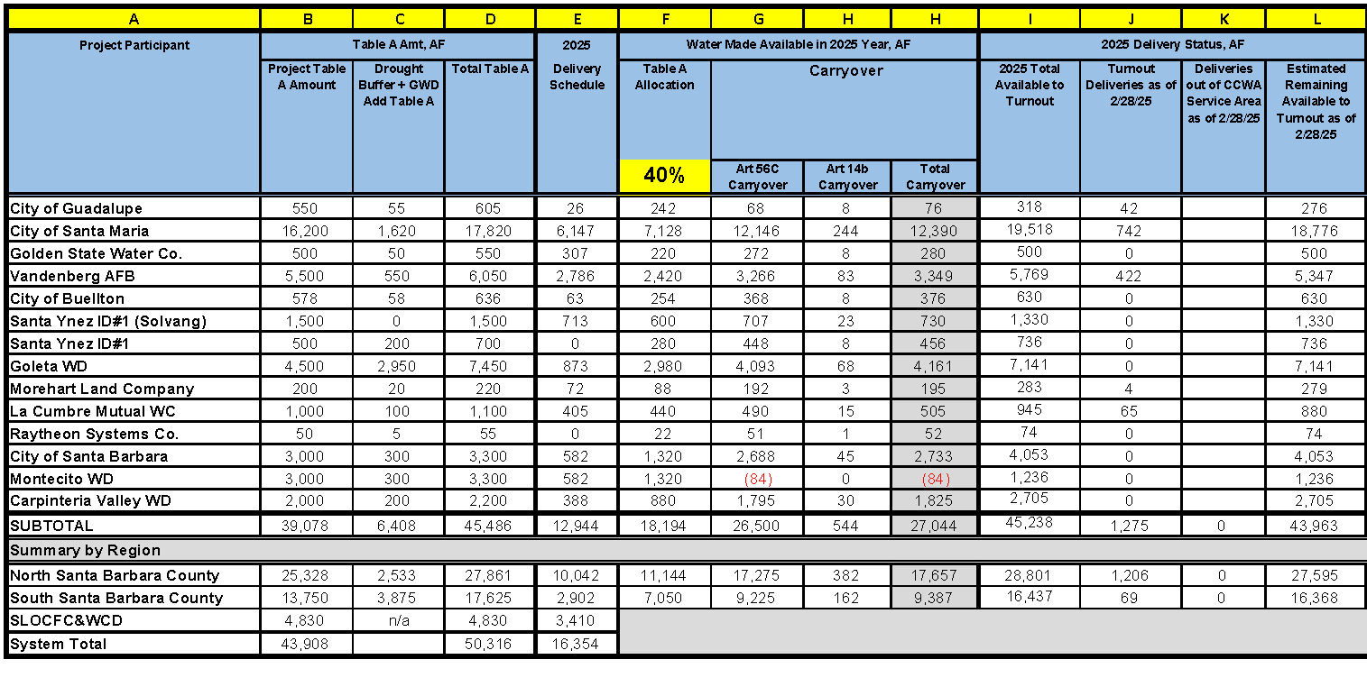
2025 Water Delivery Status Report

Slide 10
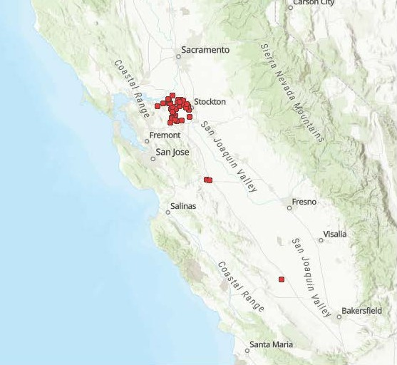
Golden Mussel Detections
March 26, 2025

Slide 11
Golden Mussel Detection in Coastal Branch
In February a colony of golden mussels was discovered in the Coastal Branch at Las Perrillas Pumping Plant
DWR is conducting additional inspections to determine the extent of their spread
CCWA has not observed any golden mussel colonies at the WTP
The WTP is an effective built-in control to remove golden mussel veligers from source water and prevent passage downstream to CCWA and/or CCWA Participant facilities

Slide 12
Golden Mussel Detection in Coastal Branch
DWR is developing plans to mitigate golden mussel colonies in SWP facilities upstream of the Coastal Branch, such as the O’Neil Forebay, Skinner Fish Facility and Dos Amigos Pumping Plant
There are not any immediate operational impacts to the Coastal Branch
Additional maintenance tasks are expected because of the golden mussel colonization

Slide 13


