Slide 1
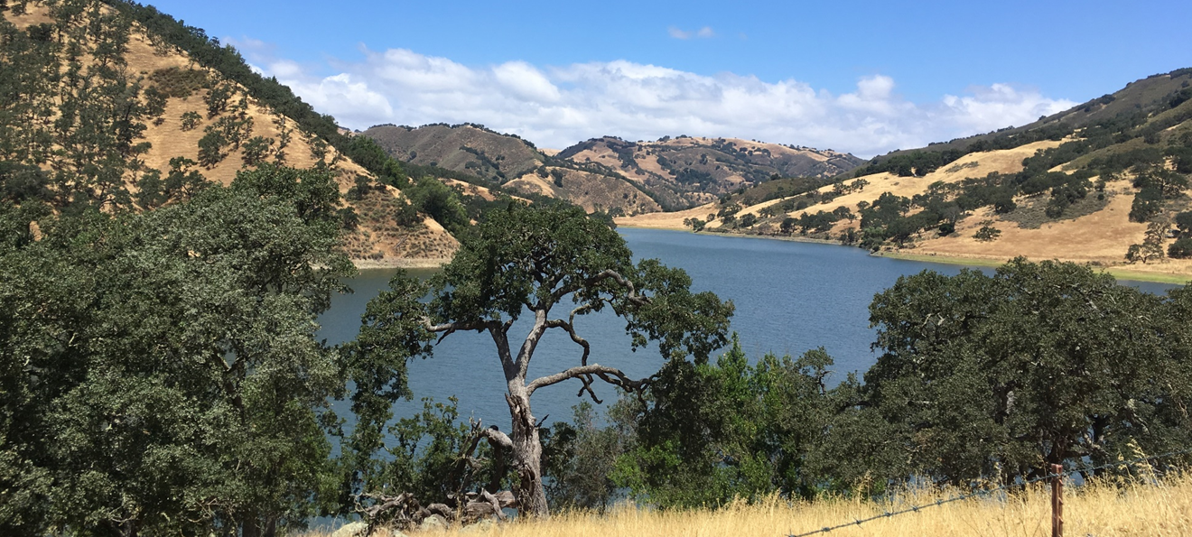
Pacheco Reservoir Expansion Project
Partnership Opportunities
January 11, 2024

Slide 2
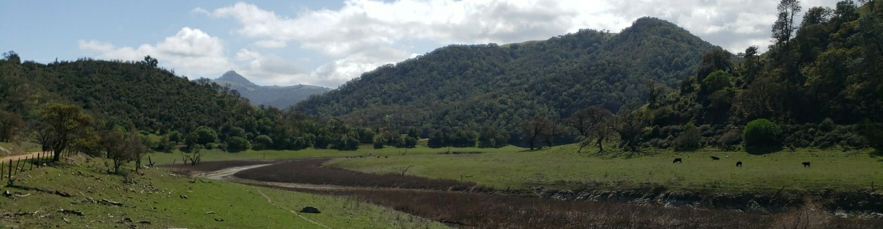
Agenda
Valley Water Background and Outlook
Pacheco Reservoir Expansion Project (PREP)
Water Market Outlook
PREP Partnership Opportunity
Discussion and Next Steps
View downstream from new dam site

Slide 3
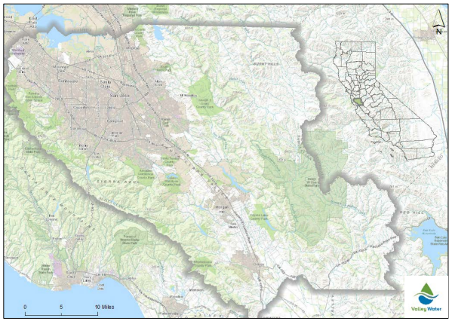
Valley Water | Background
Valley Water is an independent, special district/local agency that provides wholesale water supply, groundwater management, flood protection, and stream stewardship
Current operations include:
10 dams
17 miles of raw surface water canals
5 water supply diversion dams
393 acres of groundwater recharge ponds
91 miles of controlled in-stream recharge
142 miles of pipelines
3 drinking water treatment plants
1 advanced water purification center
3 pump stations
Valley Water Service Area

Slide 4
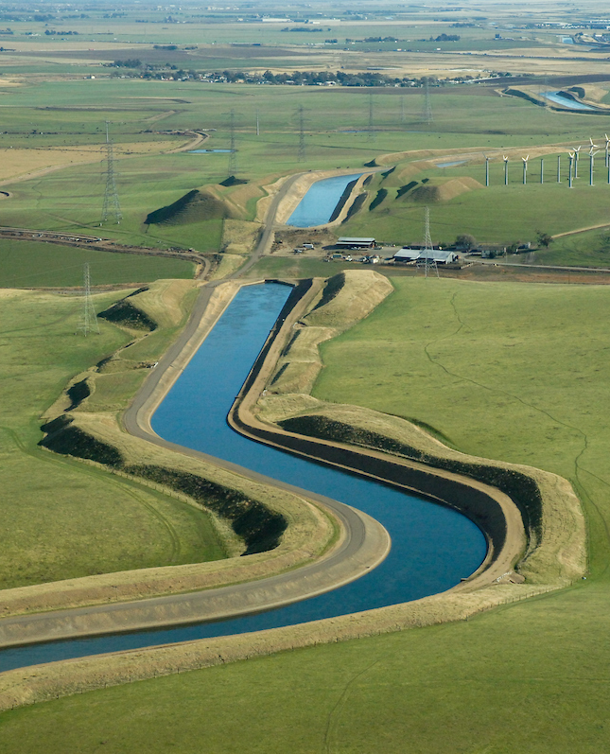
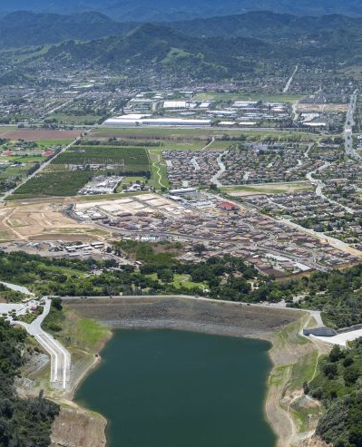
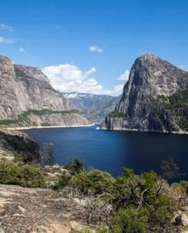
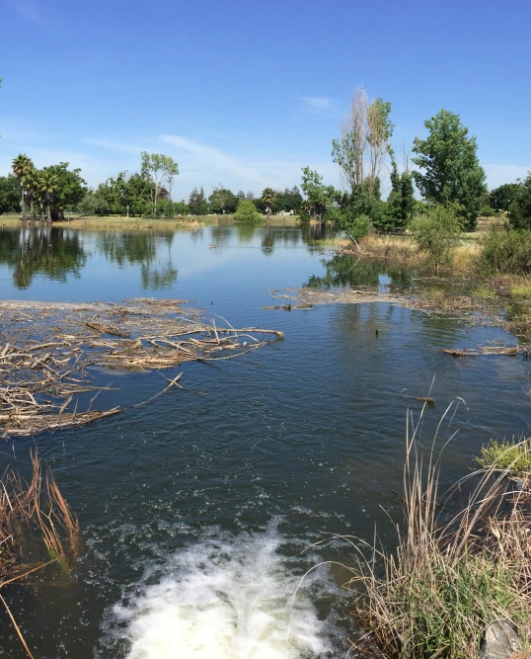
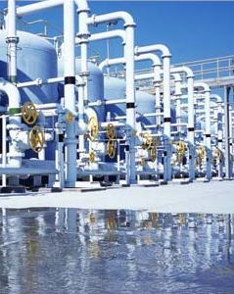
Valley Water | Supplies
Santa Clara County groundwater and surface water supplies come from five primary sources:
Central Valley Project (CVP)
& State Water Project (SWP)
Local Surface Water
San Francisco Public Utilities Commission (SFPUC)
Natural Groundwater Recharge
Recycled Water
Historical % of
Supply:
40%
25%
15%
15%
5%
Average 2020 (AF):
162,000 AF
53,000 AF
55,000 AF
61,000 AF
21,000 AF
Source: Water Supply Master Plan 2040

Slide 5
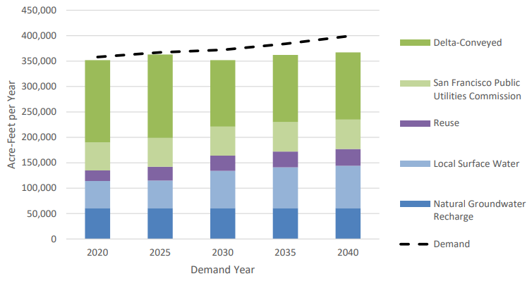
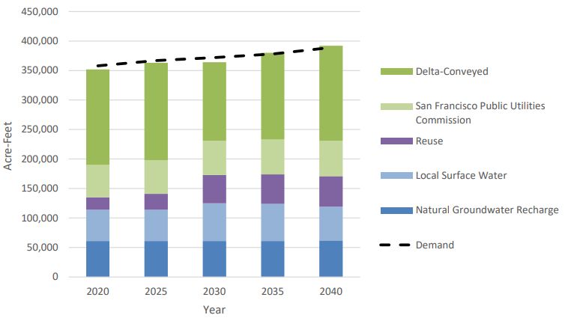
Valley Water | Outlook
Modeling for the Water Supply Master Plan 2040 indicates the baseline system will experience shortfalls in year 2030, while inclusion of Master Plan Projects, including the Pacheco Reservoir expansion, will meet water supply reliability level of service goals through 2040
Baseline System
With Master Plan Projects
Source: Water Supply Master Plan 2040

Slide 6
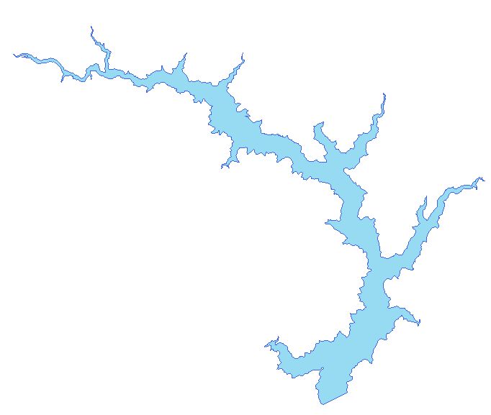
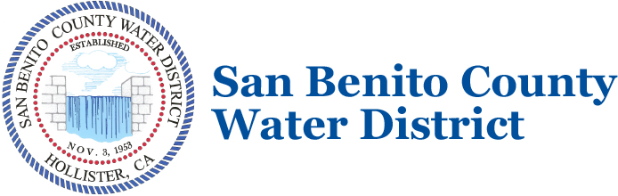
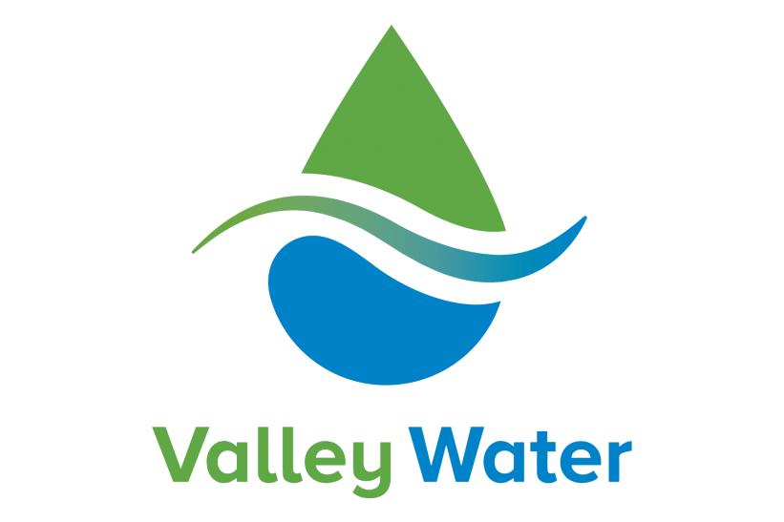
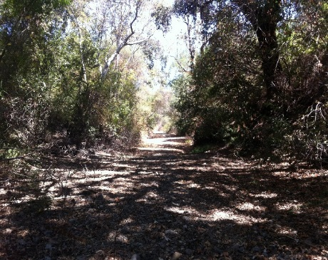
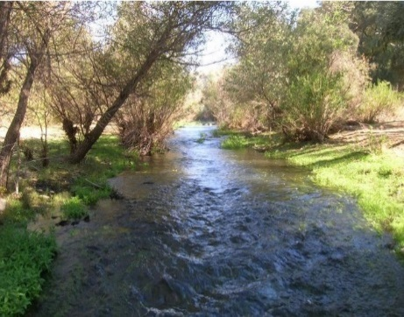
Pacheco Reservoir Expansion Project
Valley Water is investing in the Pacheco Reservoir Expansion Project (PREP) to:
Increase water supply reliability and system operational flexibility to help meet municipal and industrial (M&I) and agricultural water demands in Santa Clara and San Benito Counties during drought periods and emergencies, or to address shortages due to regulatory and environmental restrictions
Increase suitable habitat in Pacheco Creek for federally threatened South-Central California Coast (SCCC) steelhead through improved water temperature and flow conditions
Pacheco Creek in the dry season
Pacheco Creek with 10 cfs

Slide 7
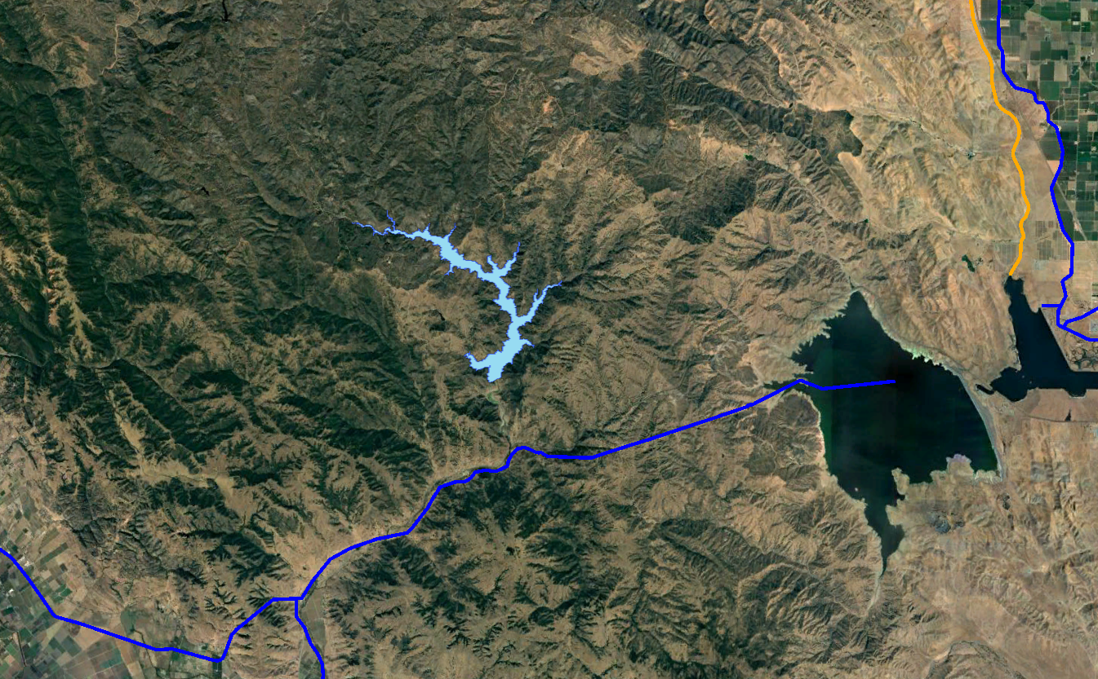
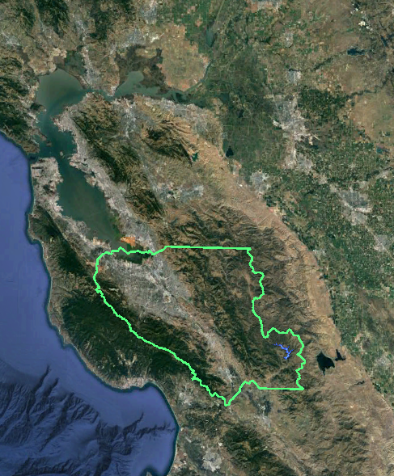
Pacheco Reservoir Expansion Project
140,000 AF Total Storage
Filled by natural inflow and CVP/SWP supplies from Pacheco Conduit
Connected to Pacheco Conduit
Existing Pacheco Conduit conveys CVP/SWP supplies from San Luis Reservoir to Valley Water and SBCWD – a new two-way connection will be built to the expanded Pacheco Reservoir
Multipurpose Use
The reservoir will be operated for water supply reliability, environmental flows, and water quality improvement
California Aqueduct
Pacheco Reservoir Expansion
Delta Mendota Canal
San Luis
Reservoir
Pacheco Conduit
To Valley Water
To SBCWD
Santa
Clara
County

Slide 8
Water Market Outlook
Future water market prices are forecast to continue increasing due to:
  Urban growth and increasing water demand.
  SGMA and increased market participation among agricultural producers growing high-valued crops.
  Reduced reliability of CVP/SWP supplies.
  Increased competition for available surface water.
Dry year prices are expected to increase faster than wet year prices.
Access to storage will become increasingly important to manage dry year water risk and cost.
* Water market prices projected using historical spot market transactions data and assuming an average critical year CVP/SWP allocation (lower bound) and the 2014 allocation (upper bound).
Projected Average Critical Year Water Market Prices ($/AF/yr)

Slide 9
PREP Partnership | Opportunity
Up to 50,000 AF of storage capacity available for Partners
Partner provides water supply to fill portion of expanded Pacheco Reservoir
Partner supplies in storage are subject to evaporative losses
Partner withdraws supplies directly or via exchange with Valley Water
50,000 acre-feet
Partners
Pacheco Pass Water District
90,000 acre-feet

Slide 10
PREP Partnership | Mechanics
Partner Water Supplies
Partner Conveyance to Storage
Conveyance to Storage
Partner water supplies would be conveyed through San Luis Reservoir and Pacheco Conduit into the expanded reservoir
California Aqueduct (CA)
Pacheco Reservoir Expansion
Delta Mendota Canal (DMC)
Withdrawal from Storage
Valley Water’s CVP or SWP supplies in the CA, DMC, or SLR would be exchanged to the partner for their stored water in the expanded Pacheco Reservoir
San Luis
Reservoir (SLR)
Pacheco Conduit
To Valley Water
To SBCWD
Partner Withdrawal
from Storage (from Valley Water CVP/SWP supplies)
To Valley Water

Slide 11
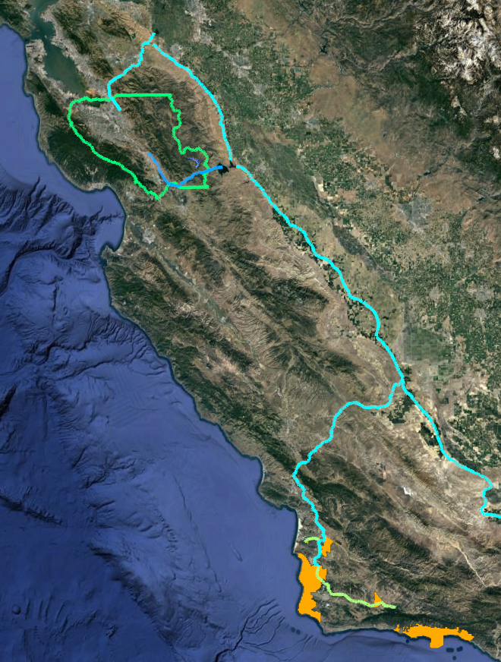
PREP Partnership | CCWA
South Bay Aqueduct
(SWP)
California Aqueduct
(SWP)
Central Coast Water Authority (CCWA) is a public entity organized under a JPA presently composed of eight members, all of which are public agencies. CCWA serves as a wholesaler of SWP water to 13 water purveyors and private companies in Santa Barbara County, and another 11 water purchasers in San Luis Obispo County.
CCWA Primary Facilities:
Polonio Pass Water Treatment Plant
Mission Hills Aqueduct Extension
Santa Ynez Aqueduct Extension
CCWA Primary Water Supply:
CCWA holds a contract to purchase up to 45,486 acre-feet of State Water Project (SWP) water per year through the Santa Barbara County Flood Control and Water Conservation District
Transfers from other SWP contractors
Limited ability to take Article 21 Water
Pacheco Reservoir
Expansion
San Luis Reservoir
(CVP and SWP)
Santa Clara County/
Valley Water
Service Area
Pacheco
Conduit (CVP)
Coastal Branch Aqueduct
(SWP)
CCWA Member
Agencies
Mission Hills/Santa Ynez Aqueduct Extension
(CCWA)
Sources: https://www.ccwa.com/member-agencies, https://www.ccwa.com/files/2ef736ded/FY2023and2022ACFR.pdf, https://www.slocounty.ca.gov/Departments/Public-Works/Forms-Documents/Projects/State-Water-Project-Water-Management-Tools-Study/2021-12-17-Coastal-Branch-WMS-Draft.pdf, https://www.ccwa.com/files/eaafa278c/Board+Report-Aquaterra+Water+Bank+Information-October+2022.pdf
Notes:
Central Coast Water Authority is presently composed of eight members, all of which are public agencies: the Cities of Buellton, Guadalupe, Santa Barbara and Santa Maria, Carpinteria Valley Water District, Goleta Water District, Montecito Water District and Santa Ynez River Water Conservation District, Improvement District No. 1 (in which the City of Solvang is located). Each member appoints a representative to the Authority’s Board of Directors.
The primary purpose of the Authority is to provide for the development, financing, construction, operation and maintenance of certain local (non‐state owned) facilities required to deliver water from the State Water Project ("SWP") to certain water purveyors and users in Santa Barbara County.
Typically, CCWA is not able to take delivery of Article 21 water because it occurs in a very low demand period for our Project Participants and we do not currently have the ability to store Article 21 water when it is made available.

Slide 12
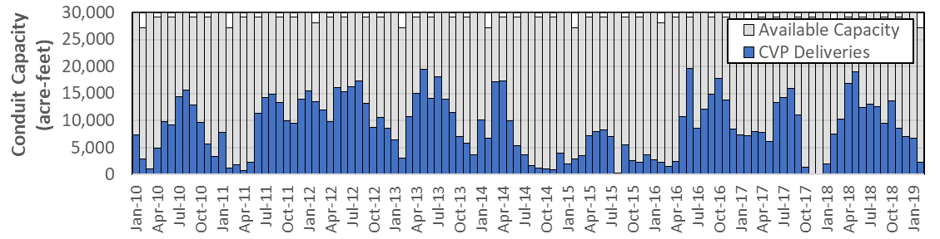
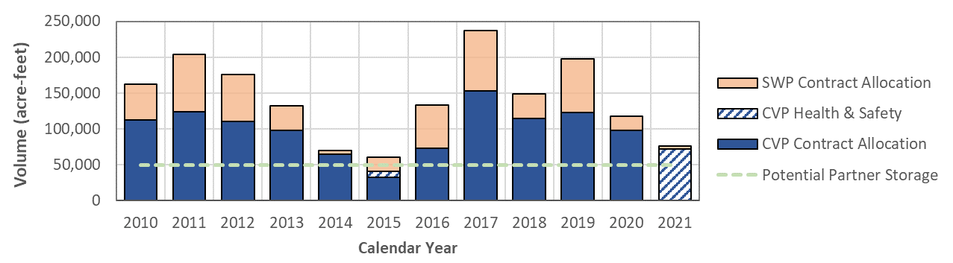
PREP Partnership | Reliability
Adequate wet year capacity to convey Partner water to PREP
30,000 AF monthly maximum capacity in Pacheco Conduit (490 cfs)
Monthly Capacity in Pacheco Conduit: 2010 - 2019
Reliable Partner water return via exchange with Valley Water supplies
Annual CVP M&I/Ag + CVP Health and Safety minimum + SWP: exceeds full Partner storage capacity
Annual CVP and SWP Deliveries to Valley Water: 2010 - 2021
*
*
*Public Health and Safety water was provided in two of the last 12 years. Consistent with the Reclamation M&I shortage policy, exchanges of Valley Water Public Health and Safety Minimum water would be subject to Reclamation approval on a case-by-case basis.
Source: Valley Water Annual PAWS Report

Slide 13
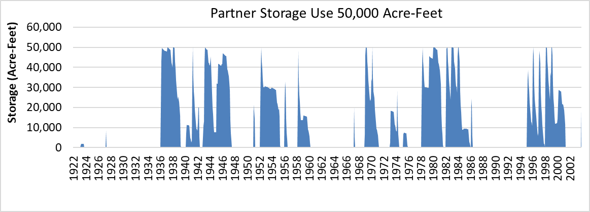


PREP Partnership | Opportunity
What modeling tools are available for decision support to Partners?
Combination of system operations models (CalSim II, WEAP) and internal Valley Water tools that simulate Valley Water and Partner operations throughout an 82-year period based on the following inputs:
Sources of Supply
Priorities and Constraints
Demand Patterns
Modeled Operations
Project Water
(CVP or SWP)
Inputs
Conveyance
M&I
Storage
Storage
Non-storable Water (e.g., Section 215/Article 21)
Ag
Withdrawals
Delta Exports
Refuges
Evaporation
Non-Project Water
Exchanges
Yield

Slide 14
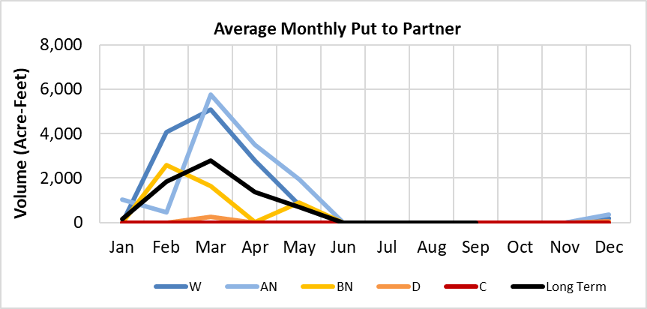
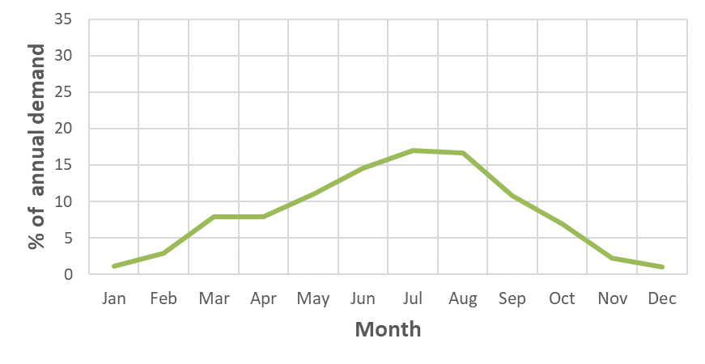
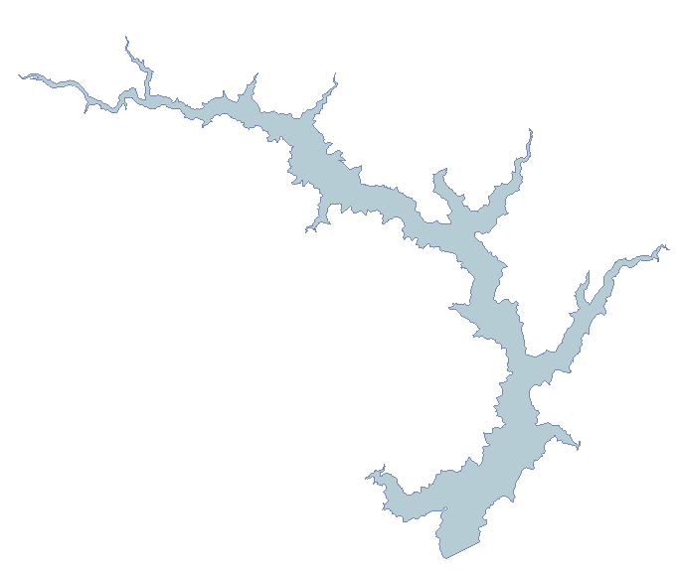
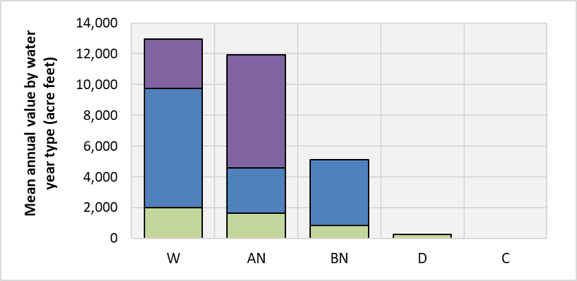
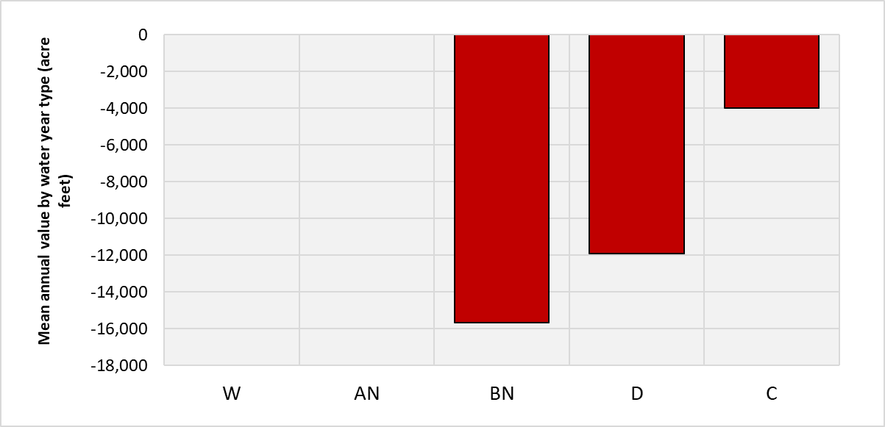
Preliminary Information Needed
Source of
CCWA
Water Supply
Timing of Conveyance to Storage
Timing
of
Withdrawals
Desired Ownership Model and Term
Project Water
(e.g., SWP)
Monthly
Monthly
Own or Rent
Non-Storable Water (e.g., Article 21)
Annual/Water Year Type
Annual/Water Year Type
Non-Project Water (e.g., pre-1914)
<30
Partner
50
100
100 years
Other
Project Life

Slide 15
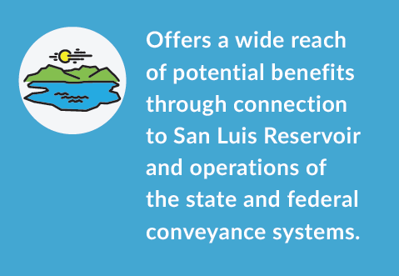
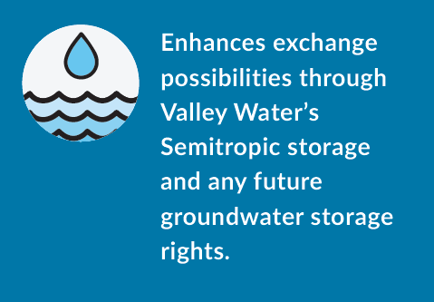
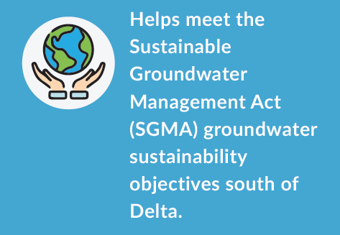
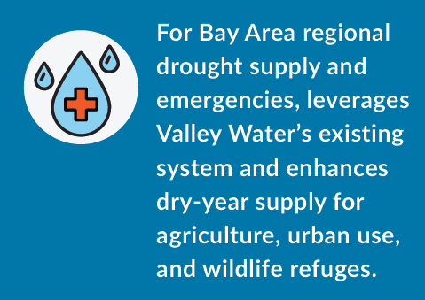
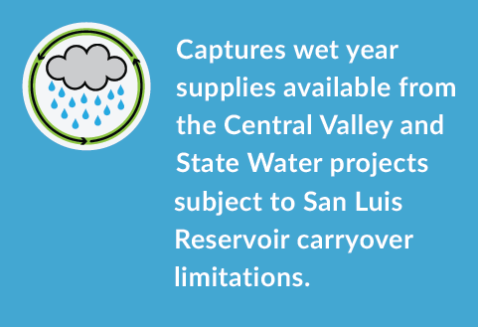
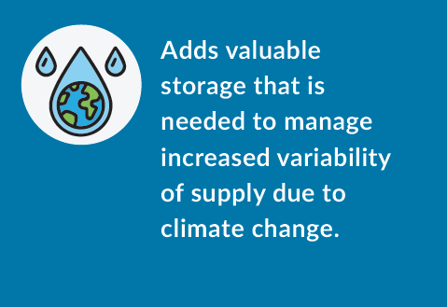
Value to Potential PREP Partner
Offers a wide reach of potential benefits through connection to San Luis Reservoir and operations of the state and federal conveyance systems.
Enhances exchange possibilities through Valley Water’s Semitropic storage and any future groundwater storage rights.
Helps meet Sustainable Groundwater Management Act (SGMA) groundwater sustainability objectives South of Delta.
For drought supply and emergencies, leverages Valley Water’s existing system and enhances dry-year supply for agriculture, urban use, and wildlife refuges
Captures wet year supplies available from the Central Valley Project and State Water Project subject to San Luis Reservoir carryover limitations.
Adds valuable storage that is needed to manage increased variability of supply due to climate change.

Slide 16
PREP Costs
The preliminary construction cost estimate based on 30% design is $2.0 billion* to be funded from multiple sources:
California’s Proposition 1 Water Quality, Supply and Infrastructure Improvement Act of 2014
Partner
Construction Cost*
$0.5 billion
$1.5 billion
Other Potential Partner Costs
PREP Operations and Maintenance
Proportion of San Felipe Division Federal Facility Repayment
Source of Supply
Exchange/ Conveyance Cost
* Reflects construction and non-contract costs in 2022$

Slide 17
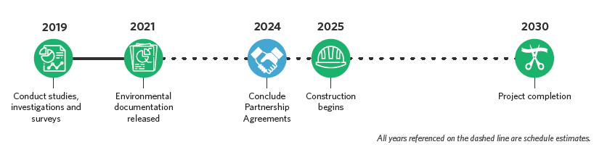
PREP Timeline
Valley Water is continuing to conduct investigations and surveys to design and evaluate feasibility and potential environmental impacts but anticipates construction will begin in 2027.
2019
2021
2026
2027
2027
2035
(Draft)
(Final)

Slide 18
Discussion and Next Steps
Phase | Initial Outreach | Data/Information Exchange | Initial Negotiations | Partner Due Diligence
Objective | Introductory meeting with Partner and discussion of Partner needs | Exchange background information to support Partner quantitative analysis | Preliminary agreement terms, conditions, and operations with Partner | Due diligence period (e.g., 3 months) for Partner to assess opportunity
Successful Outcome | Partner provides non-binding expression of interest to support further discussions | Valley Water and Partner initiate modeling and analysis of Partner use of reservoir | Valley Water and Partner prepare an indicative agreement (i.e., term sheet) | Valley Water and Partner prepare a draft agreement

Slide 19

QUESTIONS

Slide 20


