Slide 1
Paso Robles Subbasin Conceptual Exchange Program
March 13, 2025

Slide 2
Paso Basin SWP Supplemental Supply and Exchange Opportunities
Paso Basin SWP Supplemental Supply Study
Potential Exchange Program
Opportunities for Coordination with CCWA

Slide 3
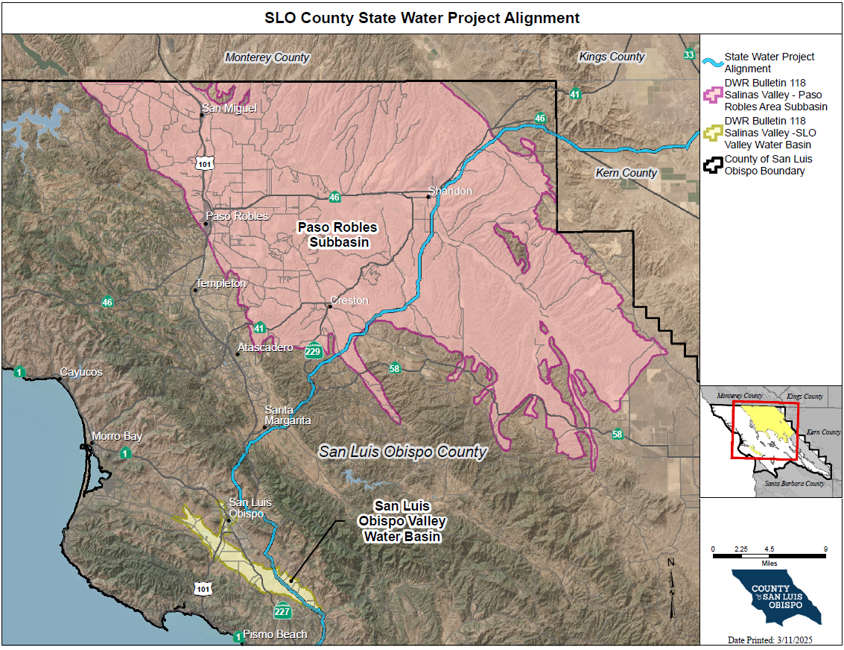

Slide 4
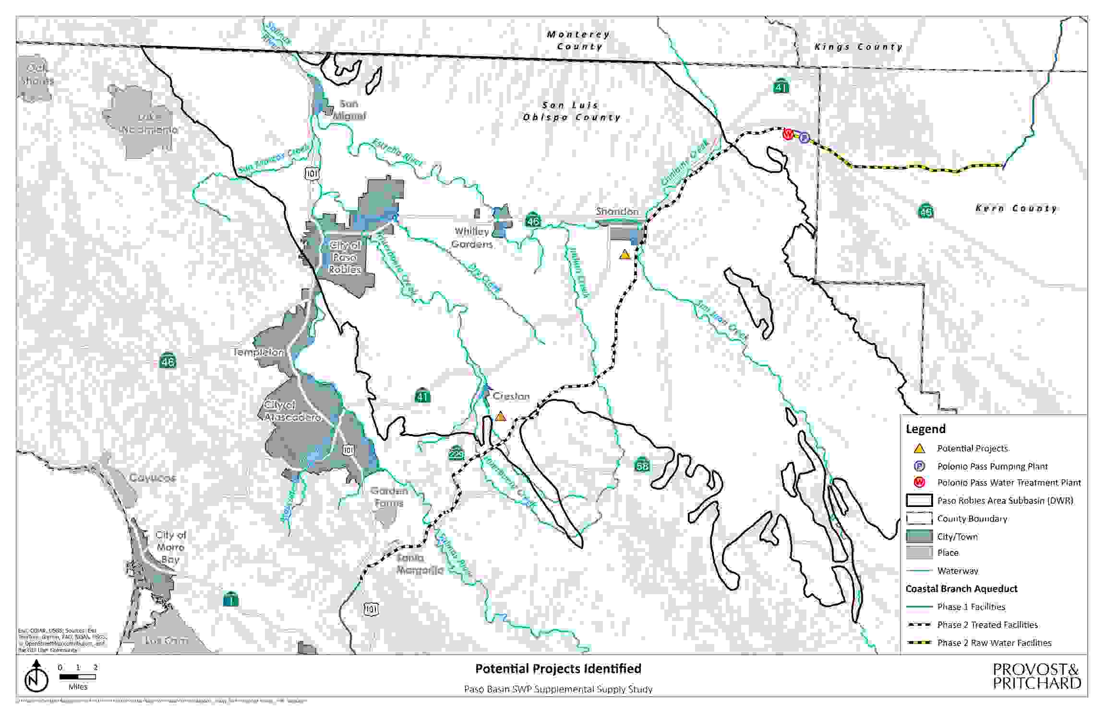
Paso Basin SWP Supplemental Supply Study
Evaluate use of SLO County 13,000 AF unallocated entitlement in Paso Basin
Paso Basin has large groundwater storage volume (30 million acre-feet) for long term wet-dry year balance
Paso Basin able to take water in wet years to avoid future water level declines
Program is costly for agricultural uses

Slide 5
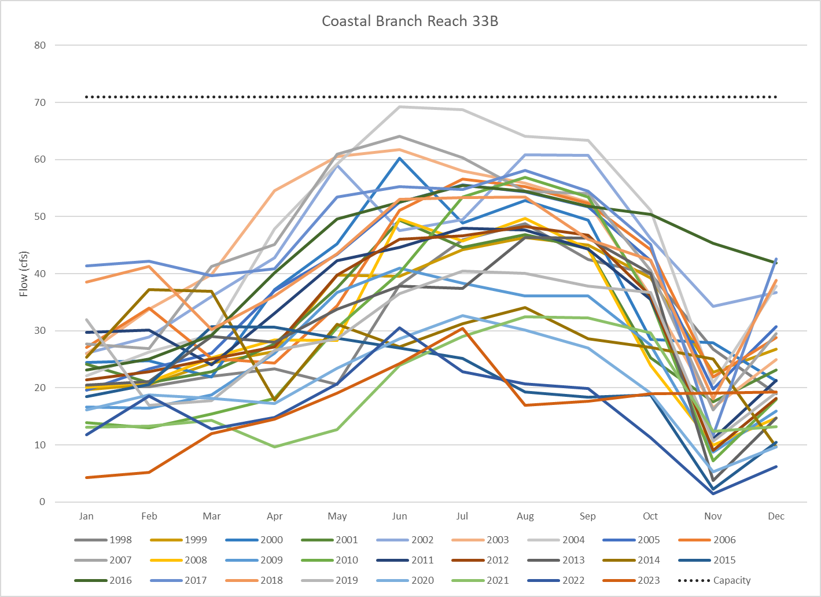
Paso Basin assumed to use Coastal Branch Capacity as Available
Paso Basin deliveries assumed to be as available – low priority
Sufficient unused capacity available upstream of Polonio Pass WTP
Capacity can be limiting in Reach 33A (below Polonio Pass) based on historical use
Program facilities sized to compensate for capacity limitations

Slide 6
Potential Exchange Program
Paso Robles Subbasin contracts with SLO County for 12, 963 AF Table A (~52% of SLO SWP Contract)
Paso Robles Subbasin Dry Year Allocation ceded to Urban Coastal User in 4:1 unbalanced exchange (example)
Paso Basin takes SWP Table A allocations for Urban Coastal Users when allocations above 50% and unused recharge capacity is available
Paso Basin deliveries from Urban Coastal Users credited at 25% (1:4) of amount delivered
Dry Year SWP Paso Basin Allocation ceded when SWP Allocations less than 25%, up to amount credited
Ratios shown and other assumptions are examples and would need to be agreed to by both parties

Slide 7
Potential Exchange Program Operations
Wet Year
Dry Year
“Excess” SWP supplies in 50% plus allocations years assigned to Paso Basin
Paso Basin recharges “Excess” SWP supplies in Paso Basin, with credit (assumed 25%) for future dry year
Banked SWP supplies capped at projected future return potential
Water would otherwise be subject to spill in San Luis Reservoir, sold, exchanged, or banked
Paso Basin would forego SWP dry year allocations for their 13,000 AF Table A in dry year (e.g., below 25% allocation)
Paso Basin dry year allocations assigned to CCWA participants up to amount of stored credits
Paso Basin relies on previously stored groundwater for water supplies

Slide 8
Program Example
1922-2021 CALSIM SWP Allocations from 2023 Delivery Capability Report
Maximum exchange volume set to 15,000 Acre-feet (based on potential delivery capability)
Assumed initial exchange assumed to be 10,000 acre-feet (assumes program is already in operation
Allocations above 50% from Urban Coastal Users are assigned to Paso Basin, up to available storage capacity and subject to maximum exchange volume
Allocations below 25% are provided to Urban Coastal Users, up to the amount of the exchange account

Slide 9

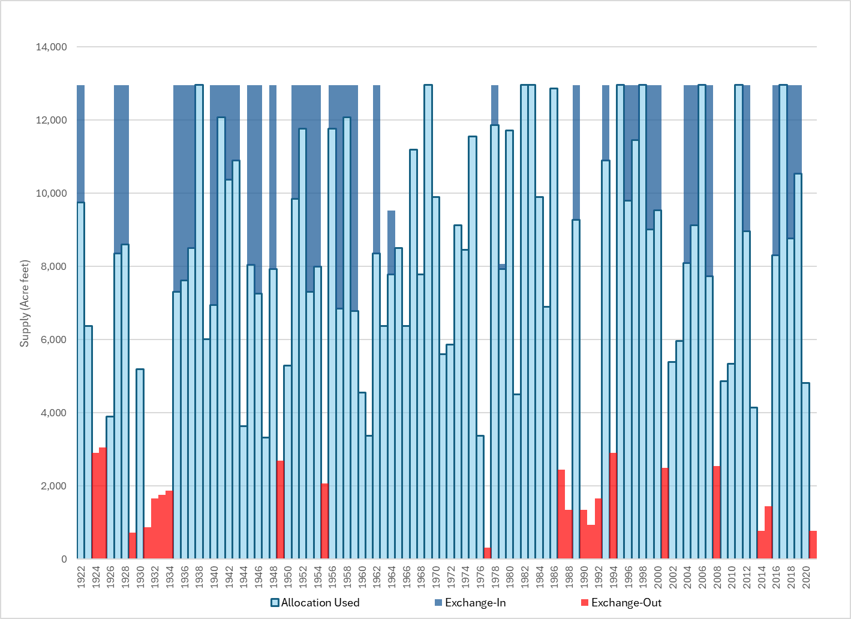
Program Example
Water Returned to Coastal Urban Users in 21 Years
Exchanges to Paso Basin in 44 Years
Exchanges temporarily terminated in 1964 when account is full
Potential for sales when account is full

Slide 10
Example Program Outcomes
Paso Basin net SWP supply increased from 7,109 AF to 8,131 AF on average, an increase of 14%
Urban Coastal User average deliveries 1,740 AF occurring in 21% of years
Potential Cost reduction benefits to Urban Coastal Users from Paso Basin use of Coastal Branch
Paso Basin user SWP charges would reduce other Coastal Branch users costs for allocated fixed costs such as WTP operation, conveyance capital repayment and conveyance operations
Program scalable depending on participant needs

Slide 11
Potential Program Benefits
CCWA Participants
Paso Basin
Implement unbalanced exchange program that assigns dry year supplies to CCWA participants
Dry year supplies improved
Reduced Coastal Branch expenses due to Paso Basin wheeling payments
Retain first priority to use of Coastal Branch facilities
Access to Coastal Branch deliveries on second tier (as available) basis
Implement unbalanced exchange program that assigns wet year supplies to Paso Basin
Affordable wheeling rates that reflect lower use priority and dry year exchanges

Slide 12
Process Status
San Luis Obispo County currently evaluating SWP management options
Paso Basin SWP Supplemental Study in progress
Paso Basin structures still in development and vineyard economy conditions are currently not positive for program
San Luis Obispo Valley Subbasin (Edna Valley) also a potential partner for similar program
Edna Valley likely an earlier participant and much lower volumes (maybe up to 2,000 AF maximum table A)
Opportunity to coordinate between SLO County and CCWA on wheeling and exchange opportunities

