Slide 1
Water Supply Situation Report
CCWA Board Meeting
April 25, 2024

Slide 2
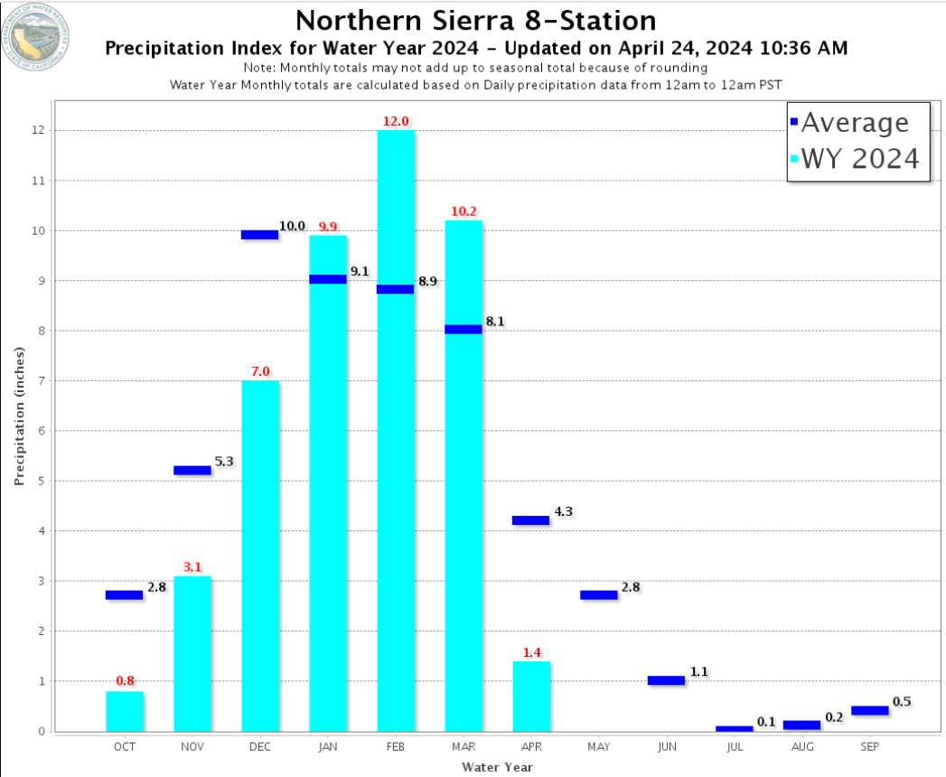

Slide 3
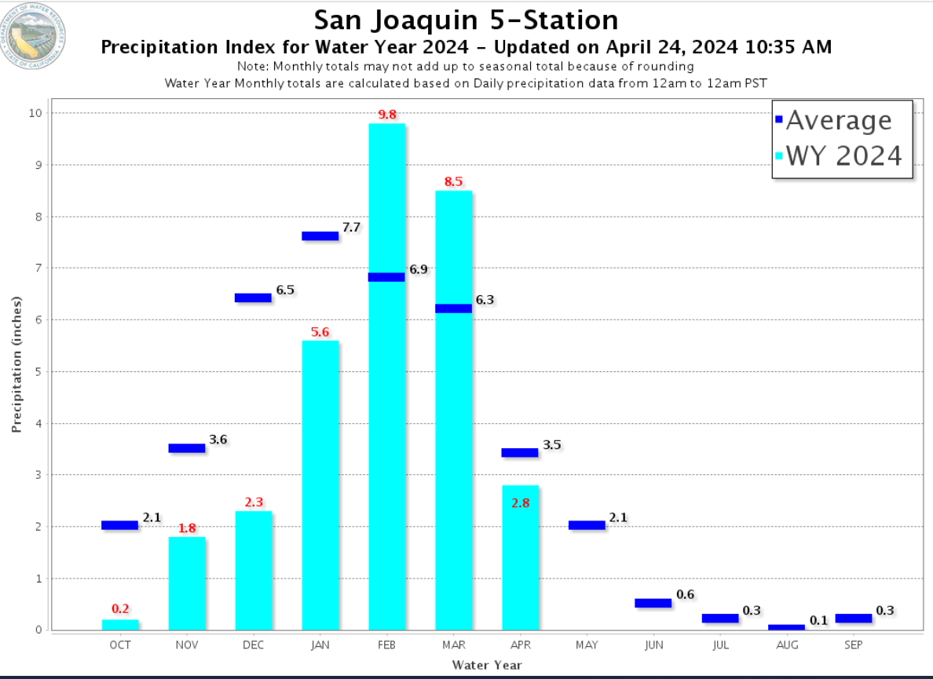

Slide 4
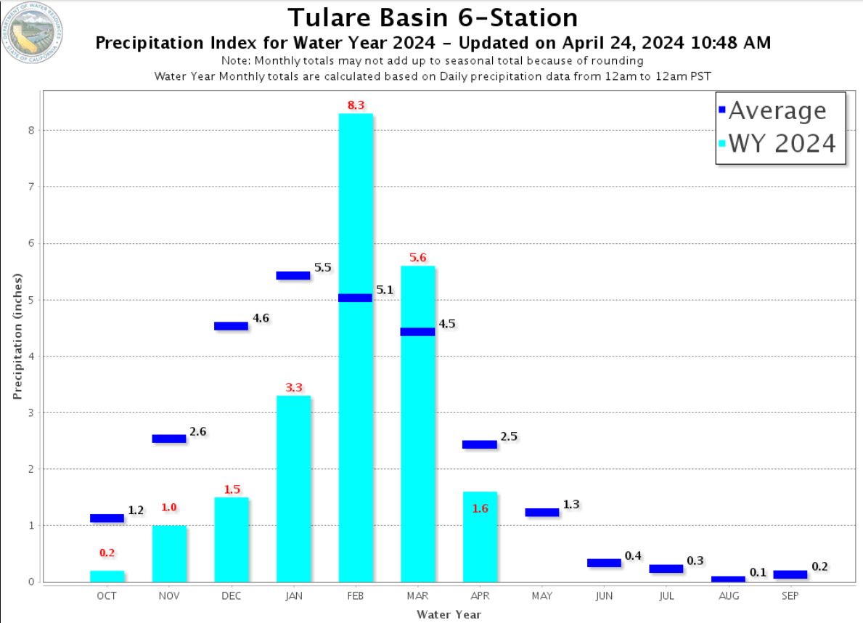

Slide 8
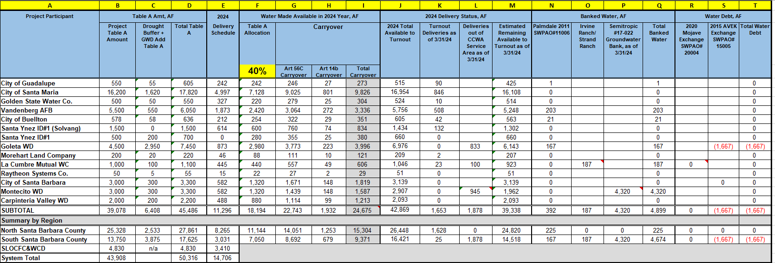

Slide 9
Questions?

