Slide 1
Central Coast Water Authority
Operating Committee Meeting
January 2024

Slide 2
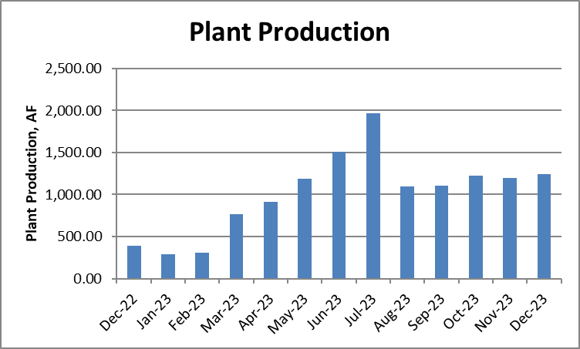
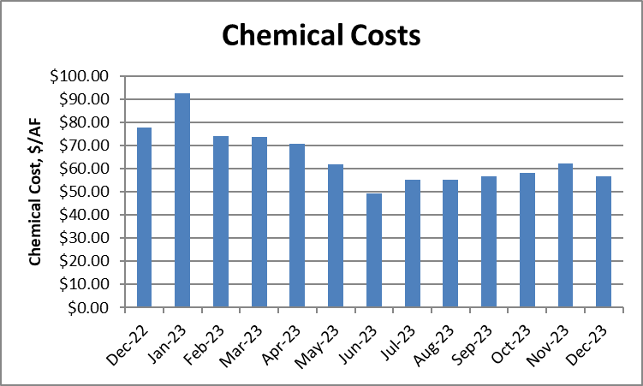
PLANT PRODUCTION, CHEMICAL COSTS
AND LAKE CACHUMA PUMPING
 | Plant Production (AF) | Chemical Costs ($/AF) | SYPF Pumping (AF)
October 2023 | 1,228.88 | $58.15 (Chem $57.05 + PAC $1.10) | 84.75
November 2023 | 1,192.54 | $62.26 (Chem $61.16 + PAC $1.10) | 64.97
December 2023 | 1,244.42 | $56.68 (Chem $55.58 + PAC $1.10) | 77.68

Slide 3
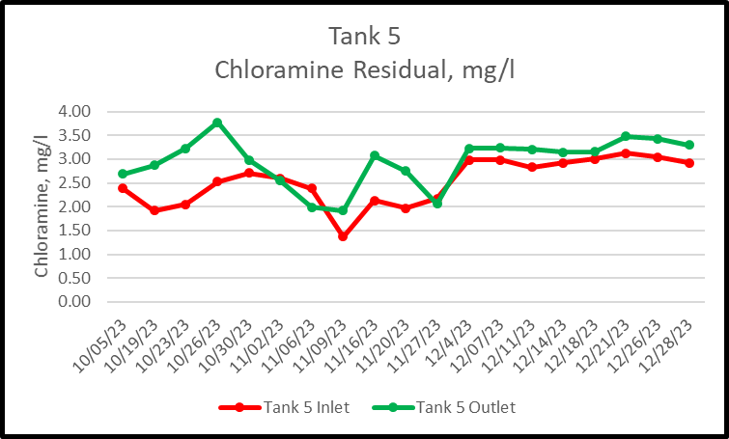
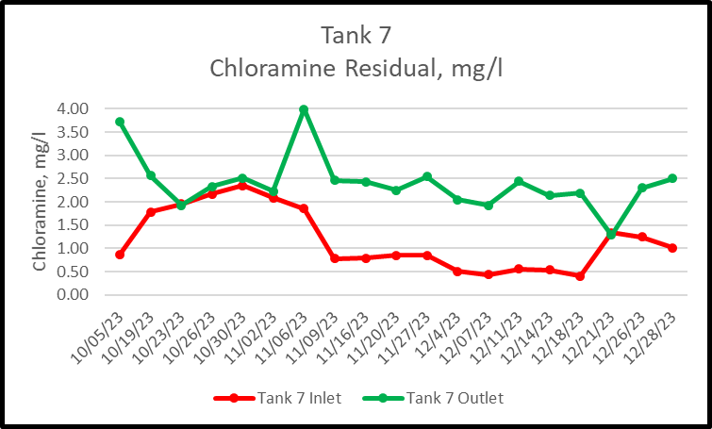
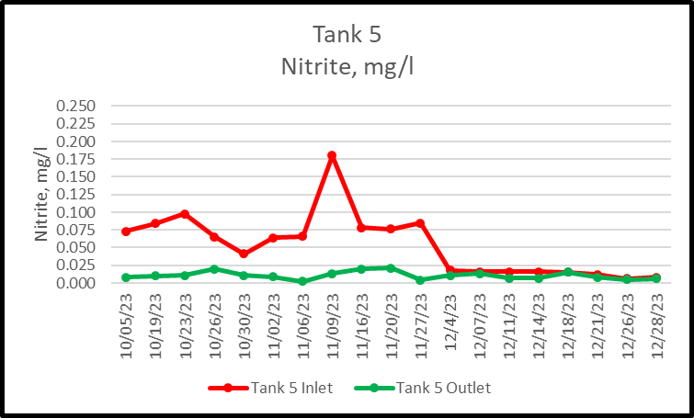
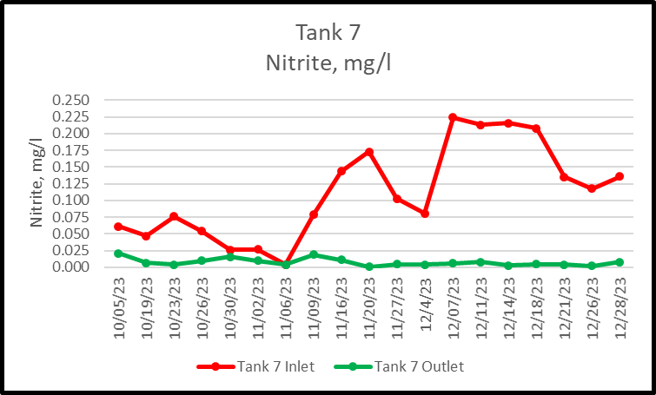
Nitrification Control Effort

Slide 4
Tank 7 Chloramination Facility
Dosing Pumps for Three Ranges, Chlorine and LAS
Using Njam Dosing Method, Oxidize Nitrite and Boost Residual.
Temporary Shelter in Place for LAS System.
Next FY, Permanent Shelter, Upsized Day Tank and Water Quality Instrumentation
Proposed Projects for Next FY
Design for Pigging the Pipeline.
New Sample Station Downstream of Tank 5
Tank 7 System Improvements
Tank 5 Inlet Chloramination Facility
Design is being finalized.
Bidding for Concrete Work, Trenching and Injection Vault in February 2024
Long Lead Item Procured. (Fiberglass Shelter).
Nipomo Chloramination Facility
All Equipment Procured/Received.
Electrical Design Complete – Submitted to PG&E.
Power Pole to be installed, allows PG&E Service Drop
Concrete Pads, building and equipment – Summer 2024
Pipe Penetrations for Sample and Dose – Winter 2024

Slide 5
MIB/Geosmin Control effort
Gas Chromatograph/Mass Spectrophotometer
All Equipment Procured/Received.
Confirming Power Supply Requirements:
  Device requires dedicated electrical circuit
  Requires Uninterruptible Power Supply
  CCWA Staff confirming
Vender will be scheduled for Installation and training following confirmation of power supply requirement.
This instrument will provide near real time MIB/Geosmin data to guide treatment operations.
Powdered Activated Carbon (PAC) System Upgrade
Technical Memorandum Prepared by HDR.
PAC was determined most cost effective.
  Construction Cost Estimated for PAC at $2.3M
  Construction Cost Estimate for Ozone at $15.7 M
  Design Phase is Proposed for FY 24/25
Existing PAC System was designed to handle up to 50 ng/l. In 2025, 2,500 ng/l was detected in the Coastal Branch

Slide 6
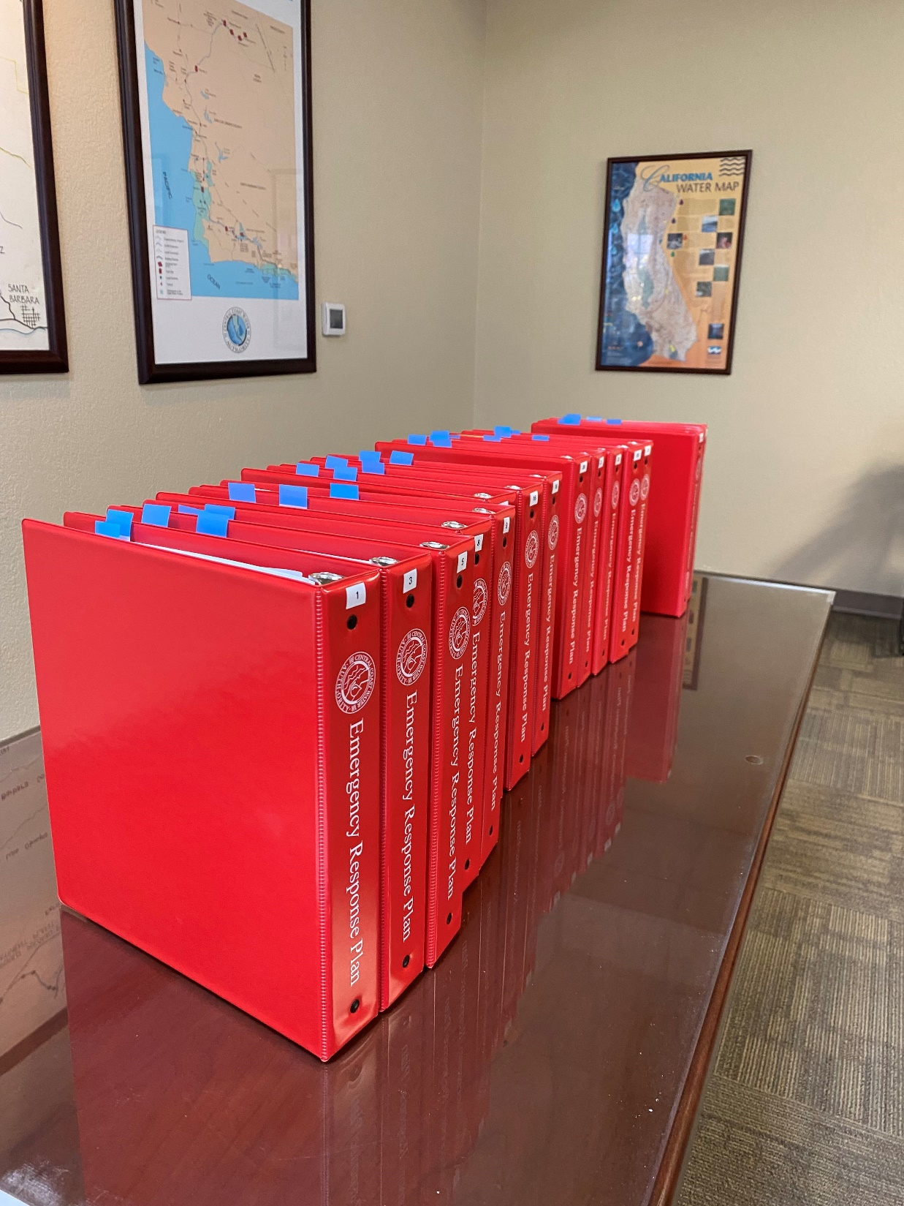
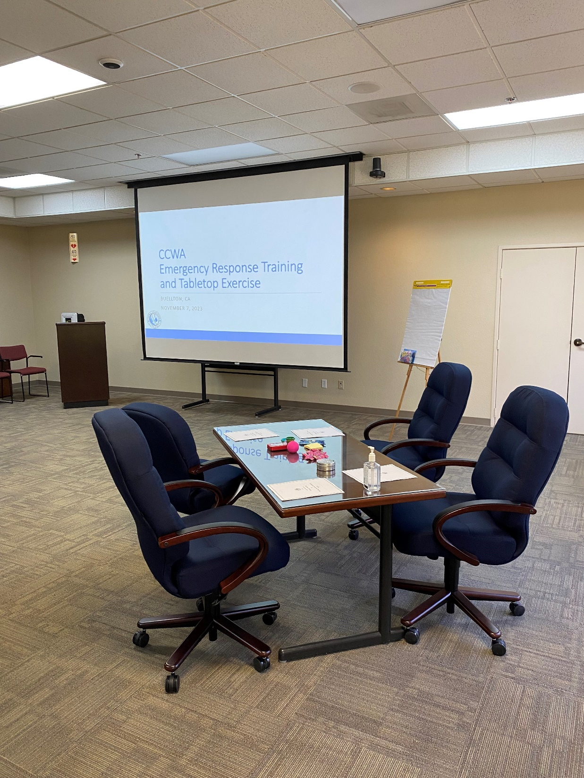
Emergency Response Plan Tabletop Exercise

Slide 7
Network Operations
Datto Annual Exercise.
Work Group Completed Cyber-Security Policy Recommendations.
Imanage Upgrade/New Financial Software.
Nutonixs Hyperconverge System Upgrade

Slide 8
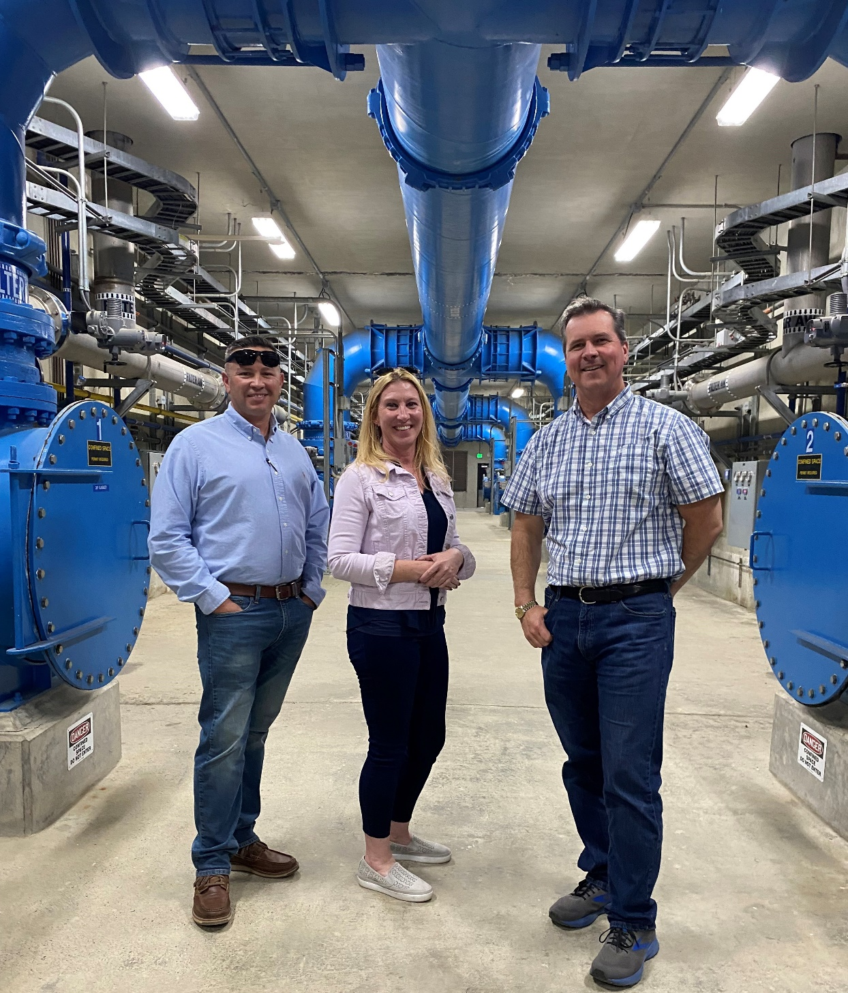
City of Santa Maria Tour

Slide 9
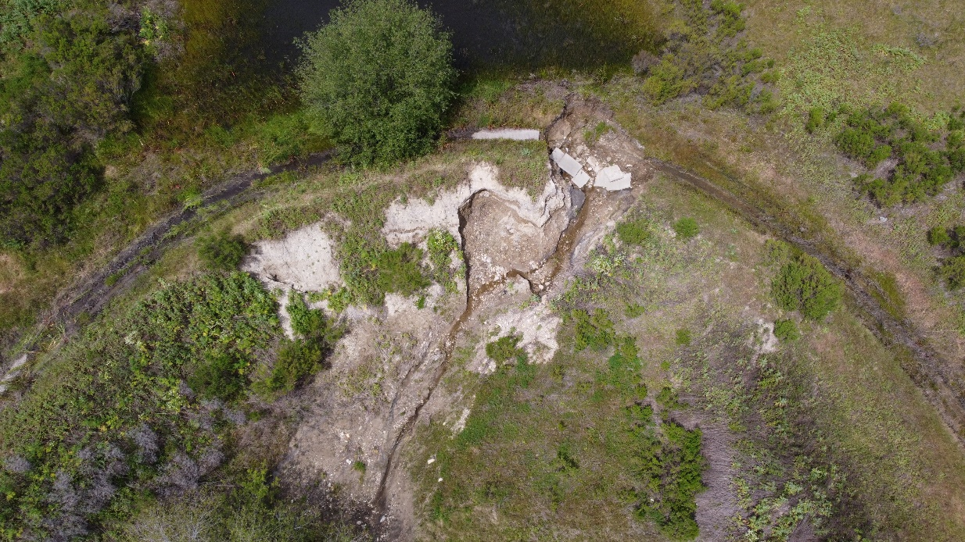
Encroachment Issues
Lopez Erosion
Lopez Impressed Current Cathodic Protection System

Slide 10
General Items
Design Work
  Carport at SYPP and WTP.
  “Rusty Riser” Project.
  Utility Water Header Evaluation.
  WTP Office Bid Documents
  SYPP Surge Tank Re-certify Design
  Operations Manager Office
  Stairs For WTP Backwash Tank and Tank 2 & 5
Hazardous Materials Business Plan
  Update of Tank 5 and Tank 7
  Update Environmental Contact Information
Formalizing Agreement with Stantec
  Staff worked for CCWA at original design and construction
  Executed Professional Engineering Services Agreement
  Utilized in Annual Project Planning
Water Accounting
  Spill Totals reconciled with DWR records, pending correction of Kern County Water Agency Schedule.
  CCWA and Semitropic Schedules match, but Kern County has not updated. Once corrected, DWR files will also match CCWA’s schedule.
Devil’s Den Pumping Plant Christmas Eve Issue.
  Discharge Valve Stuck Open.
  Resolved 12/29/23

