Slide 1
Water Supply Situation Report
CCWA Operating Committee Meeting
July 11 2024

Slide 3
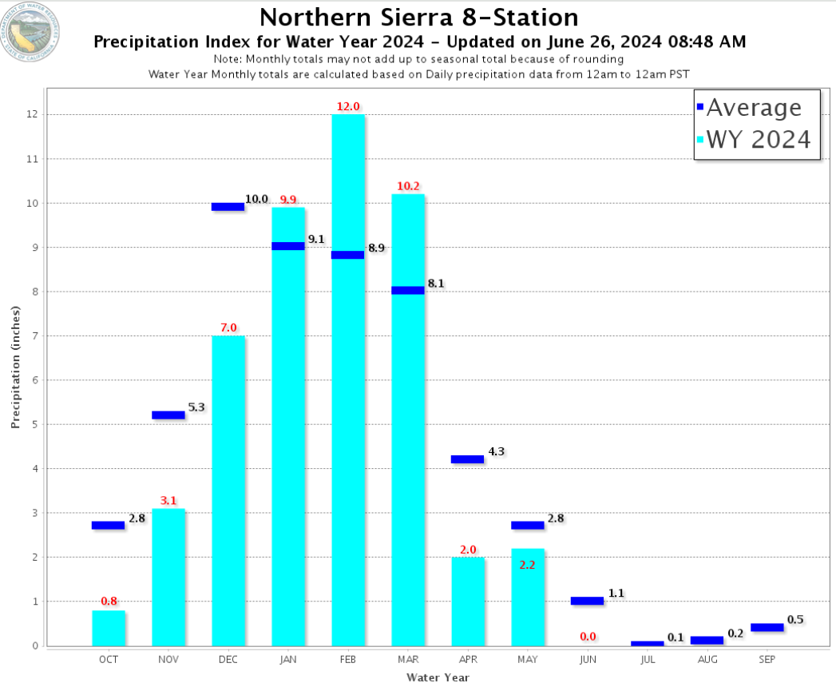

Slide 5
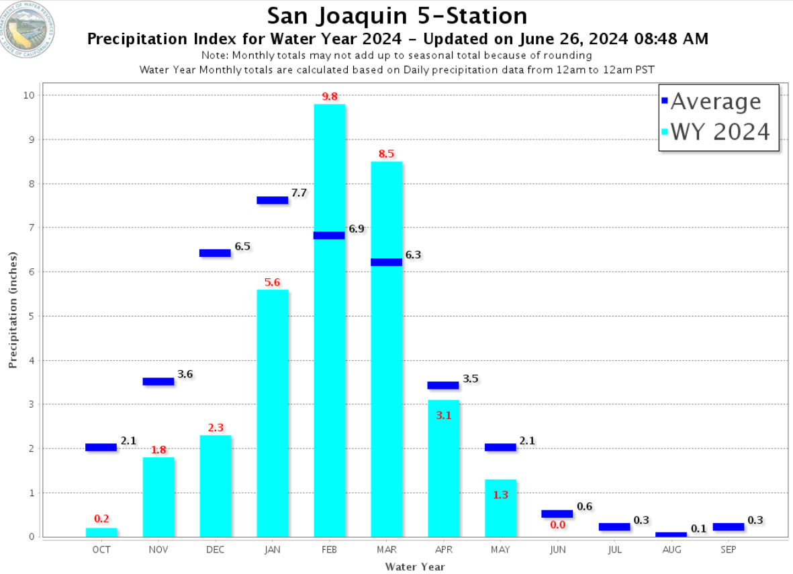

Slide 7
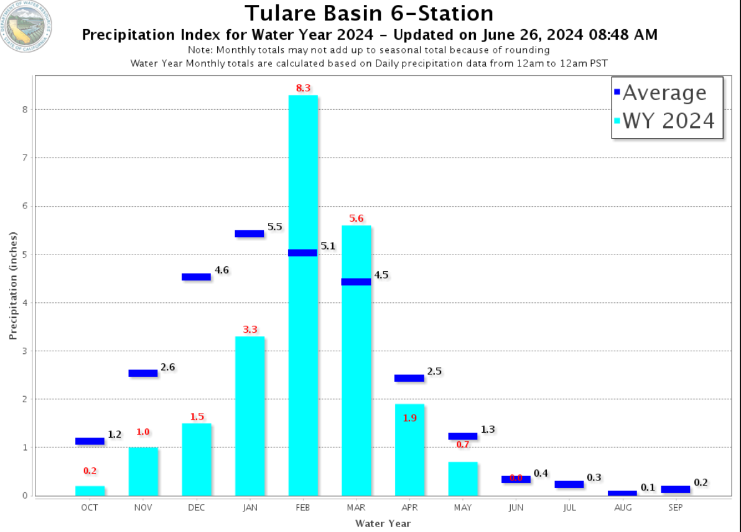

Slide 12
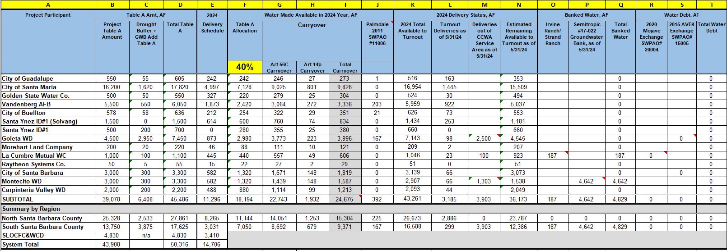

Slide 13
Questions?

