Slide 1
Water Supply Situation Report
CCWA Board of Directors Meeting
October 24, 2024

Slide 2

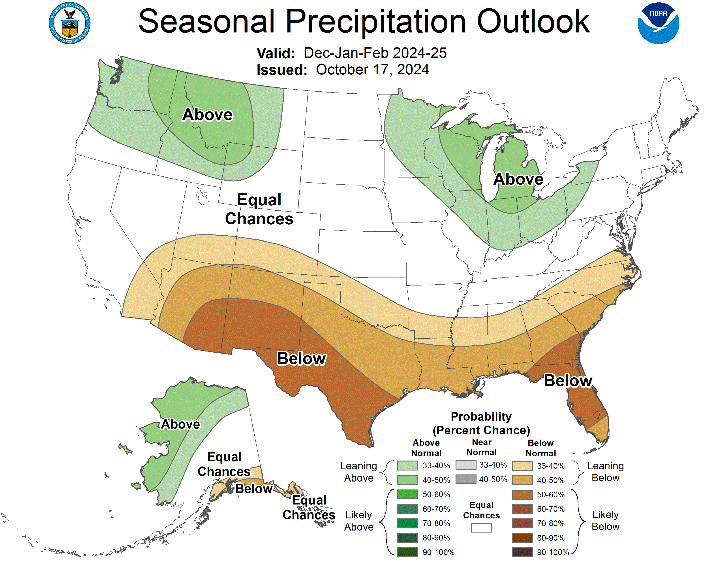
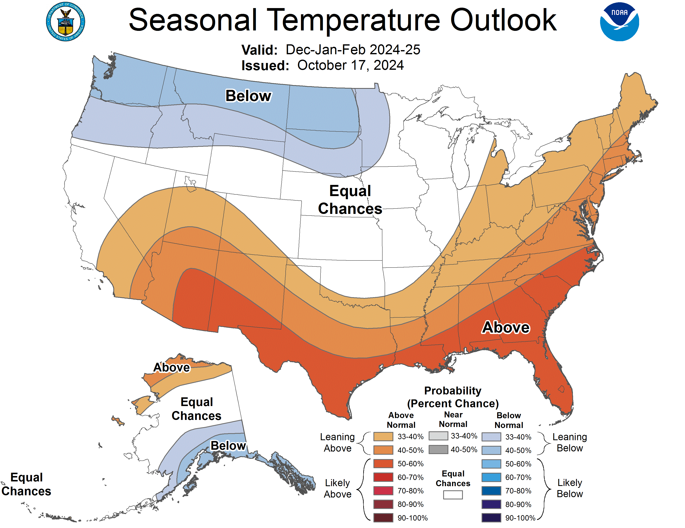
Climate Prediction Center Outlook December 2024 to February 2025

Slide 3
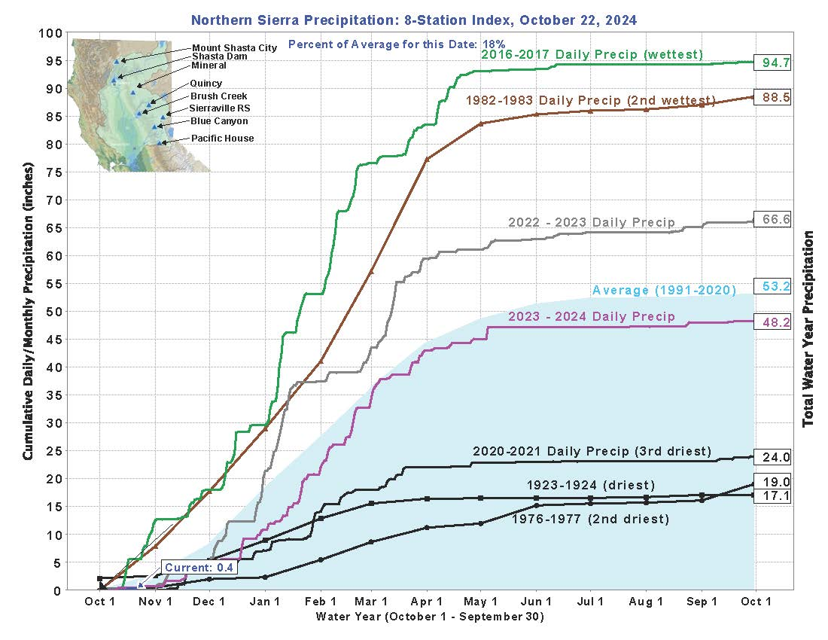

Slide 4
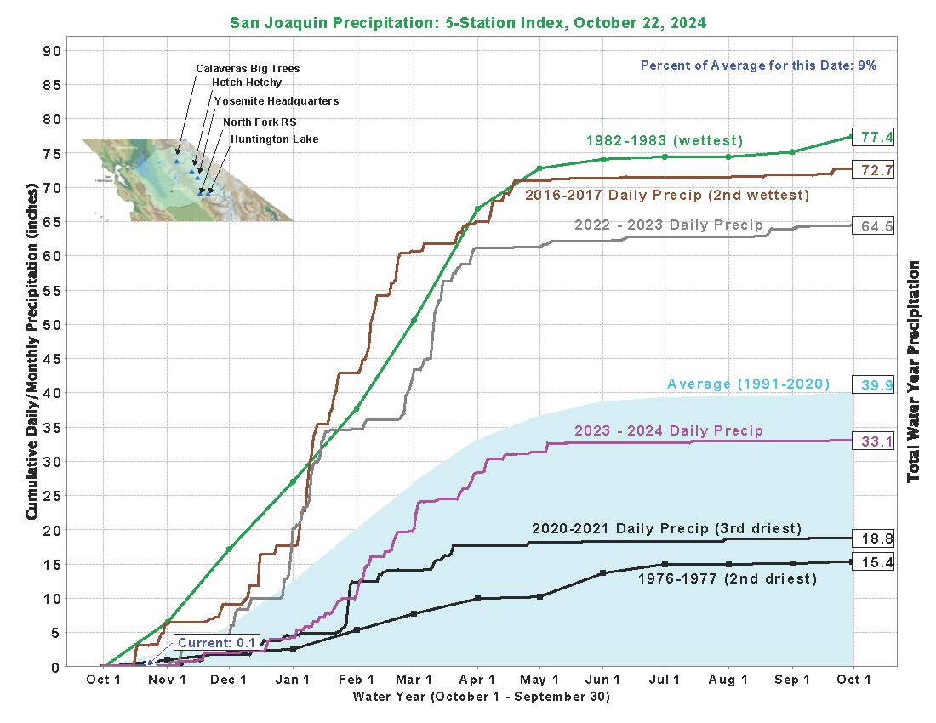

Slide 5
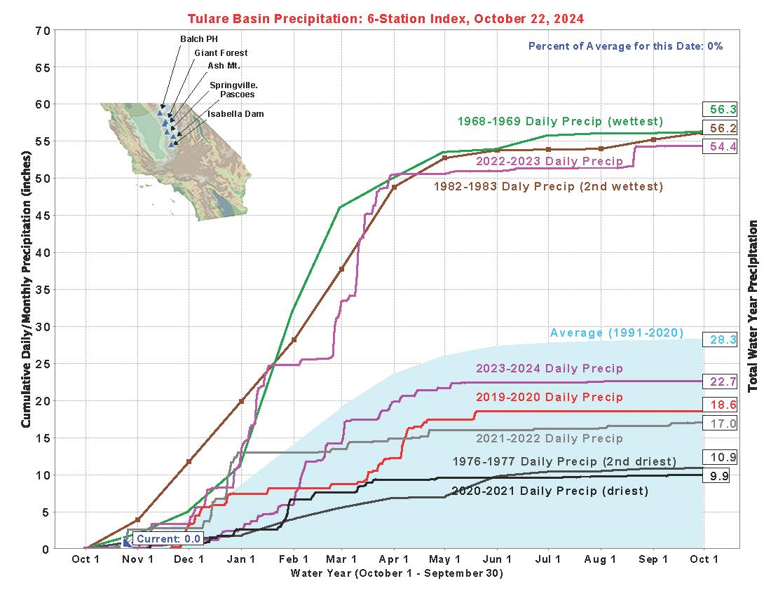

Slide 6
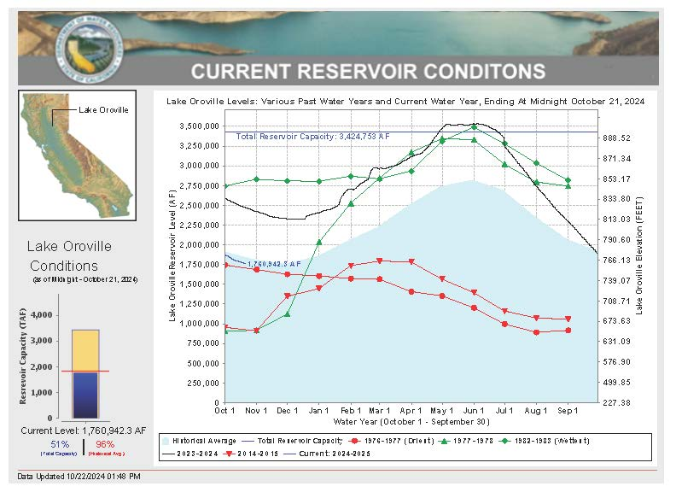

Slide 7
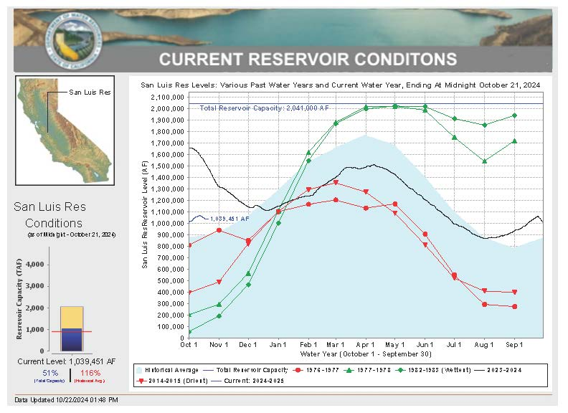

Slide 8
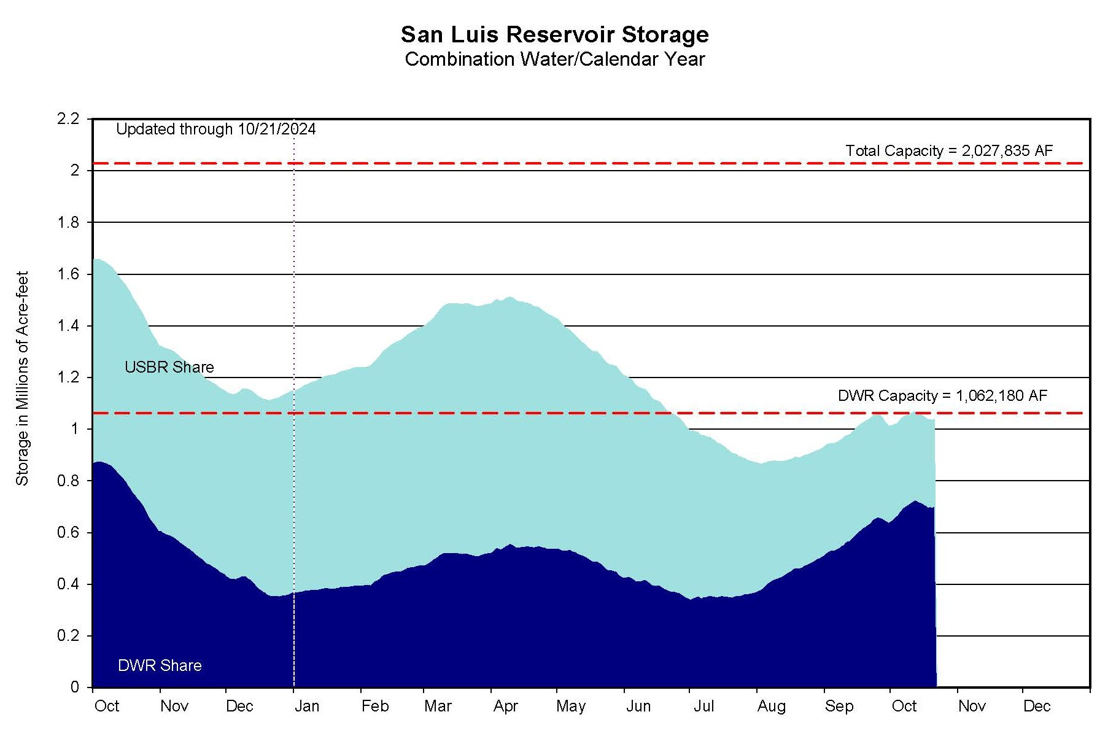

Slide 9
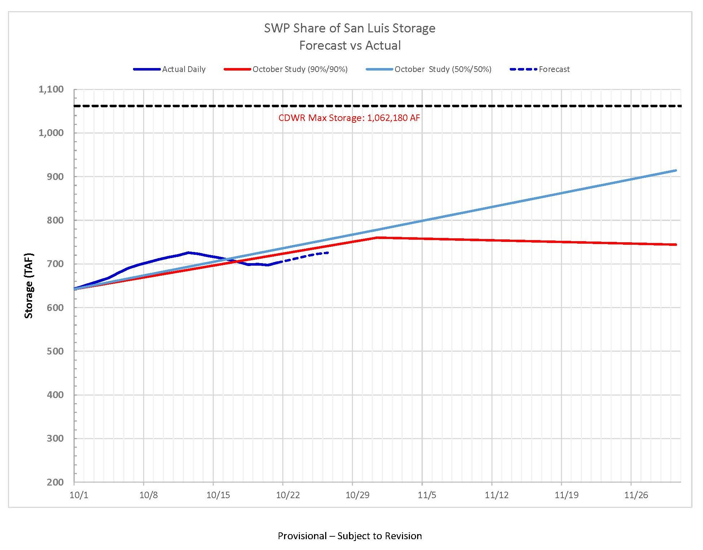

Slide 10
San Luis Reservoir Carryover
The allowable volume of carryover water is a function of year Allocation percentage and the Table A Contracted Amount
If the allocation percentage of the year is less than or equal 50 percent, the allowable carryover is 25 percent of the Table A Contracted Amount
CCWA may add up to 25% X 45,486 AF = 11,372 AF
Allowable carryover water is in addition to other previously carried over supplies
CCWA estimates 27,089 AF of carryover water will be in San Luis Reservoir on December 31, 2024

Slide 11
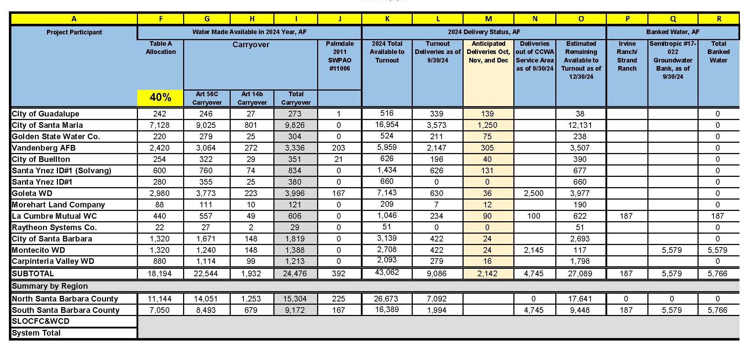

Slide 12
Overview of Water Transfers
Montecito Water District (MWD) and Homer LLC (Homer)
  Water Management Program Agreement between MWD and Homer executed
  Assistance Agreement between CCWA and MWD executed
  MWD in process of completing CEQA analysis
La Cumbre Mutual Water Company (LCMWC) and Homer
  Assistance Agreement between CCWA and LCMWC executed

Slide 13
Questions?

